Slide 1
Systems Tracts and Sequence Stratigraphic Surfaces

Slide 2
Depositional Sequence: complete cycle of base level
Goals for today:
Understand how the shoreline and facies shift through the base level cycle
Use shoreline trends to subdivide the depositional sequence
Identify surfaces that separate those subdivisions

Slide 3
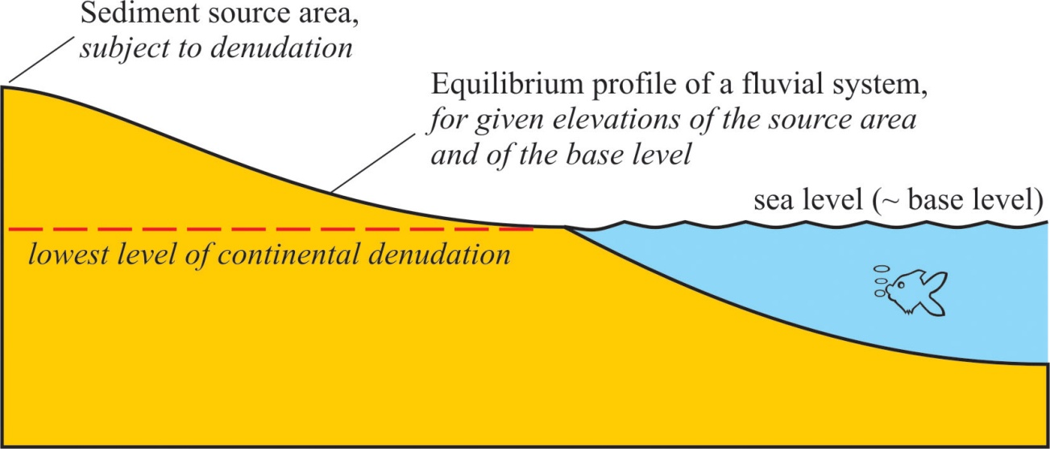
Fluvial systems conform to equilibrium graded profile anchored to base level of terminal body of water
Climate (river discharge)
transport capacity vs. sediment load
Tectonism
Eustasy

Slide 4
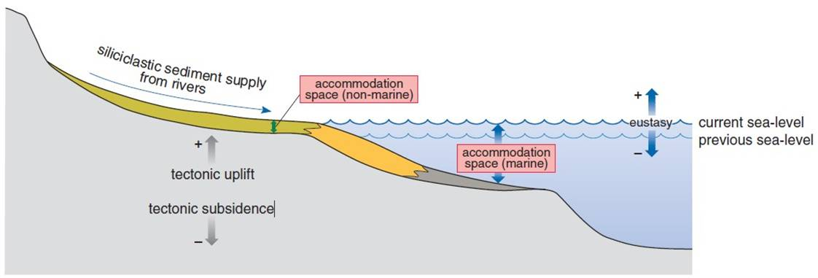
Fundamental control on formation of depositional sequences is changing accommodation space
A function of eustasy, subsidence, and climate (=base level)
Fluvial accommodation is space between actual land surface and graded profile
Marine accommodation is space between seafloor and base level

Slide 5
Terms for shoreline trajectory:
Transgression (retreat landward) vs. Regression (build seaward)
Aggradation (build upward) vs. Incision (erode downward)
Aggradation
Transgression
Regression
Incision

Slide 6
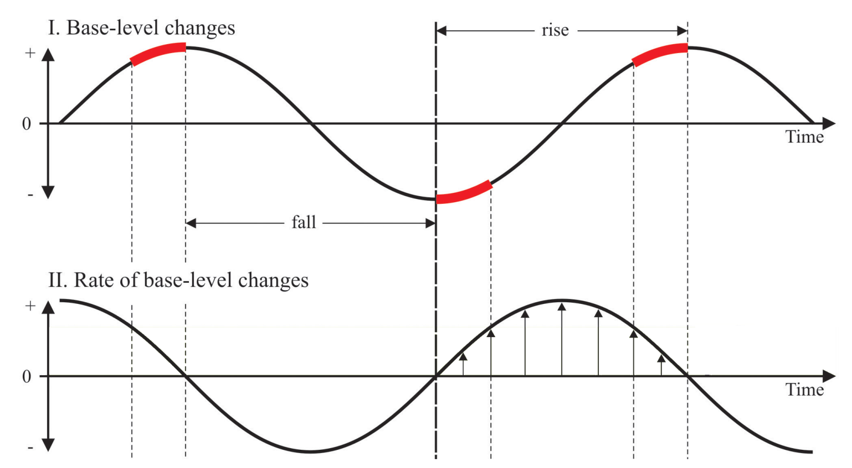
Regression and incision during base level fall
Transgression and aggradation during rapid base level rise
Regression and aggradation during slow base level rise

Slide 7
Normal regression occurs during base level rise (rate<sedimentation)
Forced regression occurs during base level fall

Slide 8
Shifts in shoreline position create distinct vertical stacking patterns of facies (retrogradation vs. progradation)

Slide 9
Some cautions:
Single reference curve applied to whole basin, whereas subsidence and sedimentation may vary spatially
Complete cycle may not develop in regions with very high subsidence or sedimentation

Slide 10
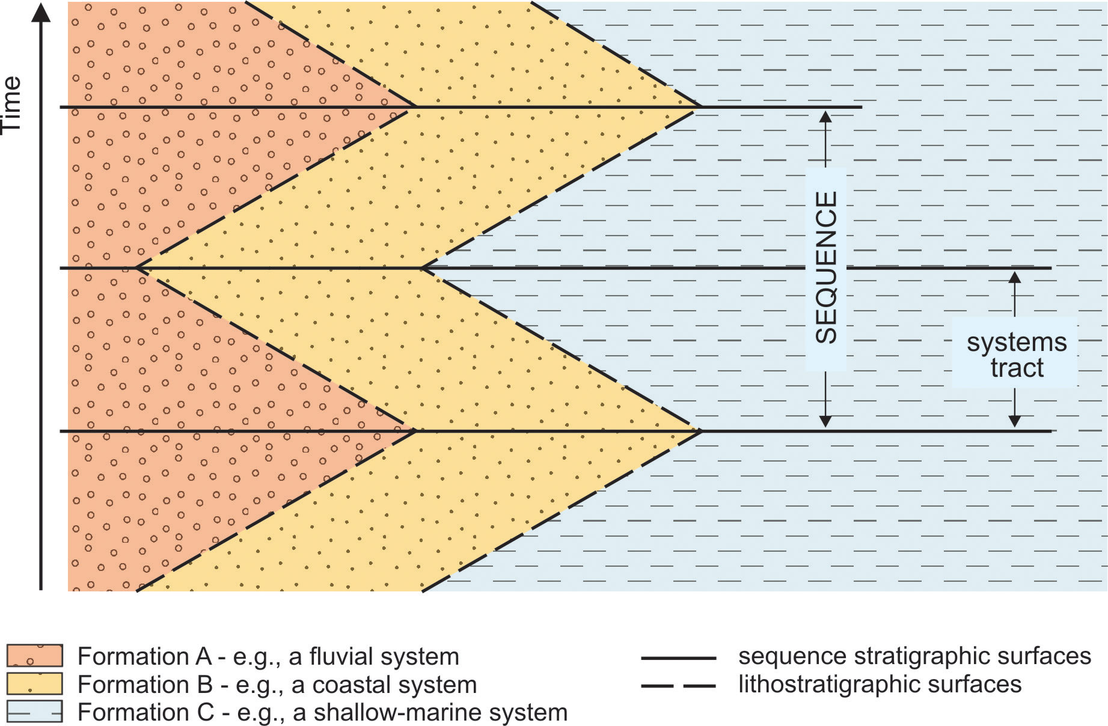
Systems Tract: intervals of relatively stable contemporaneous depositional systems, separated by surfaces representing significant reorganizations of sediment dispersal patterns
Recognized by facies stacking patterns, position within sequence, nature of bounding surface

Slide 11
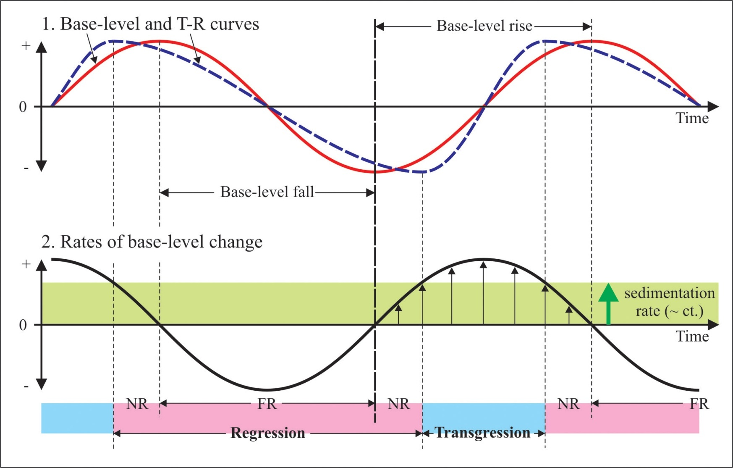
FSST
LST
TST
HST
Falling-Stage Systems Tract (FSST)
Lowstand Systems Tract (LST)
Transgressive Systems Tract (TST)
Highstand Systems Tract (HST)

Slide 12
Don’t worry – we’ll cover what these surfaces are later!
Transgressive Ravinement Surface
Maximum flooding surface
Subaerial unconformity
RSME
Maximum regressive surface
Basal surface of forced regression
Correlative conformity

