Slide 1
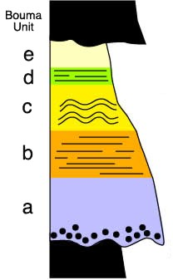
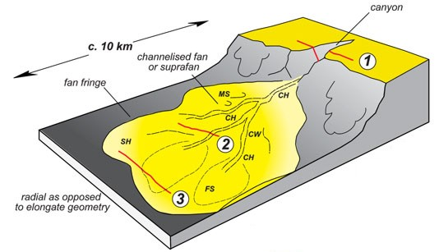
Submarine Fan Depositional Processes

Slide 2
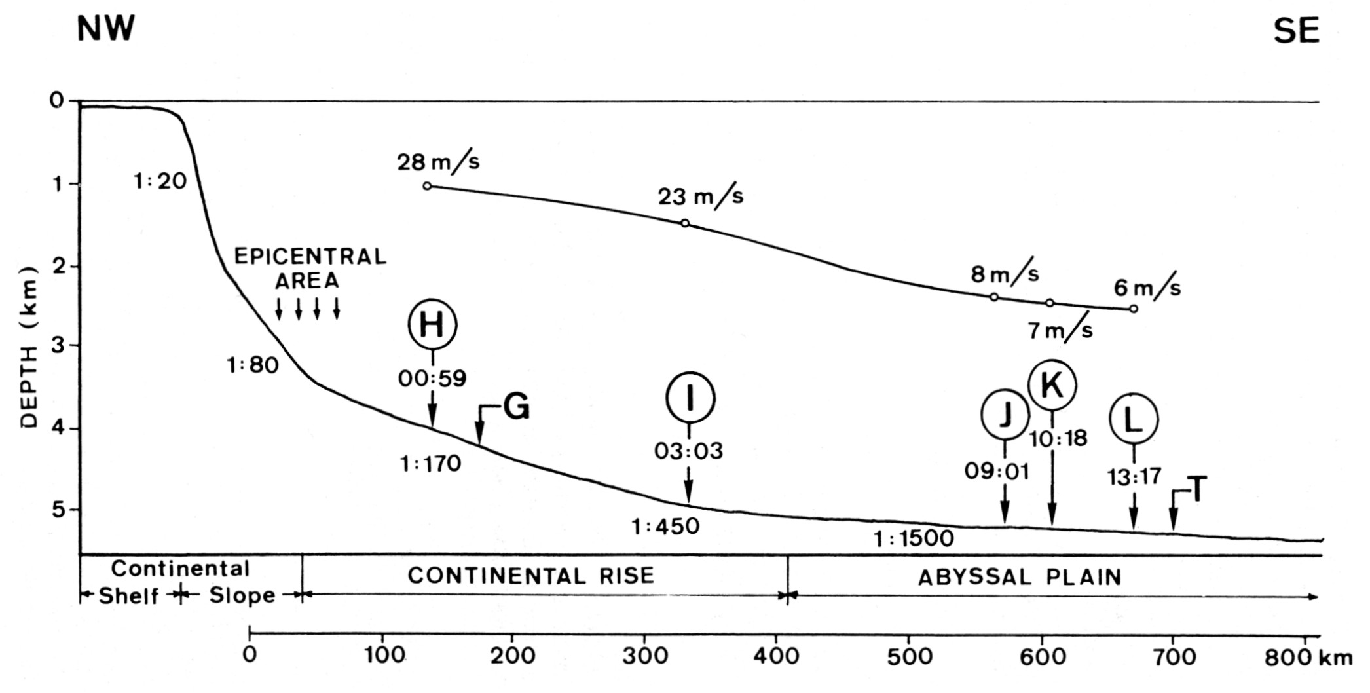
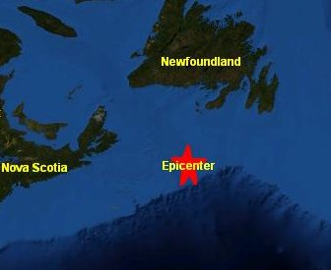
Deep-Sea Flows
The 1929 Grand Banks earthquake severed submarine telegraph cables up to 700 km from the epicenter and 13 hours after the earthquake
Notes:
One of first indications that the deep ocean wasn’t tranquil and undisturbed, as previously believed

Slide 3
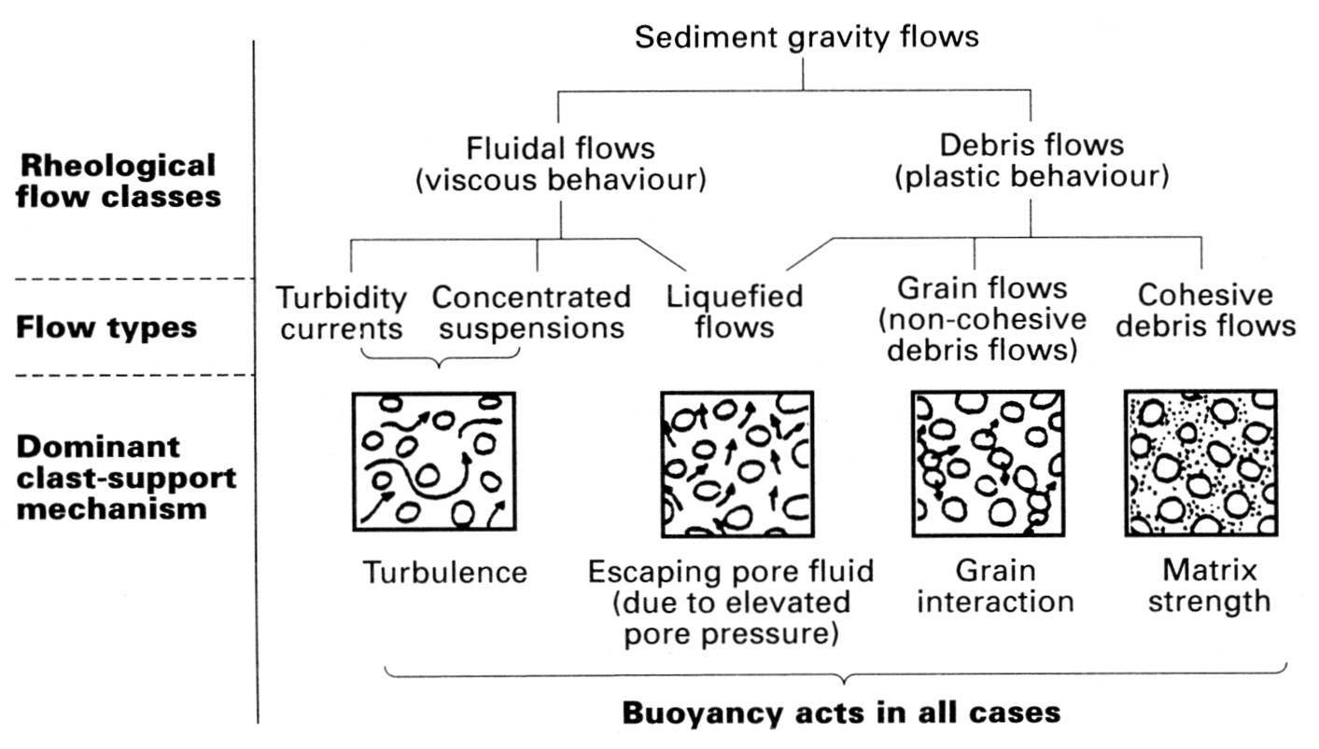
Turbidity current: sediment-gravity flow with fluid (Newtonian) rheology and sediment supported by turbulence

Slide 4
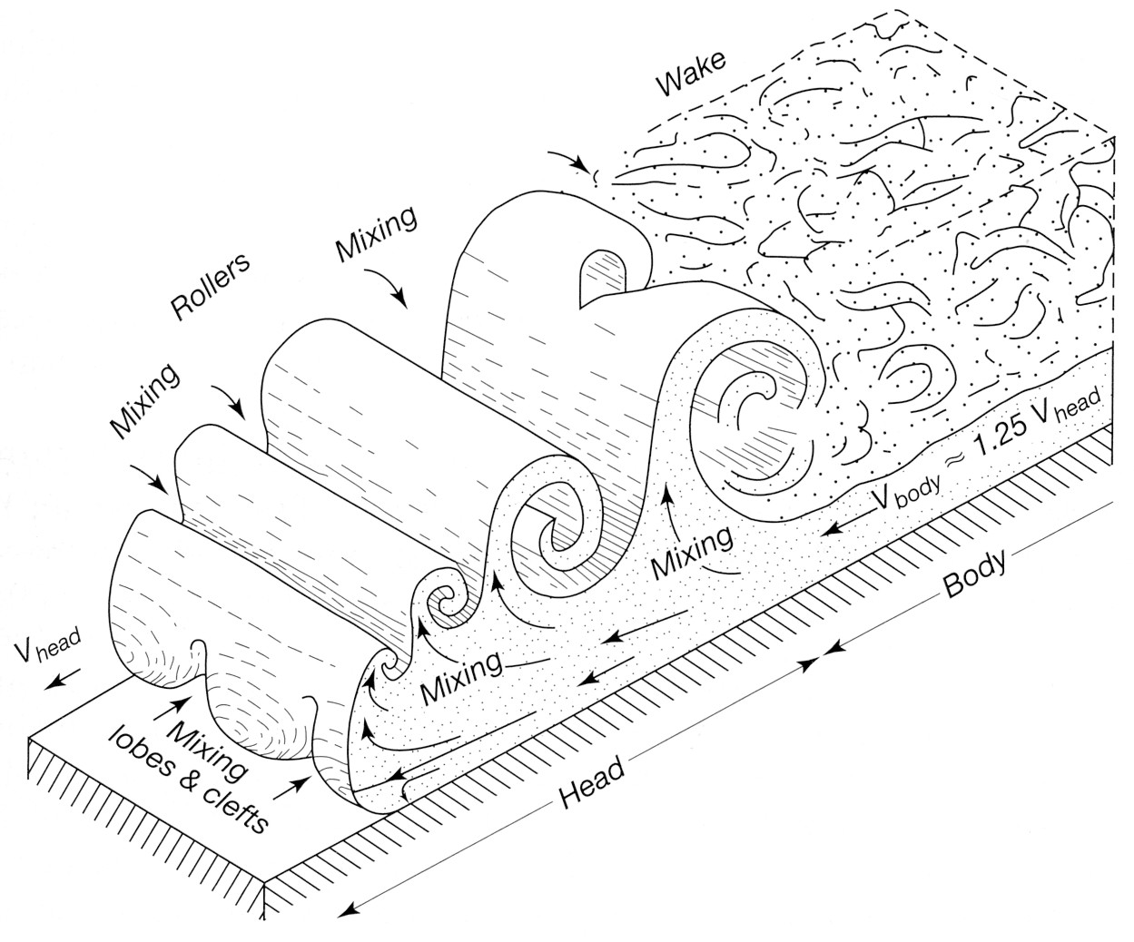
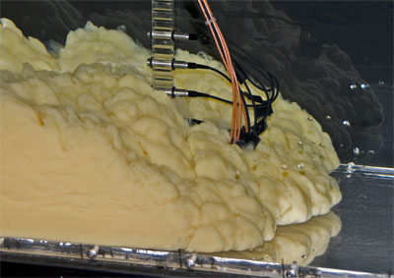
Turbidity currents driven by density contrast between suspension and surrounding fluid
$$u_{head}=k\sqrt{\frac{Δρgh}{ρ_{fluid}}}$$
Energy balance:
Gravity ⇔ Fluid resistance + particle suspension

Slide 5
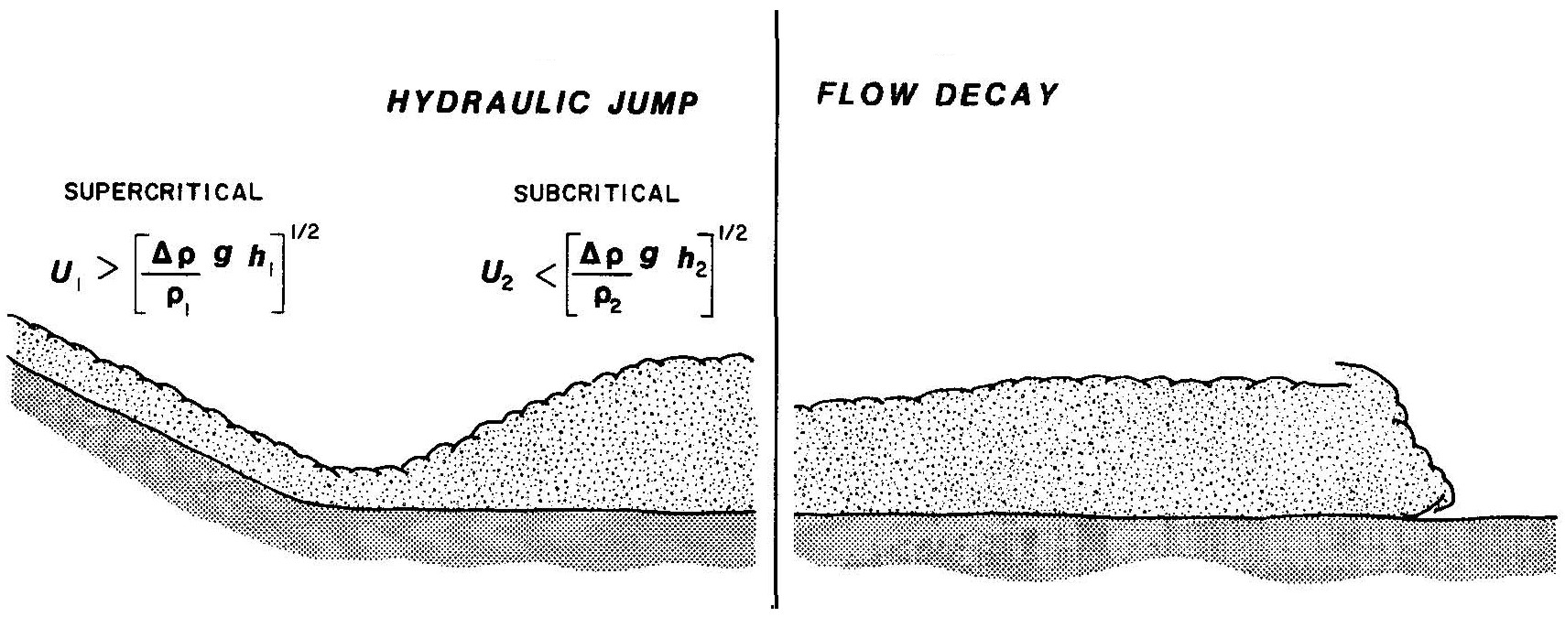
When slope decreases below critical value for supercritical flow (slope ≥ 0.5°), turbidity current undergoes hydraulic jump
Enhanced turbulence and flow homogenization
Marks transition from steady-state erosive or bypass flow to waning depositional flow
Waning turbidity currents are very mildly dissipative and can flow over distances of as much as ~5000 km

Slide 6
Deposition from turbidity currents occurs during waning flow and dissipation of the current
Density reduction – sediment loss or mixing of ambient fluid (Δρ)
Flow thickness reduction – stretching, collapse, spreading (h)
Friction at base and upper surface of flow
$$u_{head}=k\sqrt{\frac{Δρgh}{ρ_{fluid}}}$$
Sedimentary deposit formed by a turbidity current is called a turbidite

Slide 7
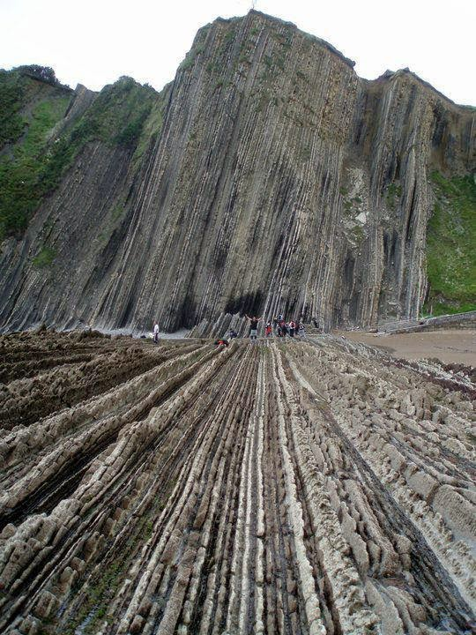
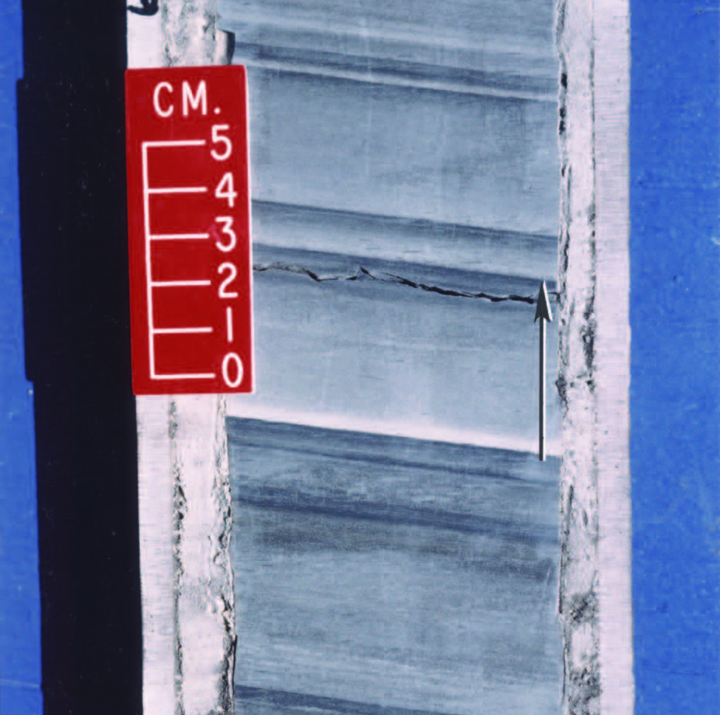
Due to the Newtonian flow rheology, turbidites are typically very laterally extensive, thin beds (typically 5-20 cm)
Unhindered settling generates graded beds

Slide 8
Particles sink through fluid at constant terminal velocity, but what is that velocity?
Forces acting on sediment particle include:
F_{D}
F_{B}
F_{G}
Drag
(Fluid Resistance)
Gravity
Buoyancy
Gravity F_{G} = 4/3 π r³ ρ_{s} g
Buoyancy F_{B} = 4/3 π r³ ρ_{f} g
When particle sinks at constant velocity: upward forces balanced by downward
F_{G} = F_{B} + F_{D}

Slide 9
F_{G} = F_{B} + F_{D}
At terminal sinking velocity:
F_{D}
F_{B}
Gravity F_{G} = 4/3 π r³ ρ_{s} g
Buoyancy F_{B} = 4/3 π r³ ρ_{f} g
F_{G}
Given similarity of gravity and buoyancy:
F_{G} – F_{B} = F_{D}
F_{G} - F_{B} is “effective gravity” = 4/3 π r³ (ρ_{s}-ρ_{f}) g
or 1/6 π D³ (ρ_{s}-ρ_{f}) g
What about fluid drag F_{D}?

Slide 10
Fluid drag has a viscous component and an inertial component, but for simplicity we will just consider viscosity
Viscosity μ is the amount of fluid movement (strain) for a given shear stress τ:
$\text{m}= \frac{\text{t}}{\frac{\text{δ}\text{u}}{\text{δ}\text{y}}}$
$\text{m}= \frac{\text{t}}{\frac{\text{u}}{\text{D}}}$
$\text{t}= \frac{\text{u}\text{m}}{\text{D}}$
or
Stress (τ) is just force per area, so the viscous force is:
$\text{F}\text{D}= \frac{\text{u}\text{m}\text{D}\text{2}}{\text{D}}$
or
F_{D} = u μ D

Slide 11
At constant terminal velocity u, the downward and upward forces are balanced
Downward force:
Upward force:
F_{G} = 1/6 π D³ (ρ_{s}-ρ_{f}) g
F_{D} = 3π u μ D
$$\text{u}=\frac{\text{1}}{\text{18}}\frac{(\text{r}\text{s}\text{−}\text{r}\text{f})}{\text{m}}\text{g} \text{D}\text{2}$$
Stokes’ Law
Stokes’ law describes the settling velocity of particle with diameter D and density ρ_{s} (larger particles sink more rapidly)

Slide 12
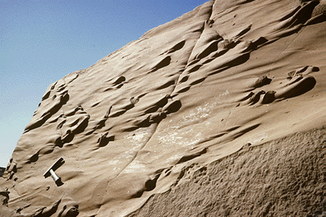
In 1962, Arnold Bouma created a generalized model for a turbidite bed, now called the Bouma sequence, based on the Annot Sandstone in SE France
Sharp, unchannelized base with sole marks

Slide 13
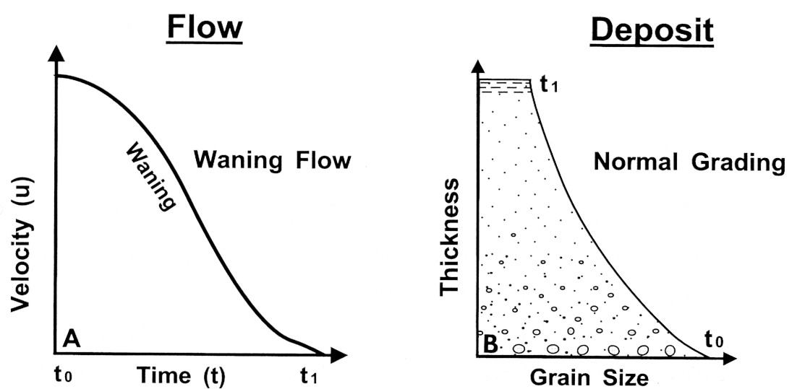
Bouma “Ta” division
Massive normally-graded sandstone reflecting unhindered settling of particles from waning Newtonian and turbulent flow
Technically, should always exhibit normal grading (flow should be Newtonian, not plastic)

Slide 14
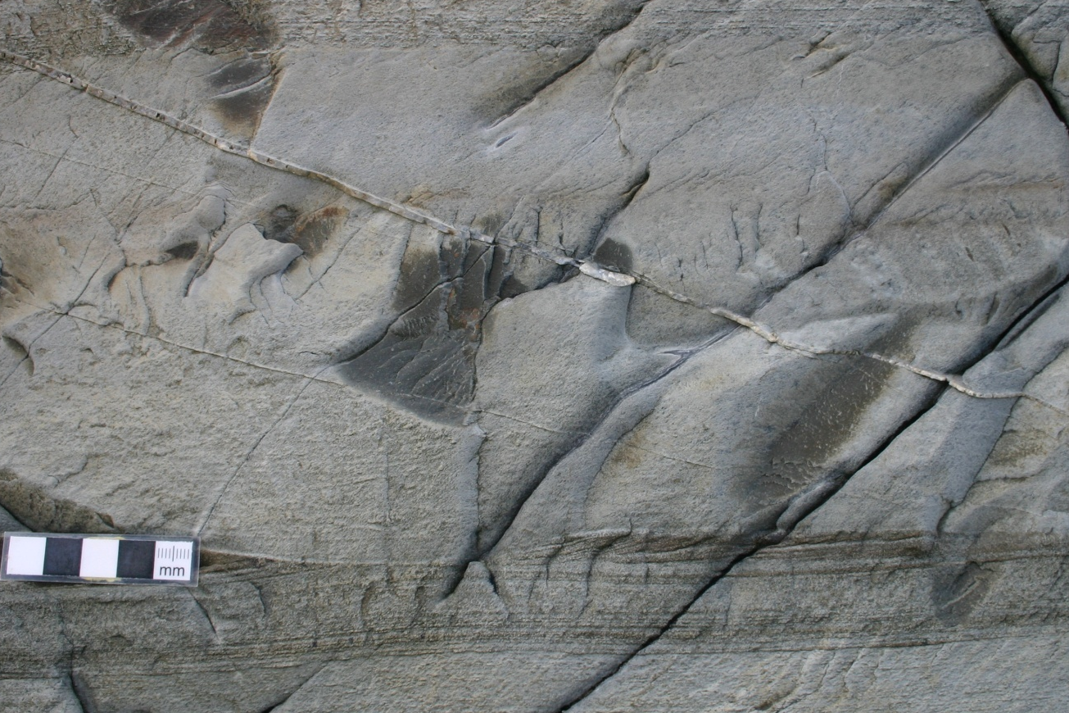
Parallel laminated Tb, rippled Tc, faintly laminated Td, and mudstone Te divisions reflect deposition from waning flow
Bouma Te division partly consists of hemipelagic (non-turbidite) mudstone
E
D
C
B

Slide 15
Fluidized flow: rheology often plastic, sediment supported by upward flow of escaping pore fluid
Fluidized flows
Notes:
Fluidized flows (and grain flows) are probably not very important for long-distance transport of sediment (compared to debris flows and turbidity currents) but may be important during deposition

Slide 16
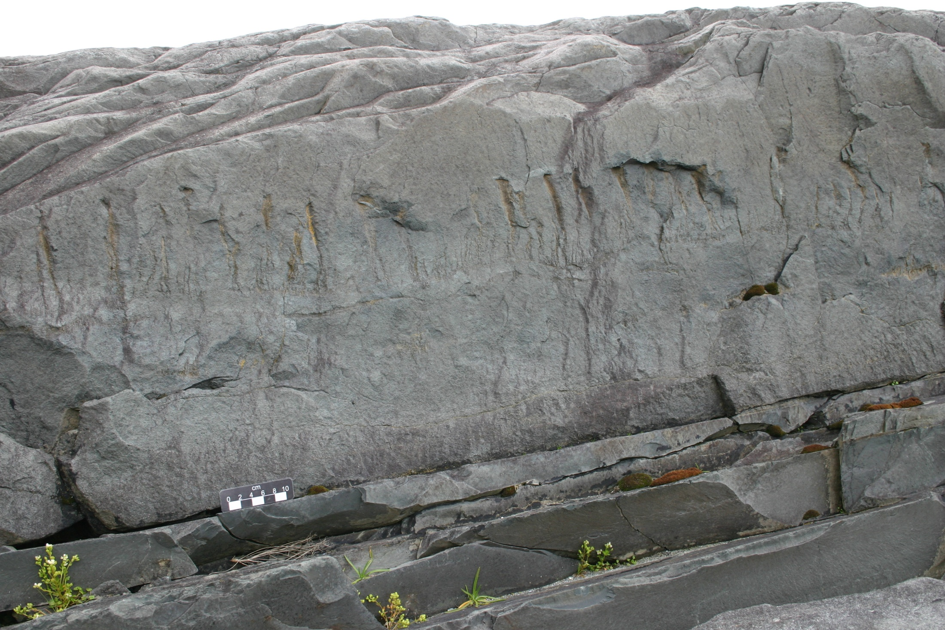
Fluidized flows contain dewatering structures from escaping pore fluids
Dewatering pillars

Slide 17
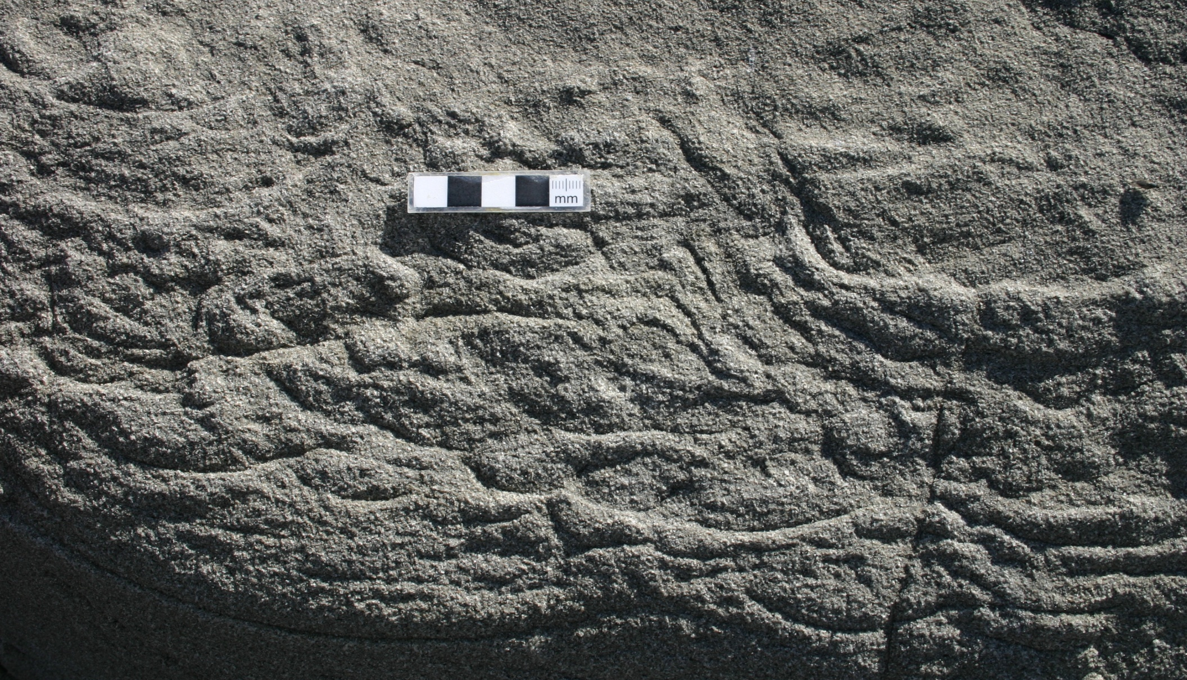
Dish structures: concave-up mud laminae in fluidized sandstone
Upward flowing pore water carries mud (“elutriation”) until it reaches and flows laterally along a less permeable barrier layer

Slide 18
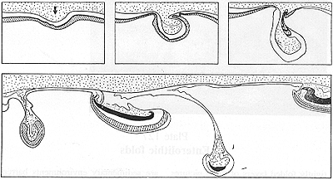
Ball-and-pillow structures
A type of load structure, formed in response to gravitational instability (force exceeding shear strength of underlying layer) between denser sediment (often sand) deposited abrupt on less dense bed (often mud/silt)

Slide 19
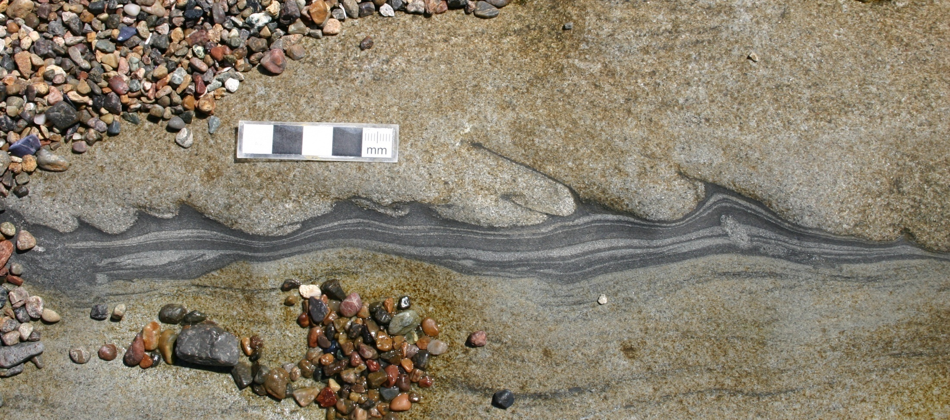
Flame structures: injection of liquefied lower bed into rapidly-deposited overlying unit, often pointing downcurrent

Slide 20
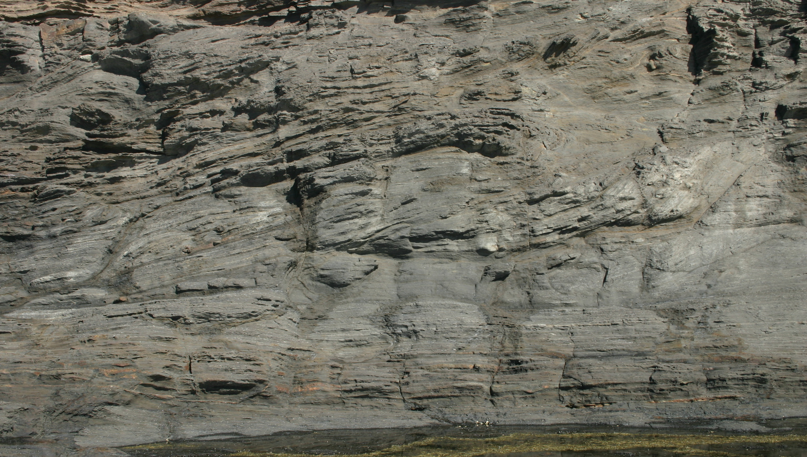
Convolute bedding: deformed, swirling laminations caused by slumping of semi-lithified units; typically forms on somewhat steeper slopes

