Slide 1
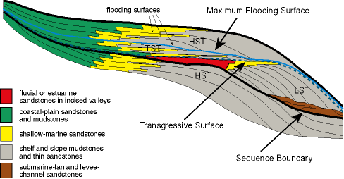
Parasequences and the Sequence Boundary

Slide 2
Recognition of all systems tracts is only possible if normal and forced regression can be separated – requires identification of surfaces (SU or RSME)
TST
HST
FSST
LST
TST
HST
FSST
Subaerial Unconformity
Regressive Surface of Marine Erosion

Slide 3
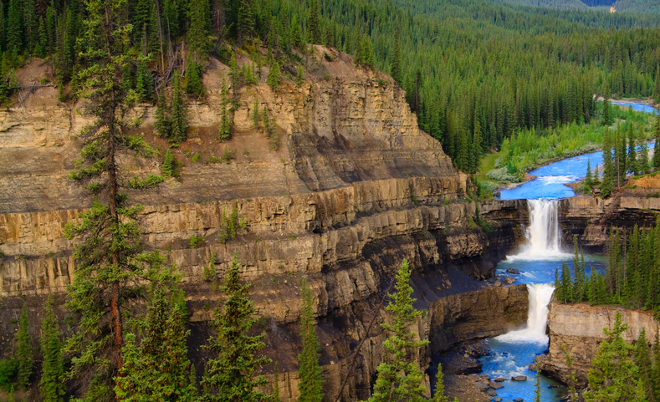
Problem: how to subdivide systems tracts in offshore shelf settings when subaerial unconformity or RSME are absent?

Slide 4
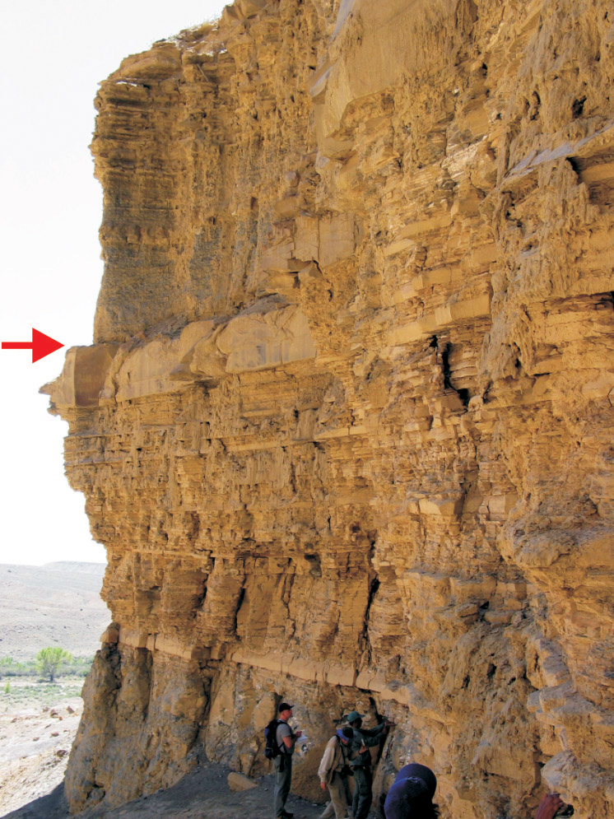
Parasequence: relatively conformable shallowing-upward succession of genetically related beds bounded by “flooding surfaces”
Parasequences best developed in coastal siliciclastics (and in carbonates)
Problem: “flooding surface” can be many things:
Transgressive ravinement surface?
Maximum regressive surface?
Within-trend flooding surface?

Slide 5
Earlier sequence stratigraphic terminology constructed systems tracts from prograding (or retrograding) parasequences sets

