Slide 1
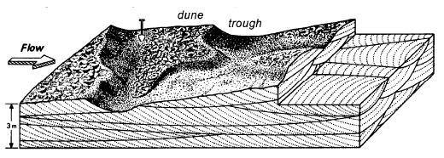
Unidirectional Sedimentary Structures

Slide 2
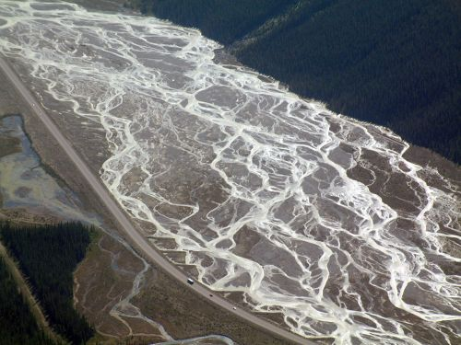
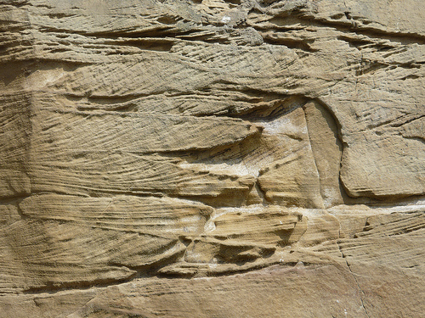
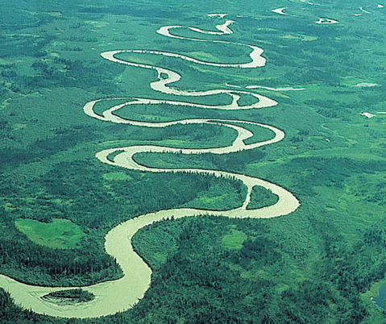
Strategy:
Relate sedimentary characteristics of ancient deposits (grain size, sedimentary structures, geometry) to features observed in modern rivers
OR

Slide 3
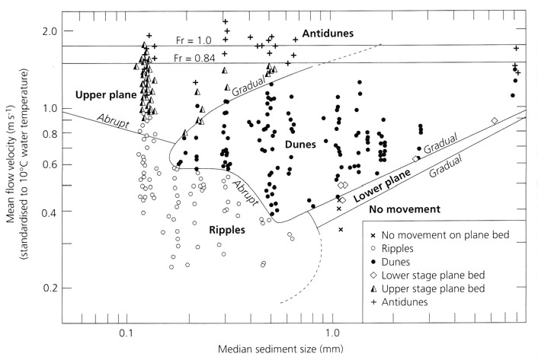
Bedforms during traction deposition from unidirectional flow
V. Fine
Fine
Medium
Coarse
V. Coarse
Granule
Pebble

Slide 4
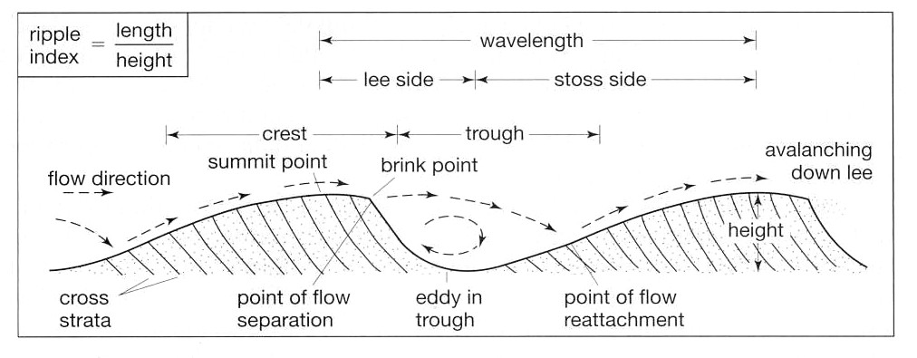
Bedforms (ripples and dunes) migrate by erosion of the upstream stoss side and deposition of sediment on the downstream lee side
Erosion
Deposition
Grains move up crest as bedload, then avalanche down lee side, generating inclined layering called cross-stratification
Notes:
Current ripple video linked

Slide 5
For bedforms with straight crests (“two-dimensional” or “2-D”):
If sediment supply is sufficient and there is net deposition, some aggradation will occur and planar cross-stratification will be preserved

Slide 6
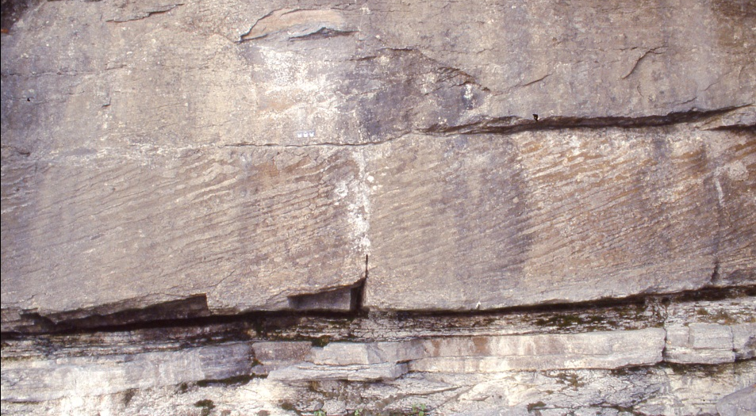
Because cross-stratification preserves the lee (downstream) side of a bedform, it can be used as a paleocurrent indicator
Current direction

Slide 7
Typically, the tops of bedforms are eroded by later flow, leaving only the bottom (or “toe”) of the cross-stratification foresets
If the rate of deposition exceeds the depth of erosion by later bedforms, ripples “climb” on earlier generations
Most often in decelerating flow when sediment deposited from suspension

Slide 8
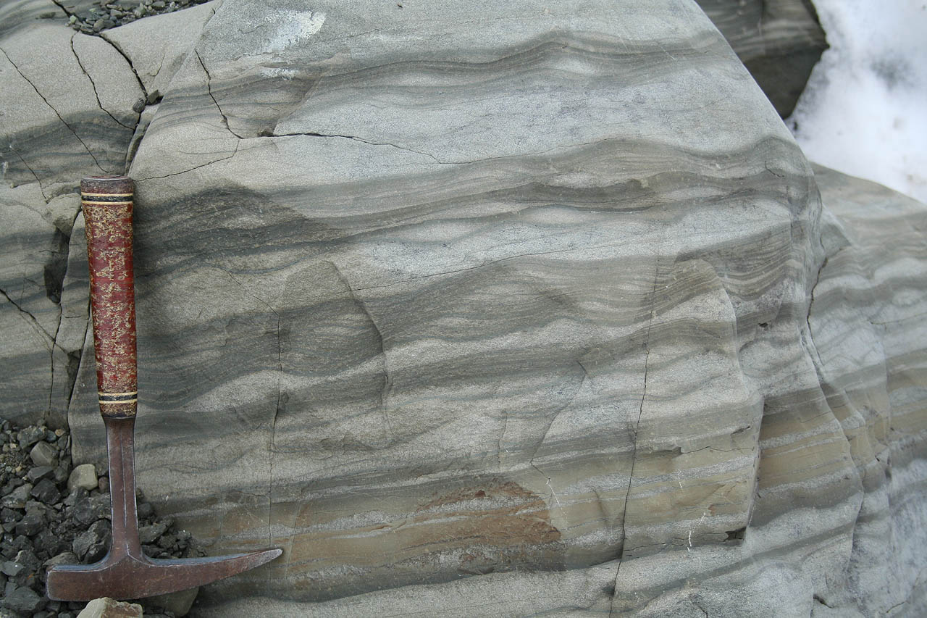
Climbing ripples
Current direction
Yakataga Fm (Pleistocene), Alaska

Slide 9
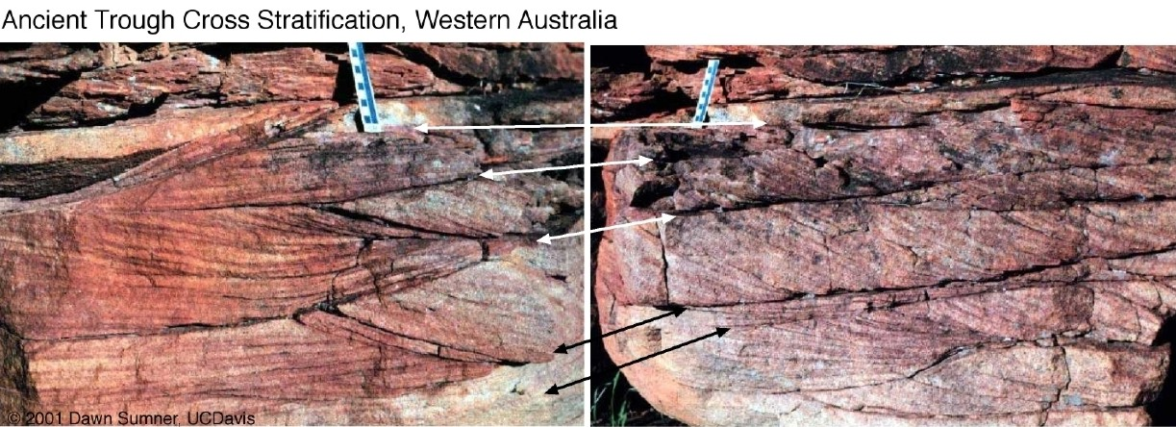
Migration of three-dimensional bedforms (crests not straight; e.g. sinuous, linguoid, etc.) produces trough cross-stratification

Slide 10
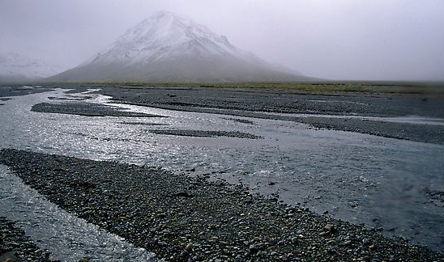
Bedforms aren’t as well developed in coarse-grained rivers, but there can still be cross-stratification from downstream migration of gravel bars
Stratification is often fairly crude (bedding may be massive) but the pebbles may have a preferred orientation called imbrication
Notes:
A bar is a predominantly emergent region of net sediment accumulation within the channel. Architectural elements are large-scale building blocks of fluvial deposits

Slide 11
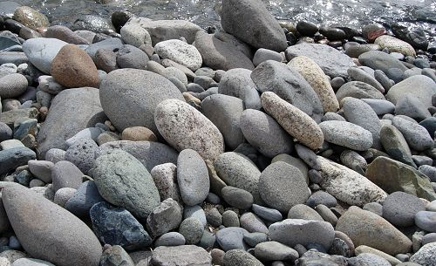
In bedload transport, it takes least energy to roll a particle around its long axis
End up with preferred imbricate fabric: stacked together with long axis transverse to flow and flat side inclined upstream
Notes:
Orthoconglomerate is another name for clast-supported conglomerate

