Slide 1
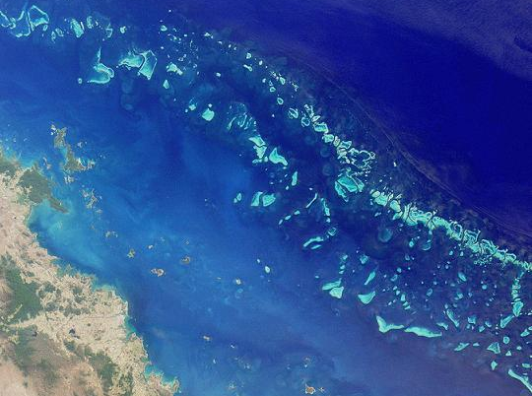
Reef Carbonates

Slide 2
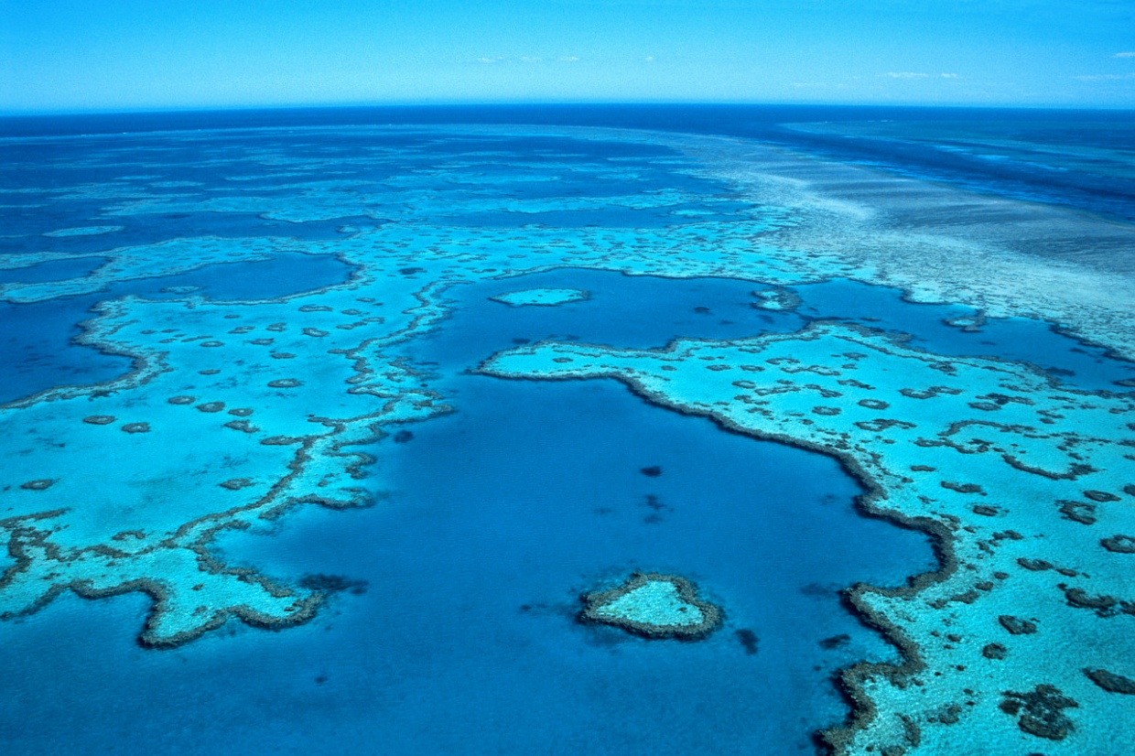
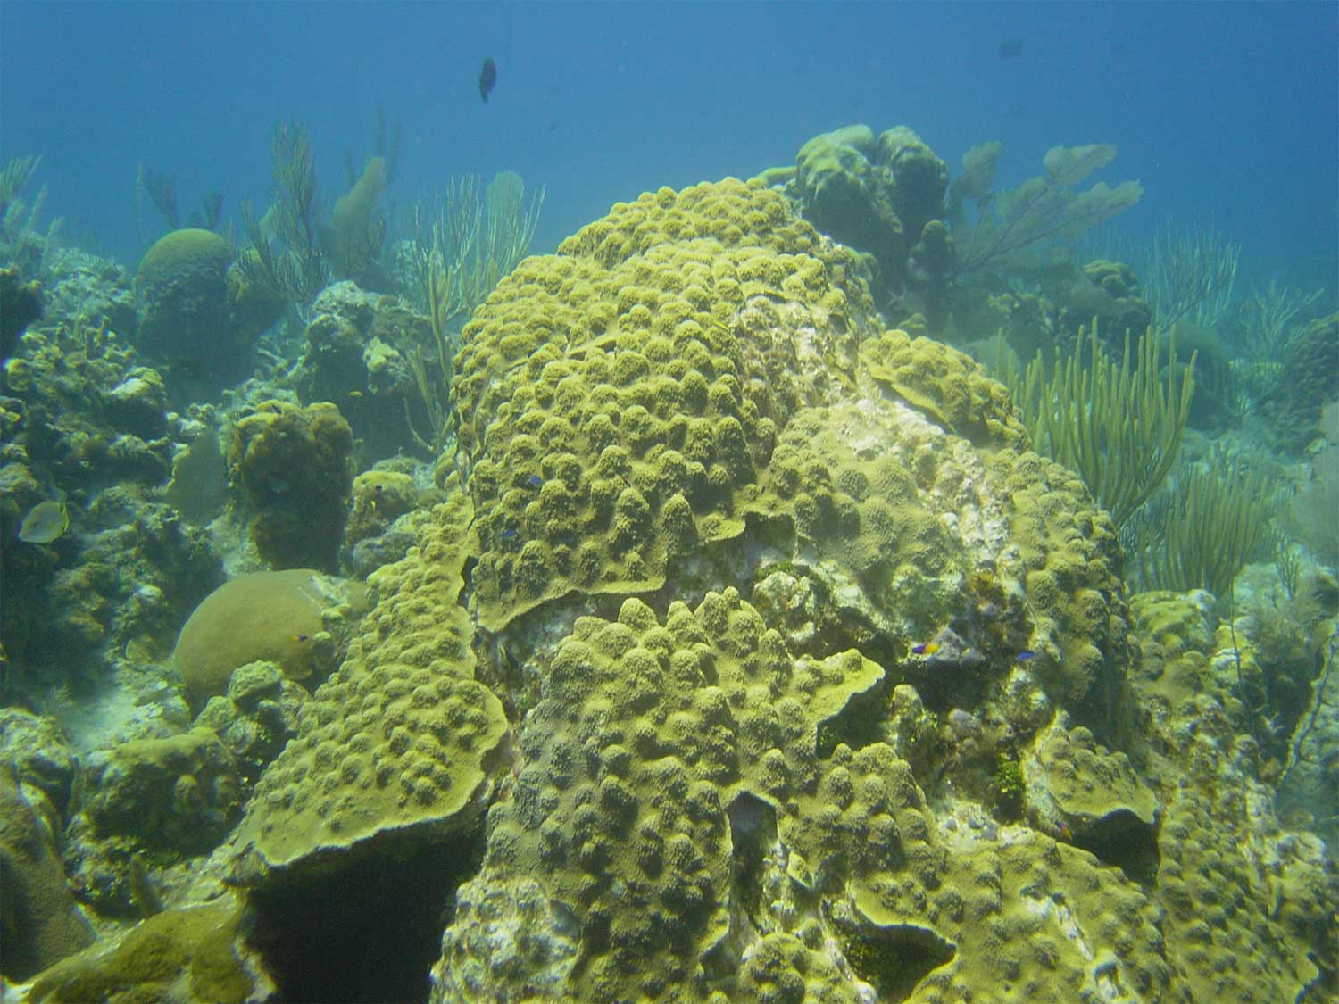
Definition of a reef
Rigid, wave-resistant structure
Bathymetric relief above seafloor
Form in situ by organic growth (rarely by mineral precipitation)
Modern reefs are nearly all constructed by corals in shallow tropical water, but this hasn’t always been the case

Slide 3
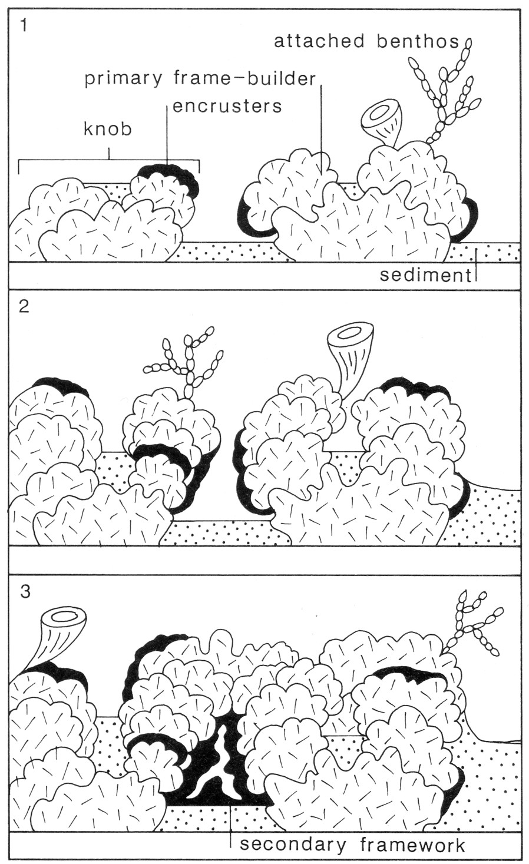
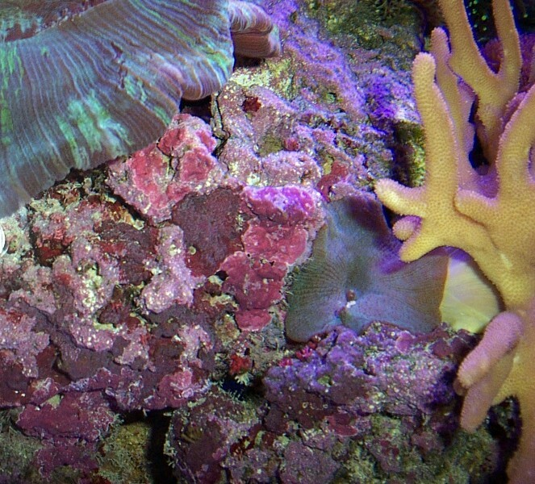
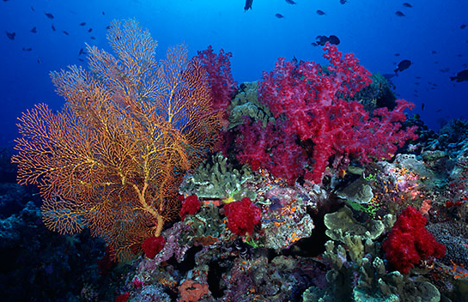
Reef formation is a balance between constructive and destructive processes
Constructive processes:
Growth of organic framework
Binding by encrusters
Sediment trapping by bafflers

Slide 4
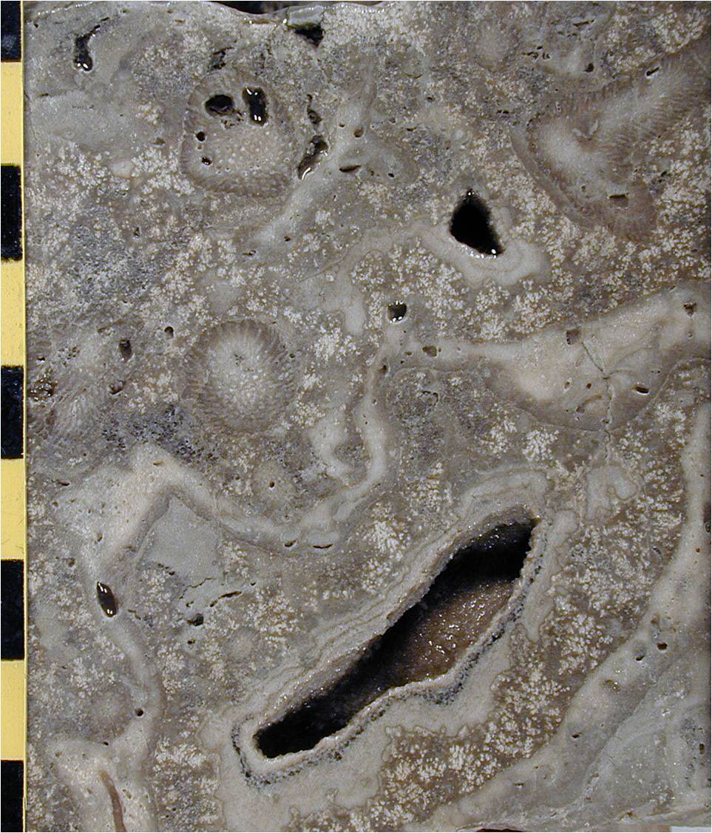
Reef limestones composed of:
Framework constructing organisms
Encrusting algae, microbes, animals
Platy “baffling” organisms
Cavities filled by sediment and/or cement

Slide 5
Microbial binding much more dominant in Proterozoic-Triassic reefs
Lower Cambrian, Nevada

Slide 6
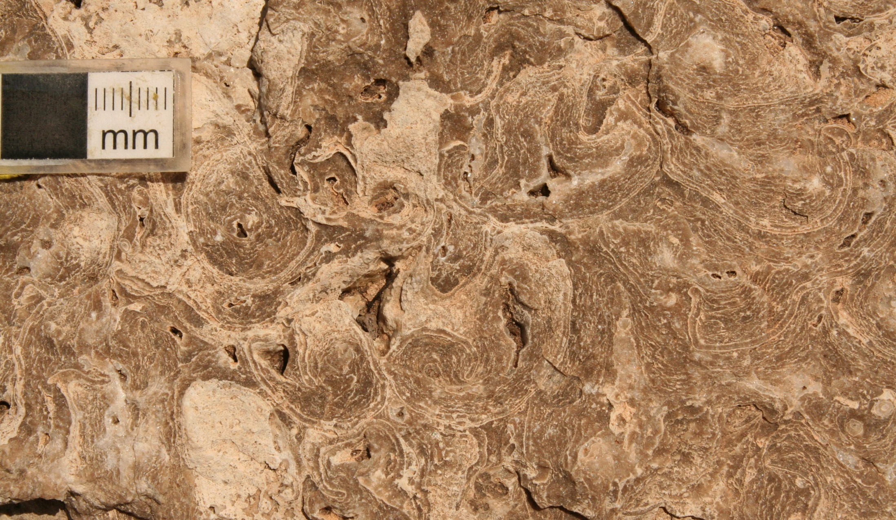
Baffling by platy algae (voids mostly filled with cement)
Middle Permian, Guadalupe Mountains (New Mexico)

Slide 7
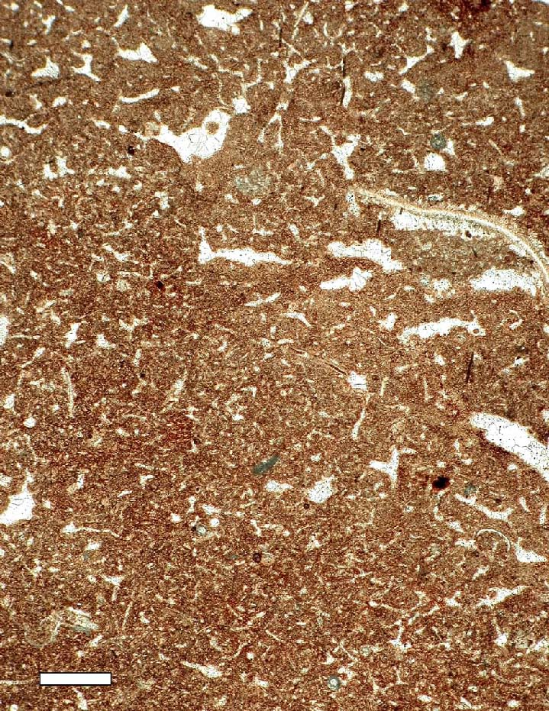
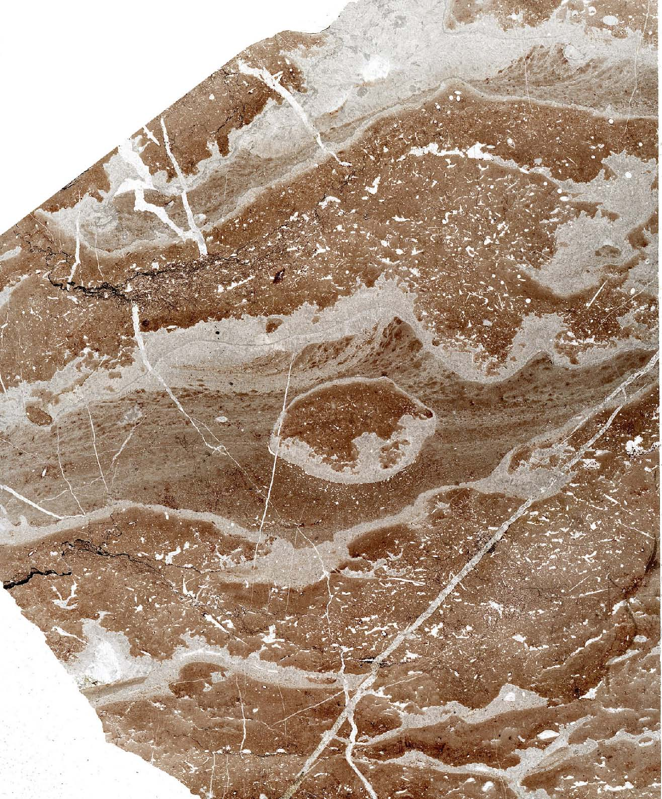
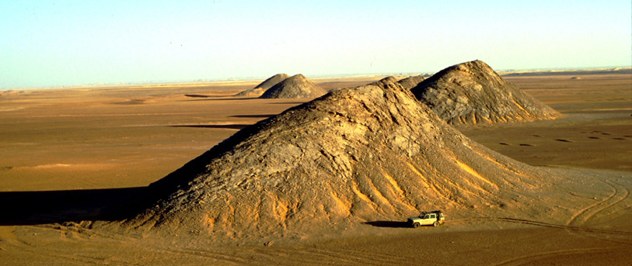
Mud mounds: buildups (“bioherms”) with bathymetric relief but no organism framework
Dominated by mud trapped by bafflers or precipitated by microbes, or by cement
Thin section
Polished slab

Slide 8
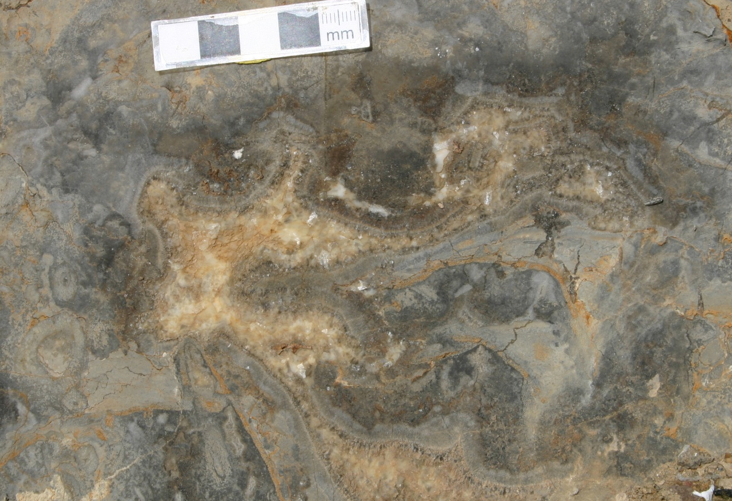
Cementation
Common cavity fill, partly responsible for steep wave-resistant reef profile
Lower Cambrian, Nevada

Slide 9
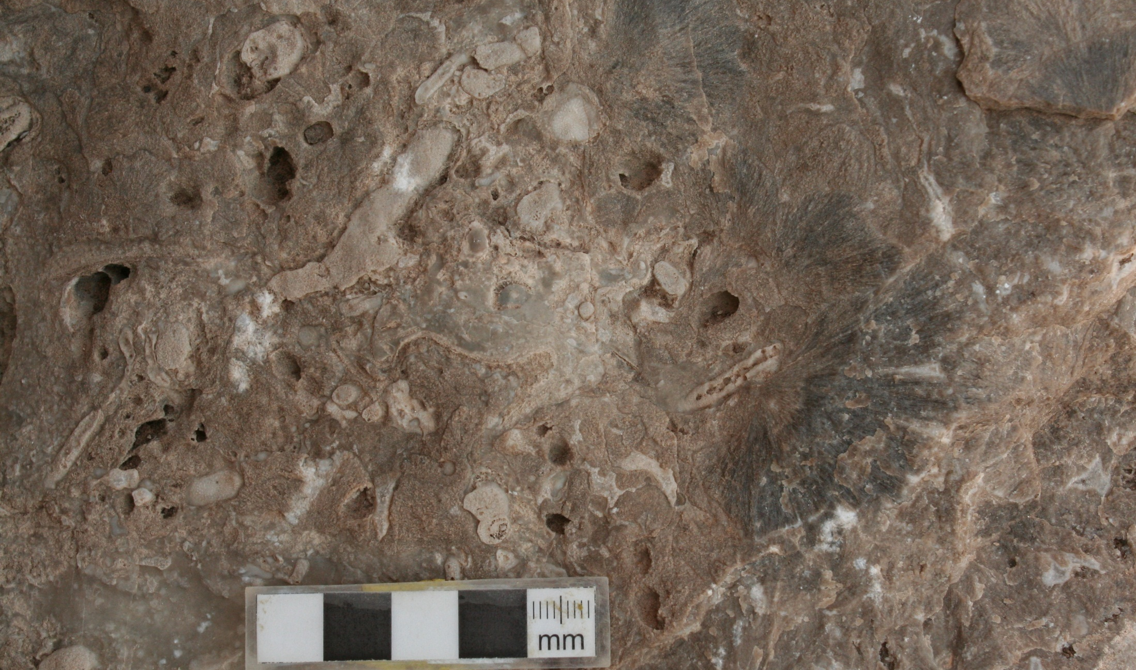
Middle Permian, Guadalupe Mountains (Texas)

Slide 10
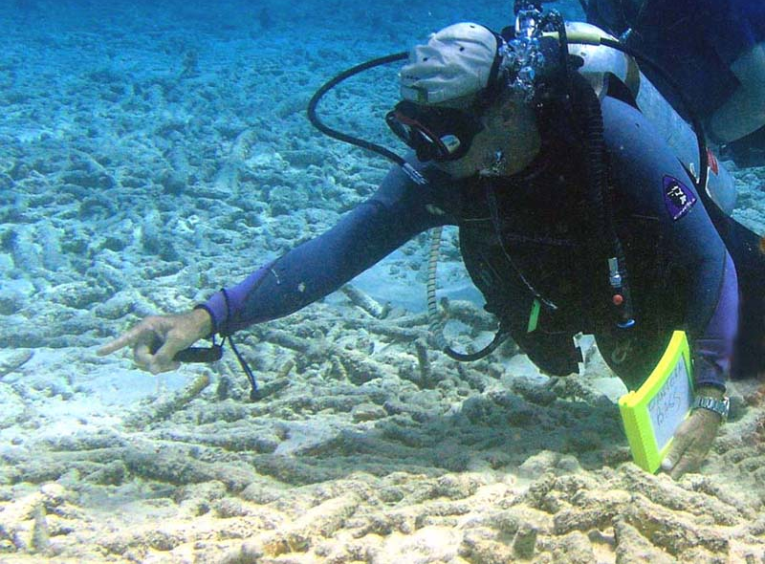
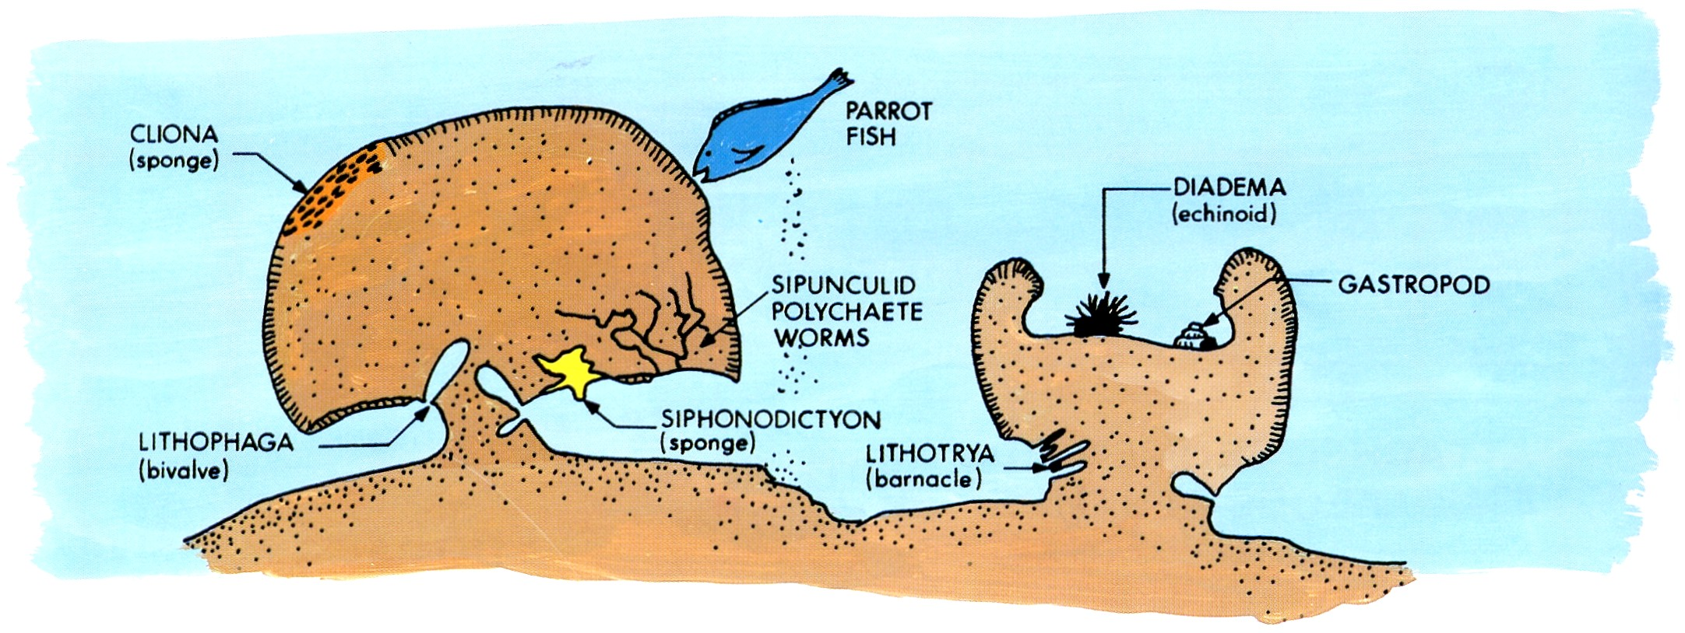
Destructive processes:
Wave energy (especially storms and hurricanes)
Bioerosion (dominant destructive process in the Mesozoic and Cenozoic)

Slide 11
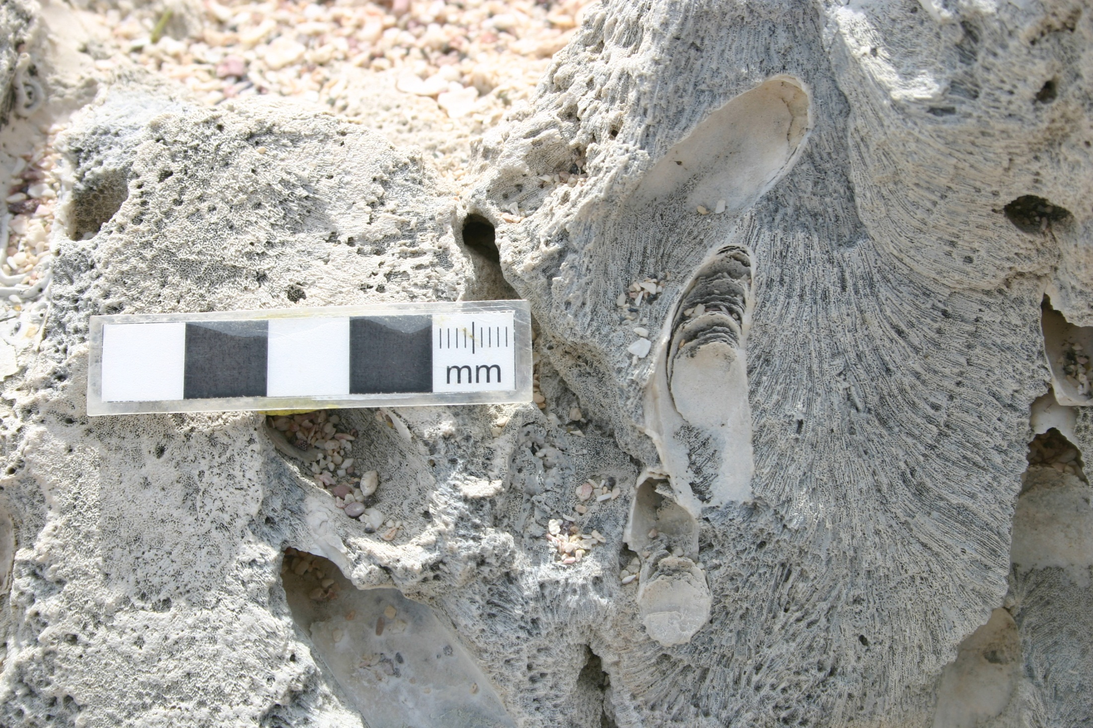
Bivalve bioerosion in coral head

Slide 12
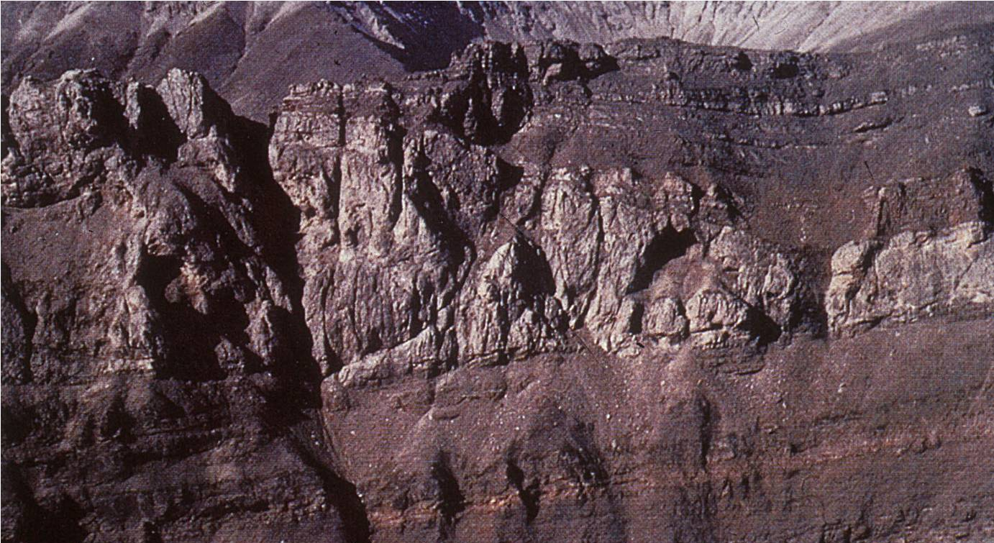
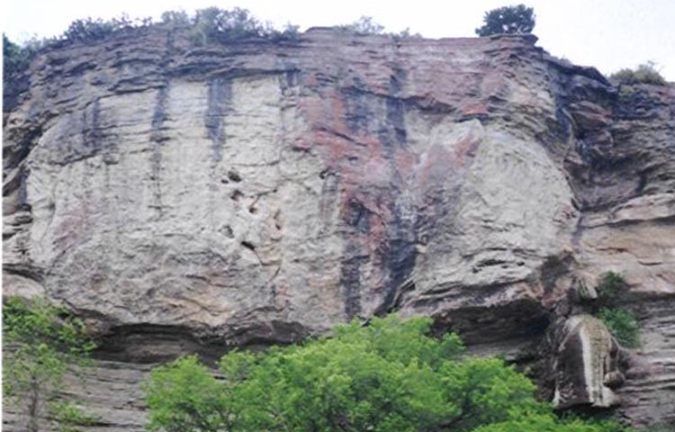
Reefs are unbedded structures composed of framestone, bindstone, or bafflestone
Due to bathymetric relief, surrounding beds onlap reef core

Slide 13
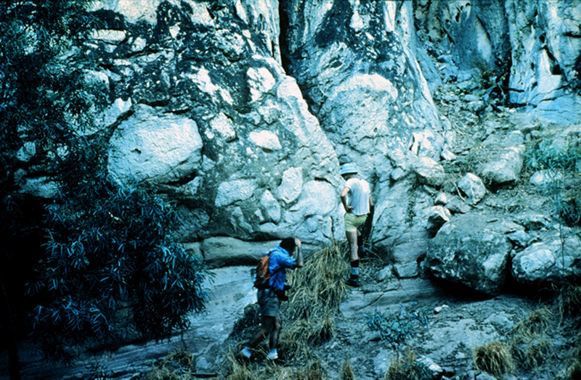
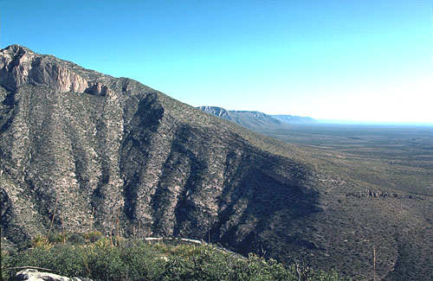
Fore-reef grainstones and rudstones
Because of rigid framework and cementation, reef foreslope can be extremely steep (to vertical)
Reef talus

