Slide 1
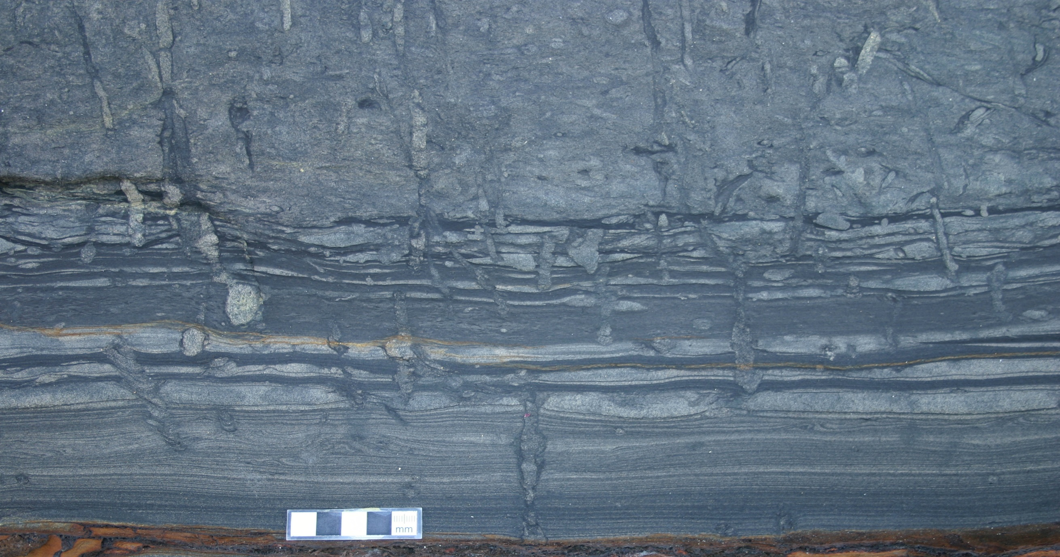
Trace Fossils and Ichnofacies

Slide 2
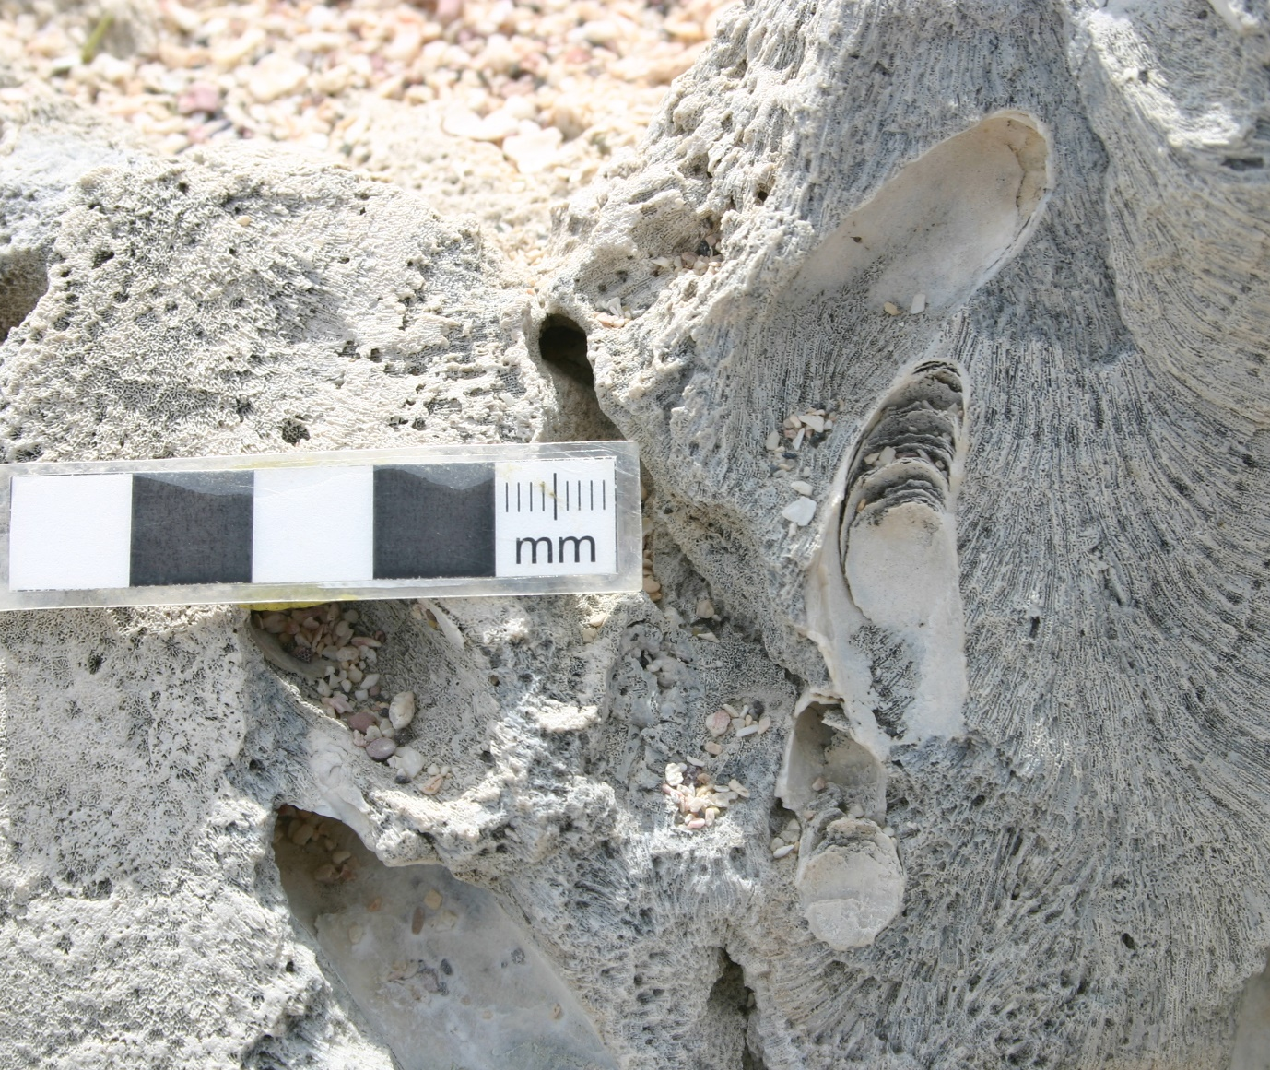
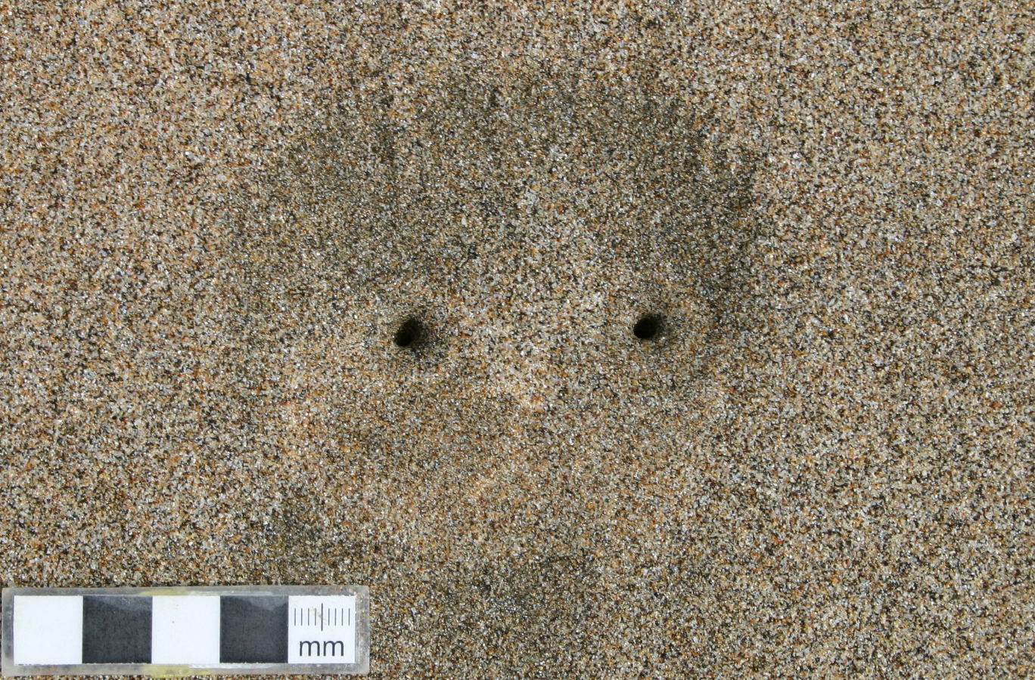
Trace fossils (ichnofossils) are the preserved activities or behaviors of organisms, preserved as tracks, burrows, and borings
Borings formed in hard rock (or shell)
Burrows formed in soft or firm sediment
Arenicolites or Diplocraterion, Floreana Island, Galapagos
Gastrochaenolites in coral, Galapagos

Slide 3
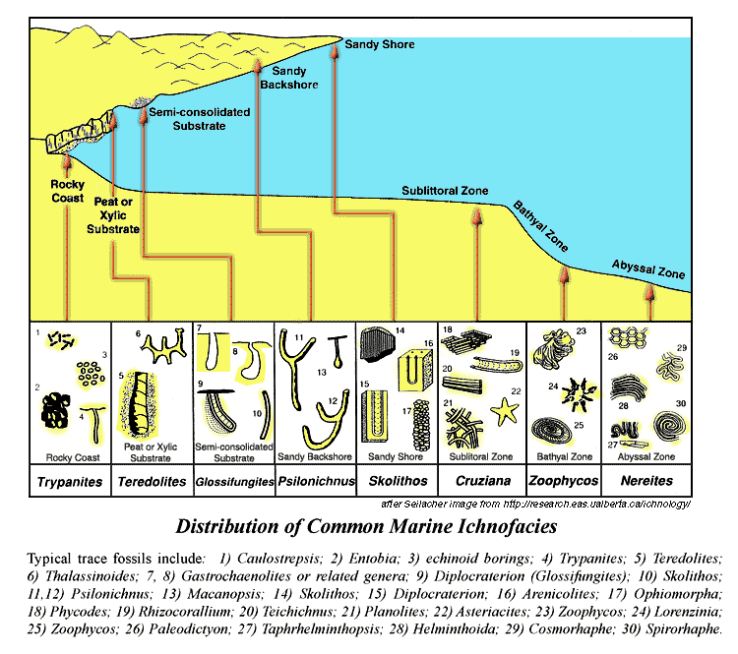
Because burrows are the interaction between organism and sediment, energy levels and substrate consistency affect distribution of trace fossils

Slide 4
Ichnofacies: a recurring assemblage of trace fossils indicative of specific environmental conditions (substrate, energy, salinity, etc.)

Slide 5
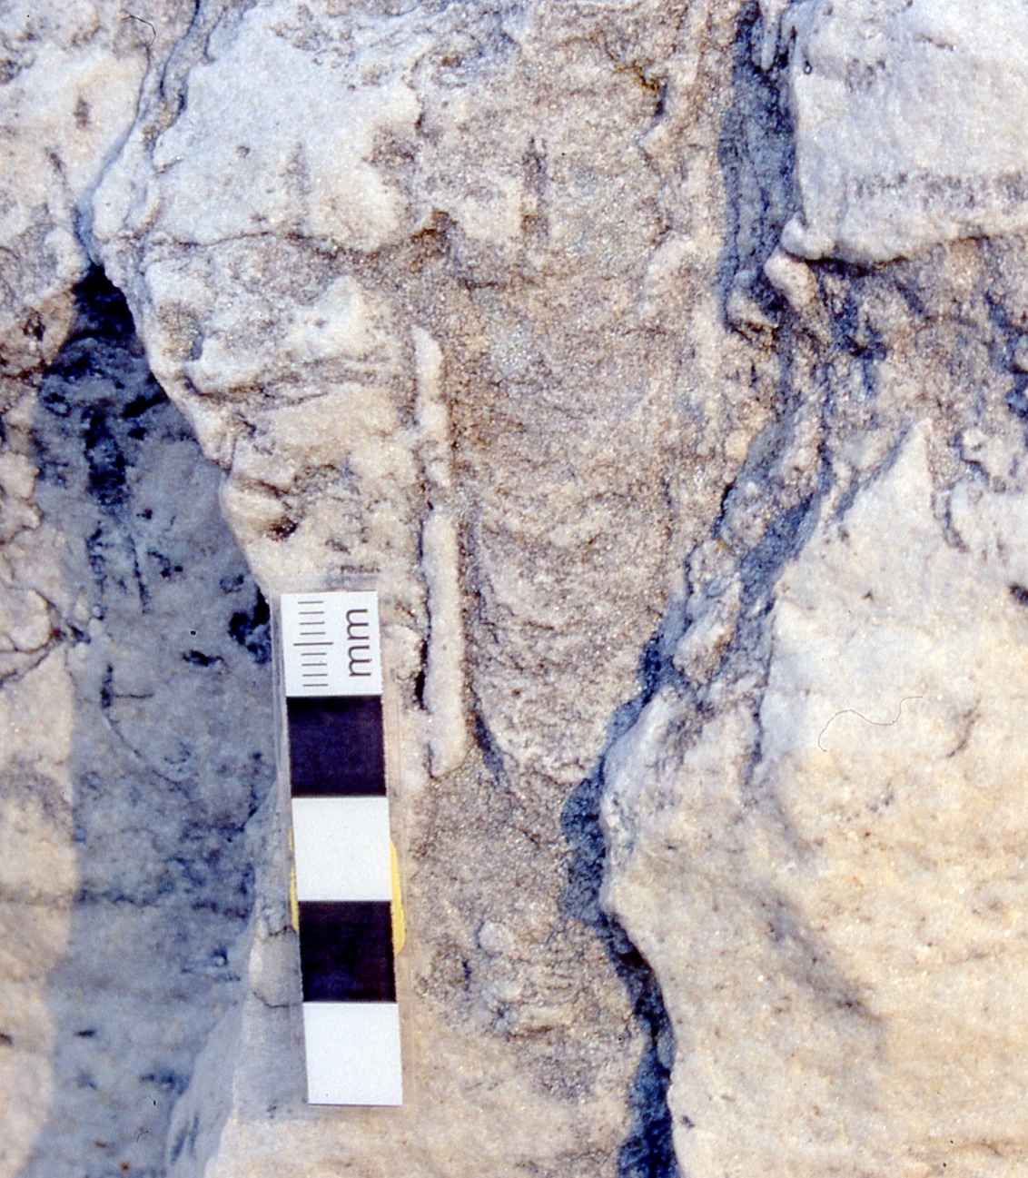
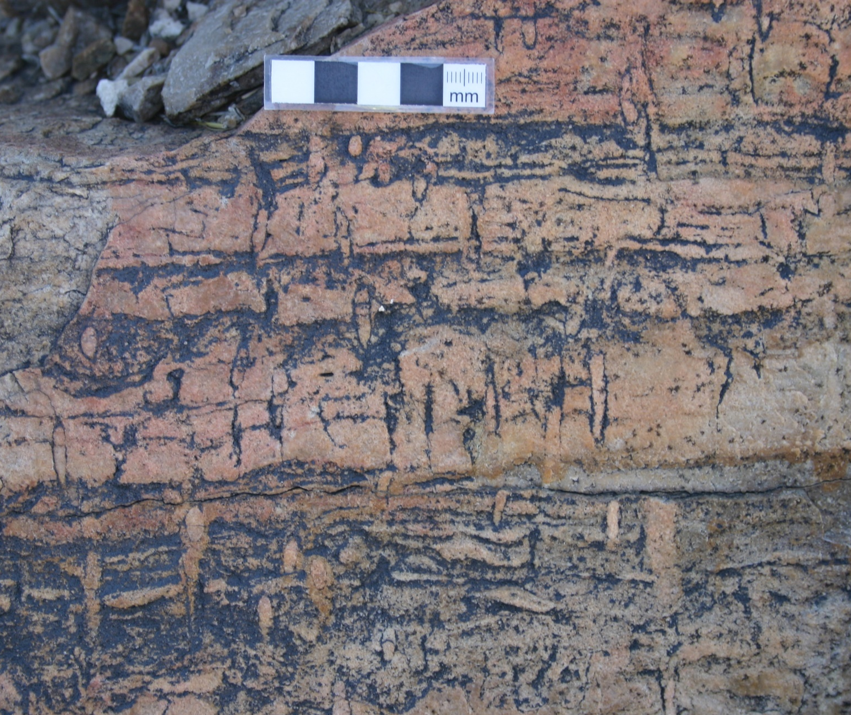
Skolithos ichnofacies found in high-energy shifting sands (beach, shoreface)
Dominated by vertical or U-shaped dwelling burrows
“Spreite”
Skolithos (Cambrian Poleta Fm, California)
Diplocraterion (Ordovician Potsdam Gp, NY)

Slide 6
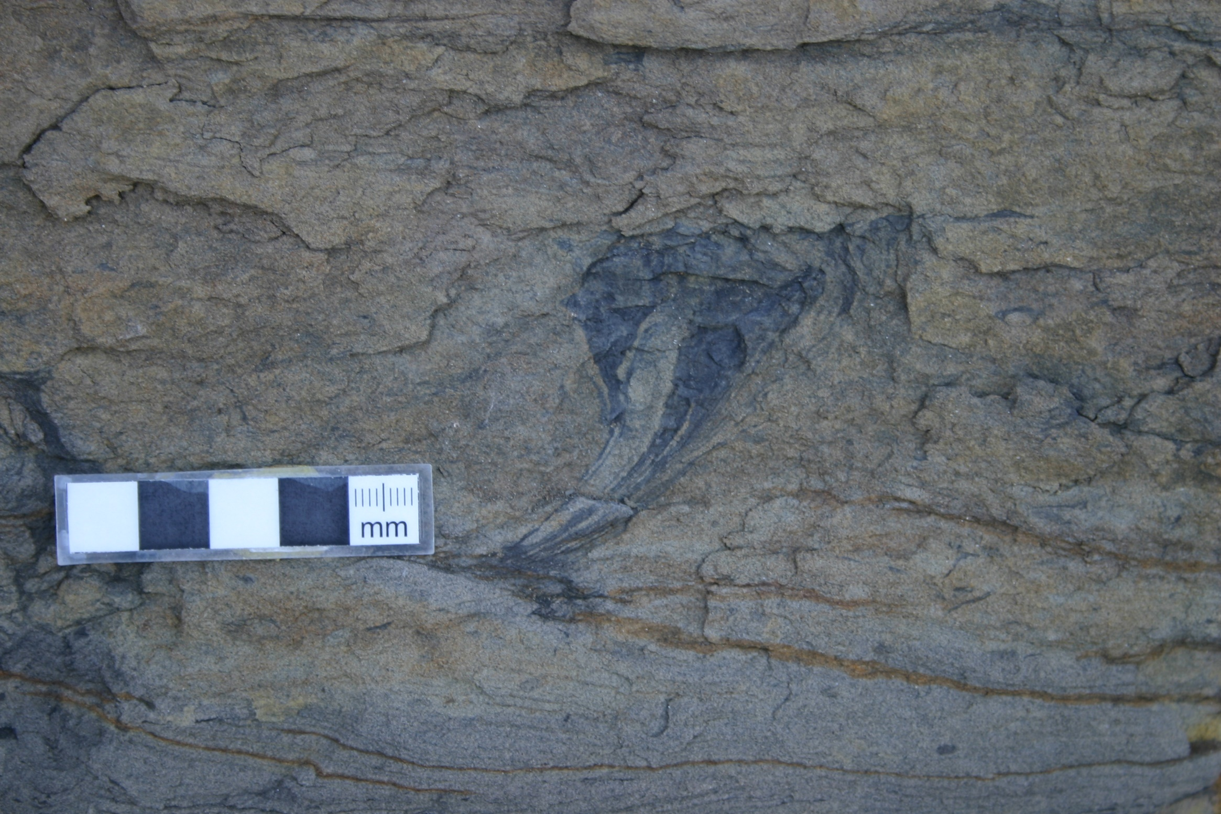
Rosselia (Permian Pebbley Beach Fm, Australia)

Slide 7
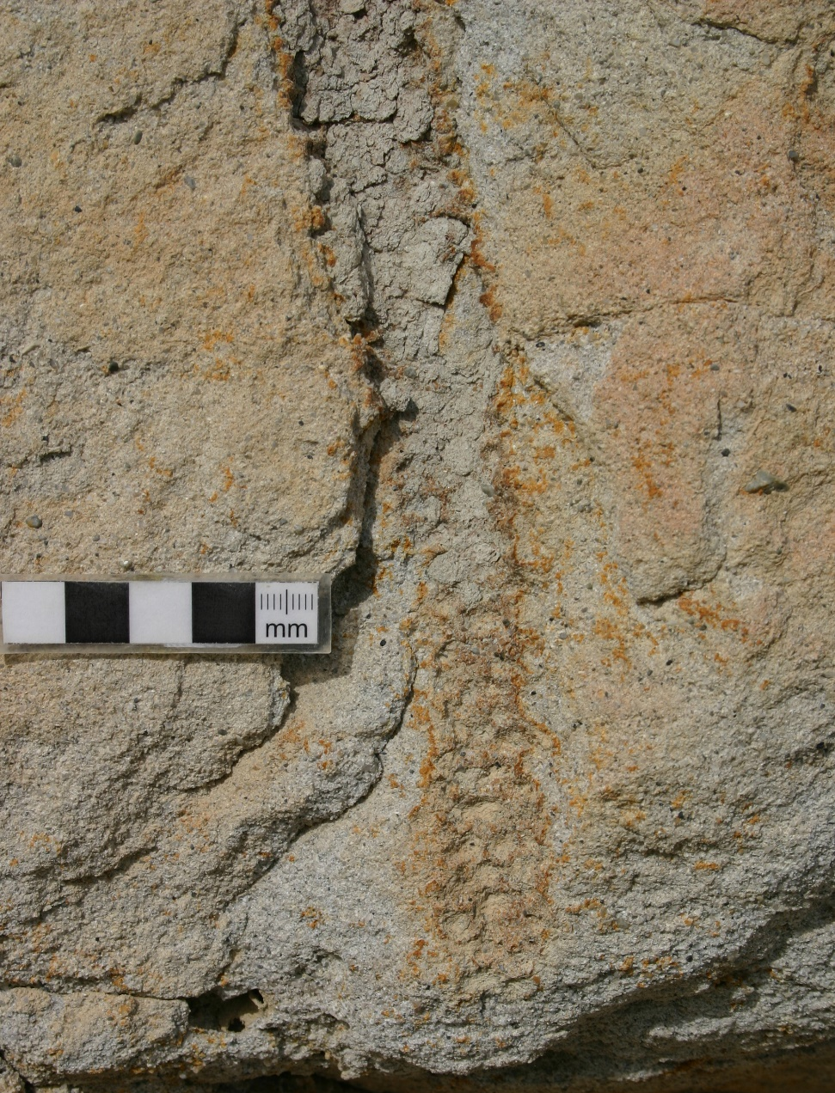
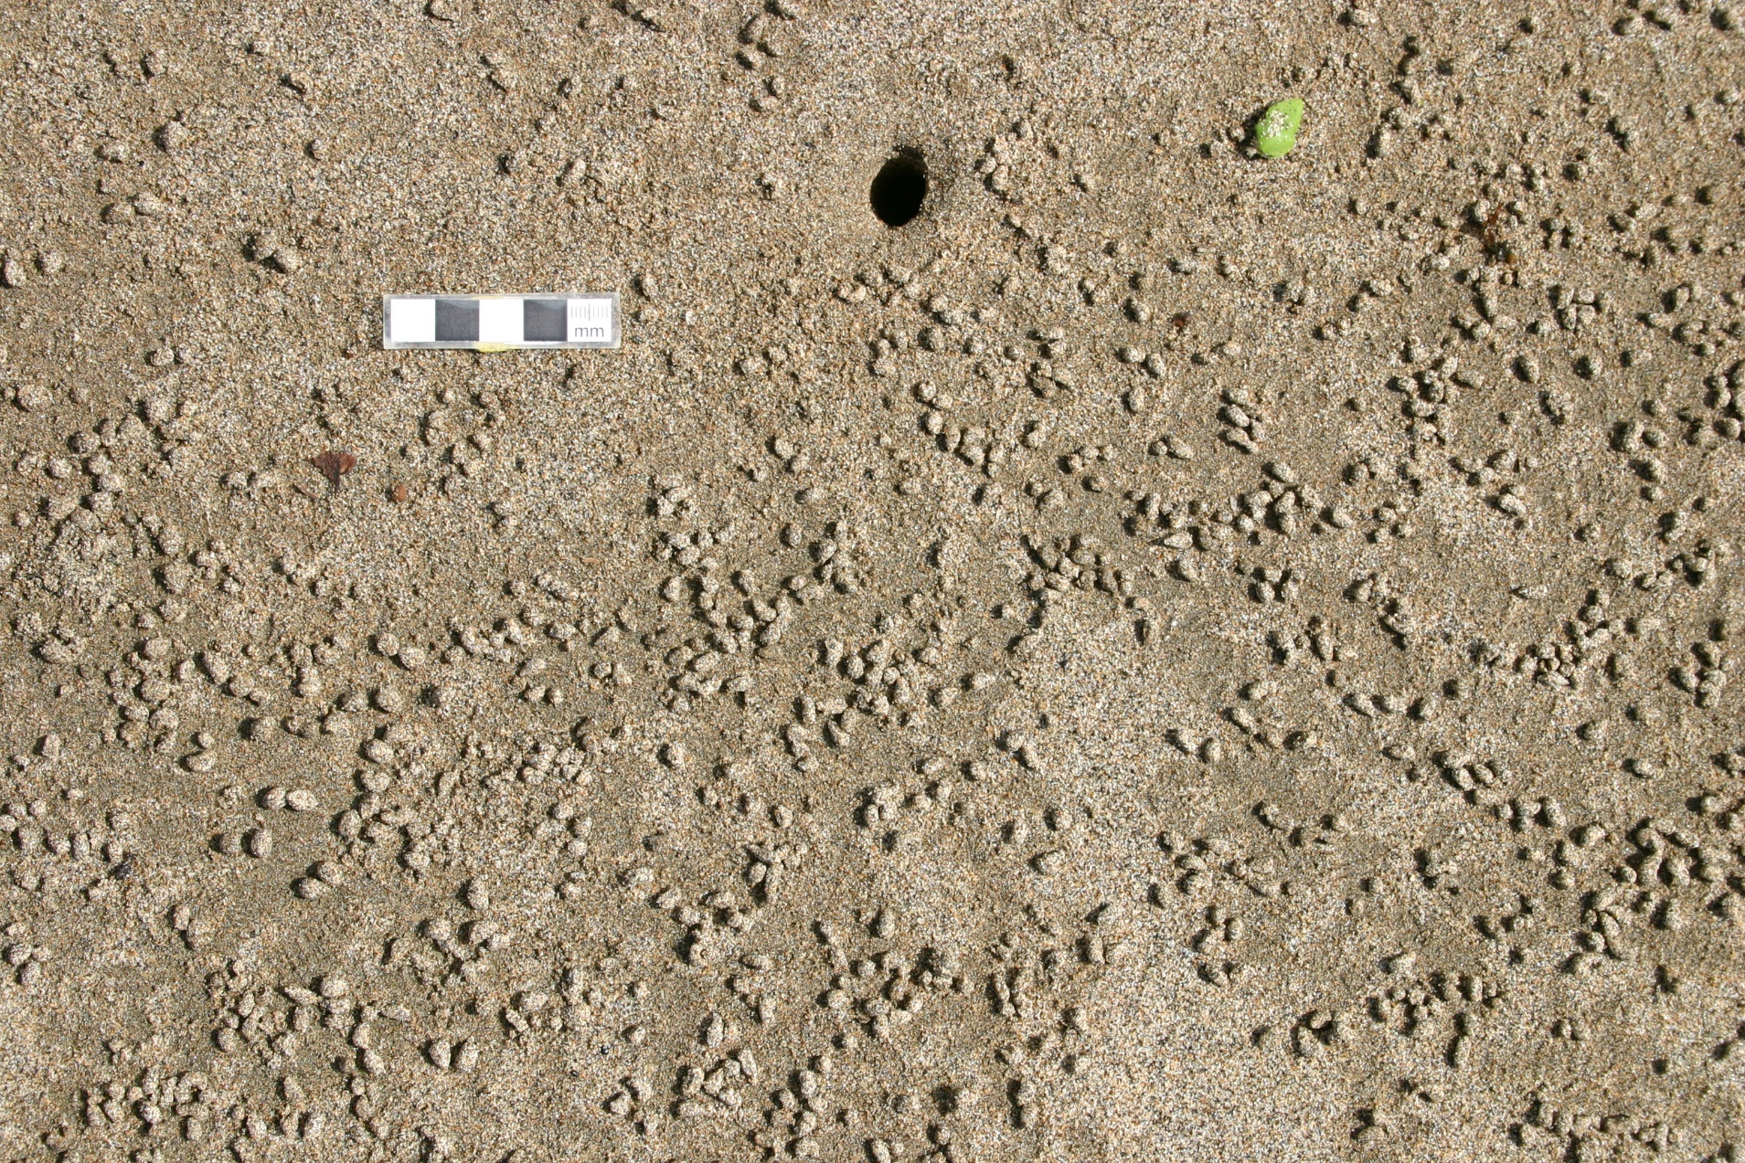
Some burrows lined with pellets for strength against shifting substrate
Ophiomorpha (Eocene Yokut Fm, California)
Modern ghost crab burrow and pellets (Floreana Island, Galapagos)

Slide 8
Ichnofacies are not specifically depth-dependent, but energy and substrate conditions do vary with depth

Slide 9
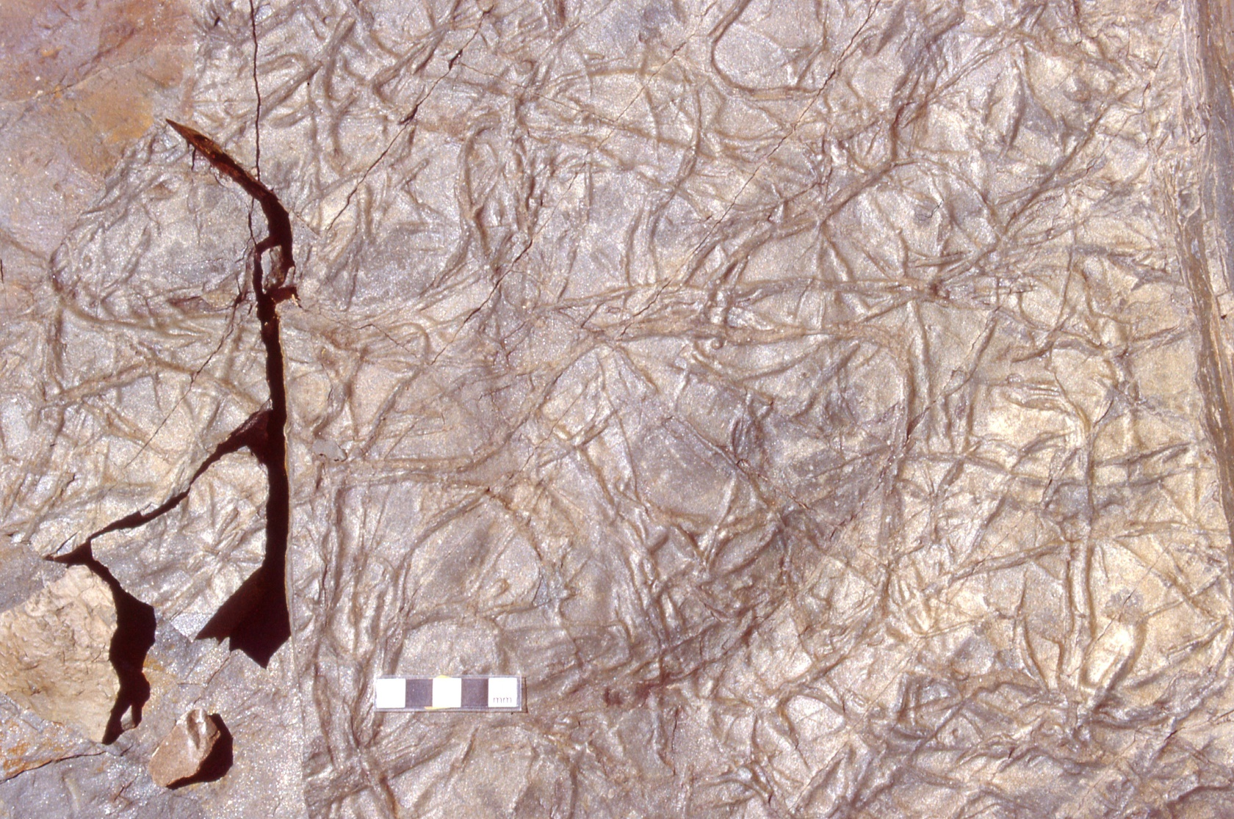
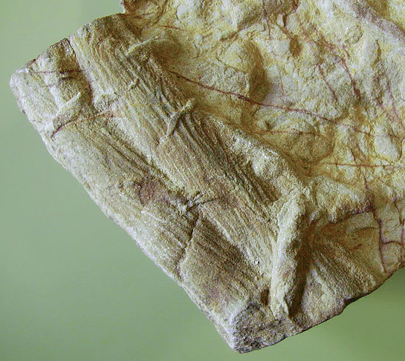
Cruziana ichnofacies found in lower-energy shelf environments (typically offshore, offshore-transition)
Contains a diverse set of mainly horizontal or inclined burrows
Planolites (Cambrian Poleta Fm, California)
Cruziana

Slide 10
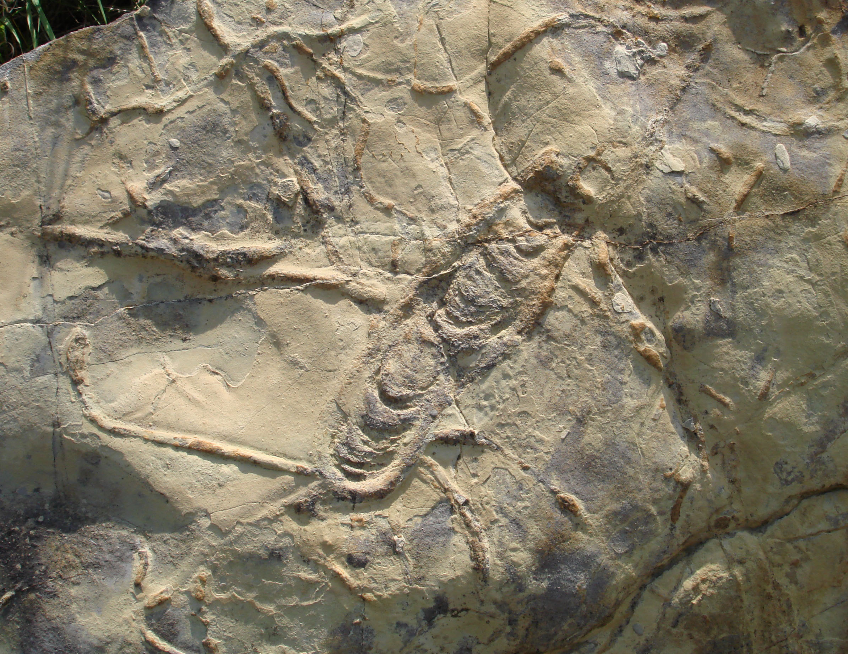
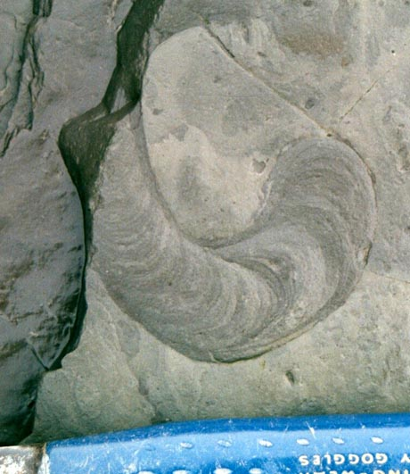
Rhizocorallium: horizontal to inclined U-shaped burrow with spreite

Slide 11
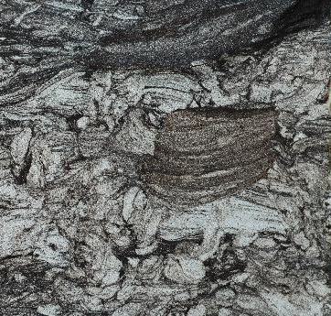
Teichichnus: upward-migrating horizontal tube with spreite
Permian Pebbley Beach Fm, Australia

Slide 12
Zoophycos ichnofacies occurs in low-energy deep-water (continental slope) settings and is dominated by complex tiered feeding burrows

Slide 13
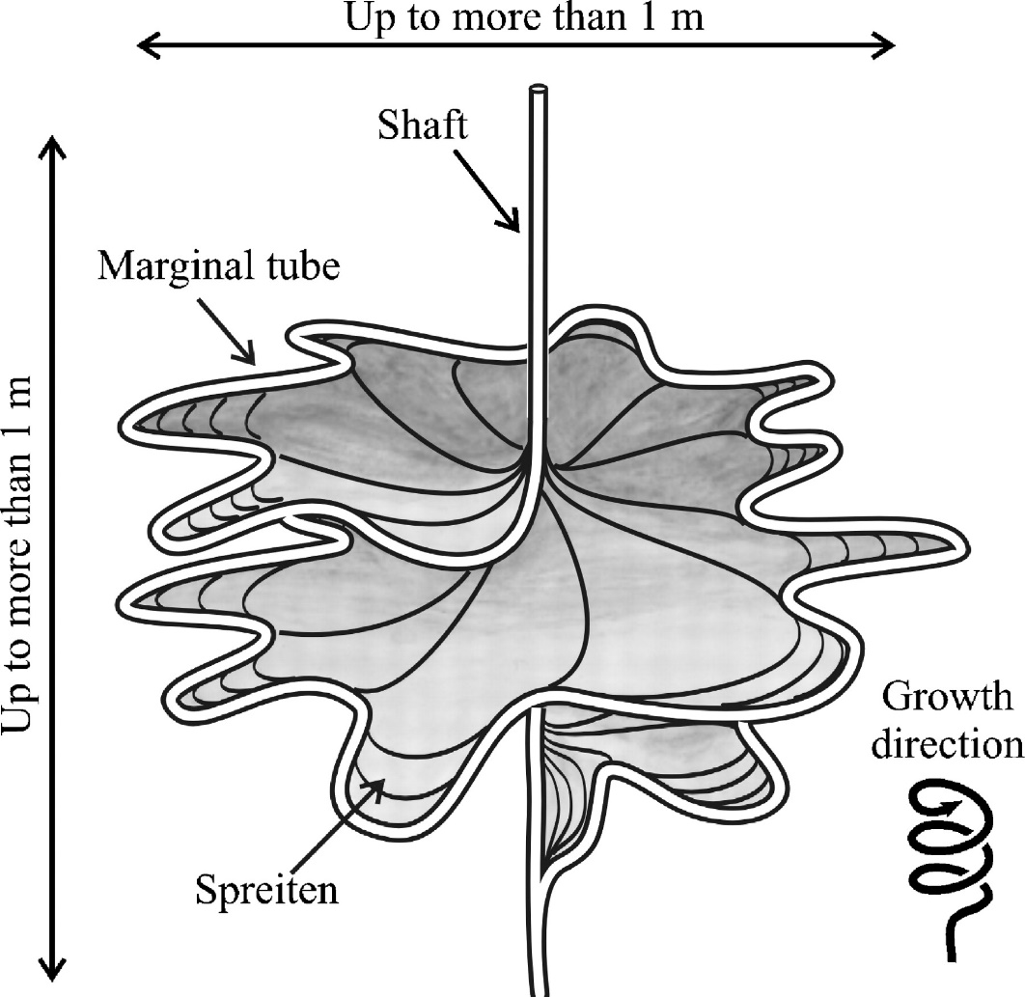
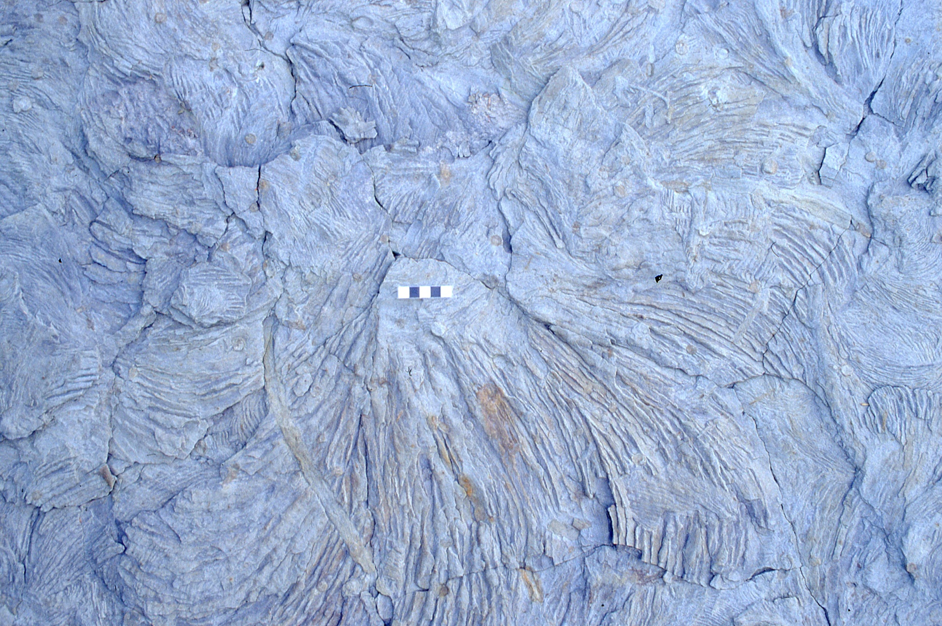
Zoophycos is an enigmatic multi-tiered feeding burrow with large lobes (containing spreite) radiating from a central shaft
Devonian Cherry Valley Fm, NY

Slide 14
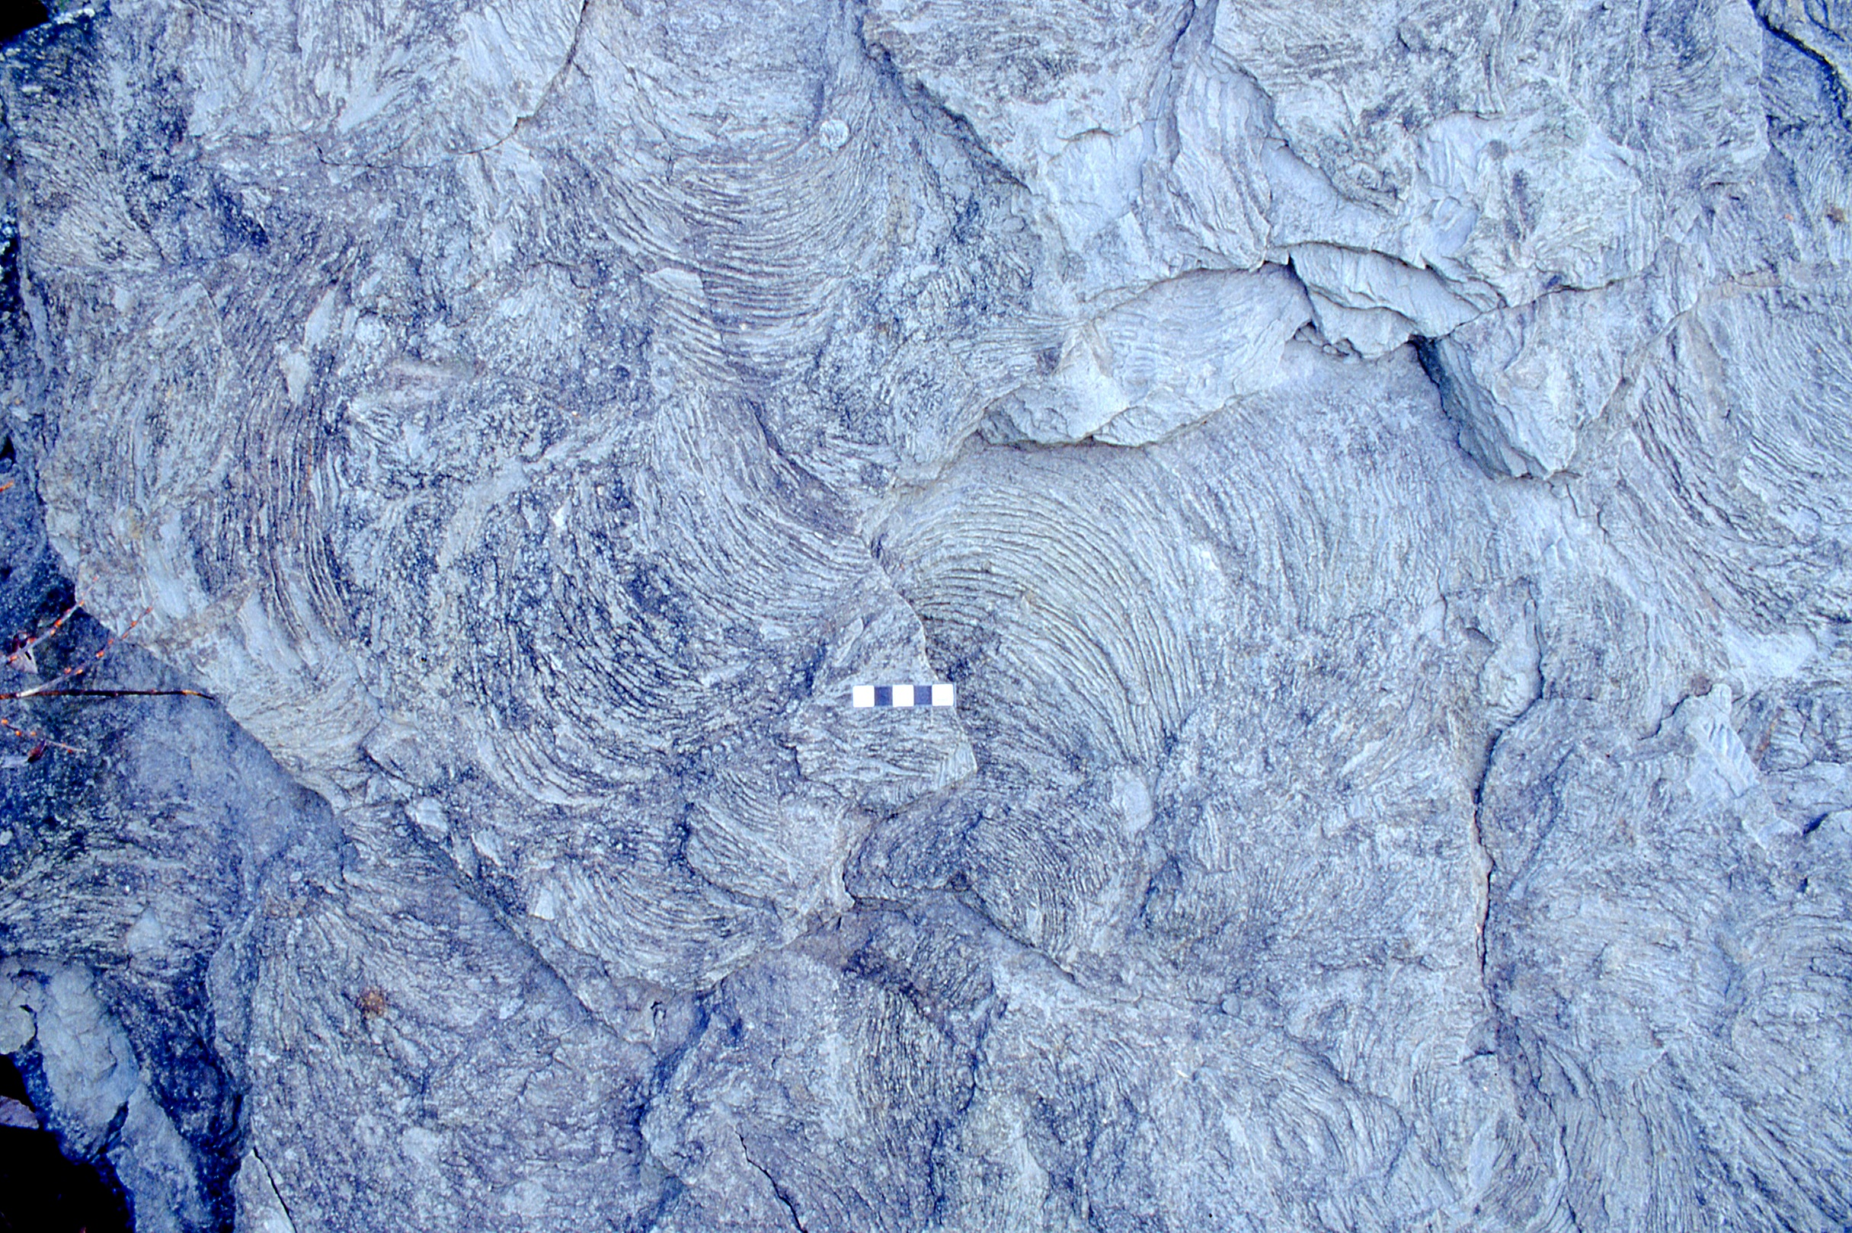
Zoophycos (Devonian Cherry Valley Fm, NY)

Slide 15
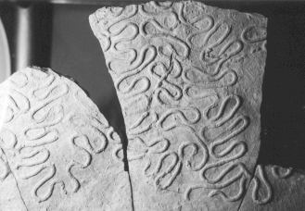
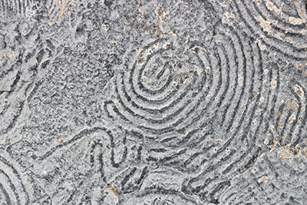
Nereites ichnofacies occurs in abyssal plain or submarine fan settings and is characterized by meandering horizontal grazing traces

Slide 16
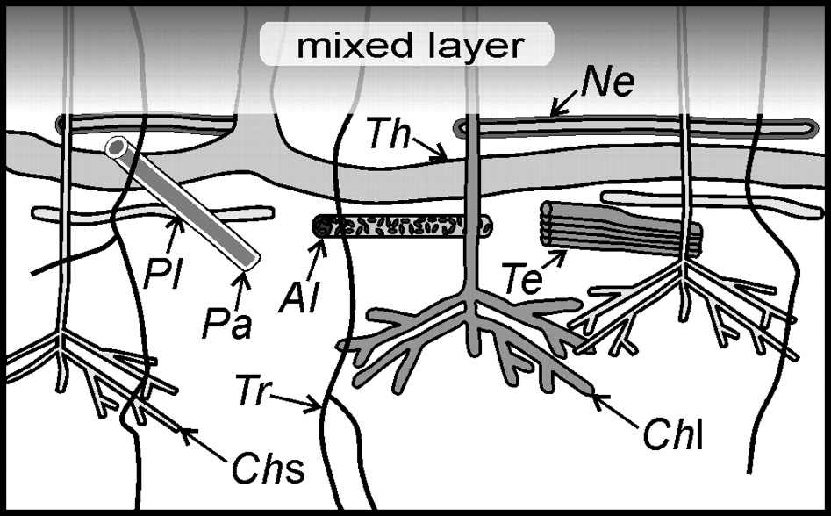
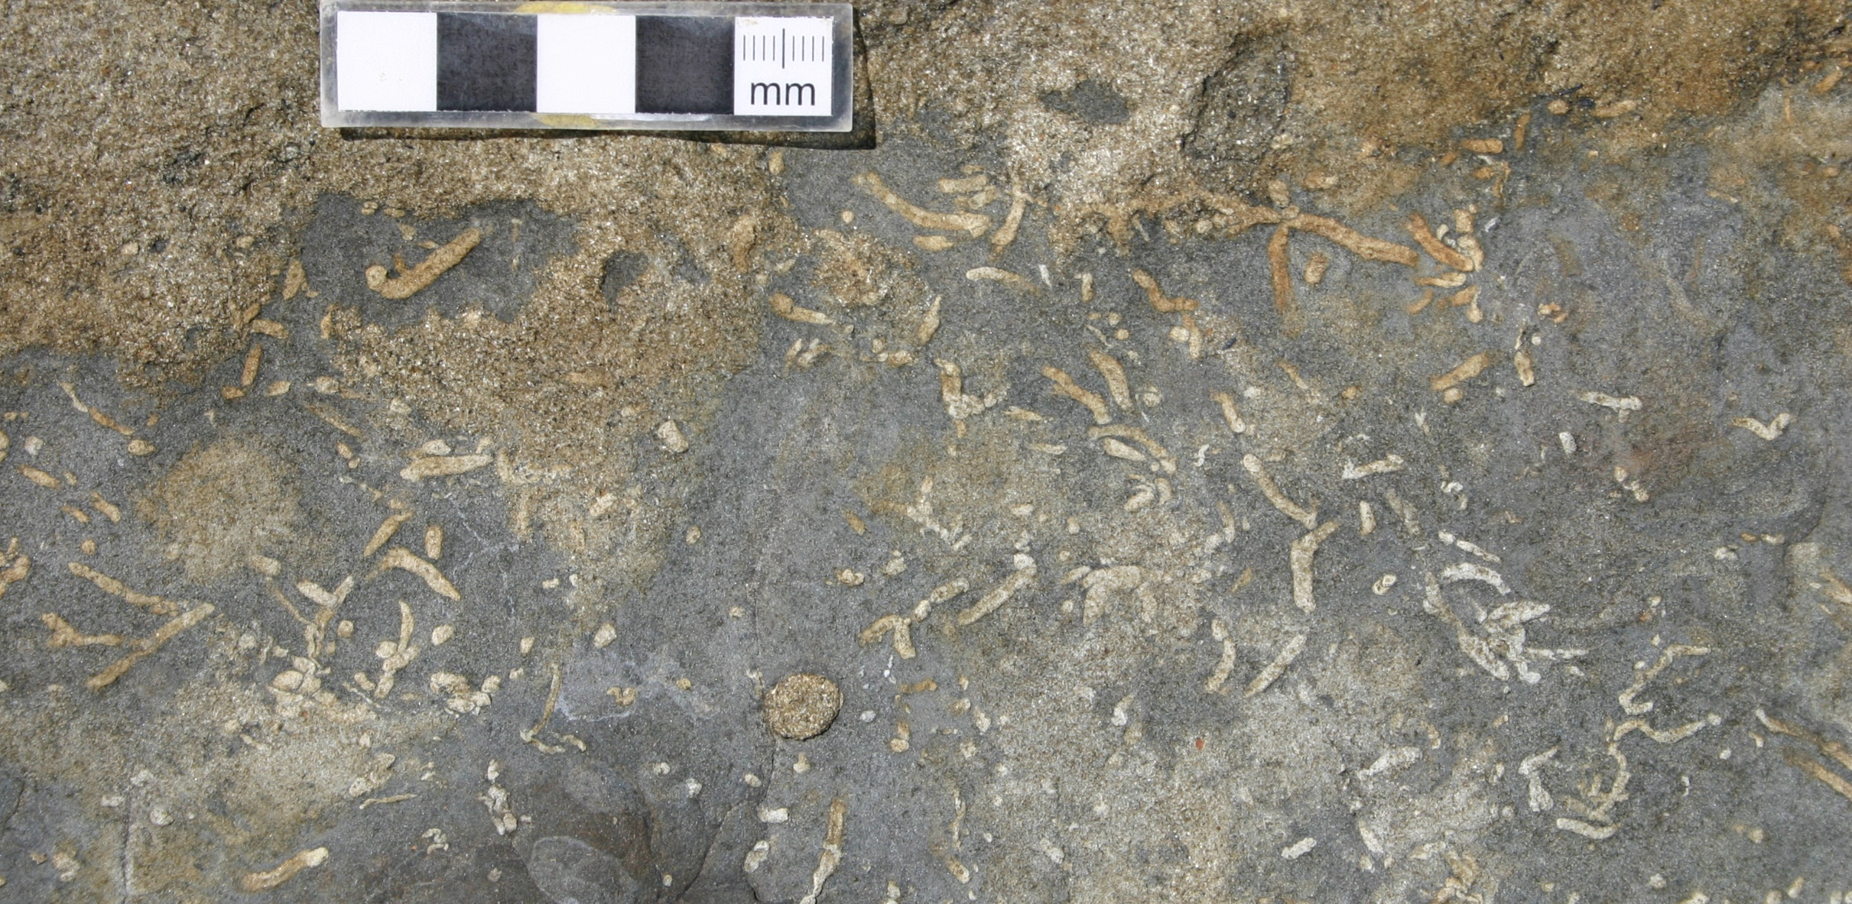
Chondrites: small tubes probing outward from central shaft; common in low-oxygen sediments
Chondrites (Paleogene Carmelo Fm, California)

Slide 17
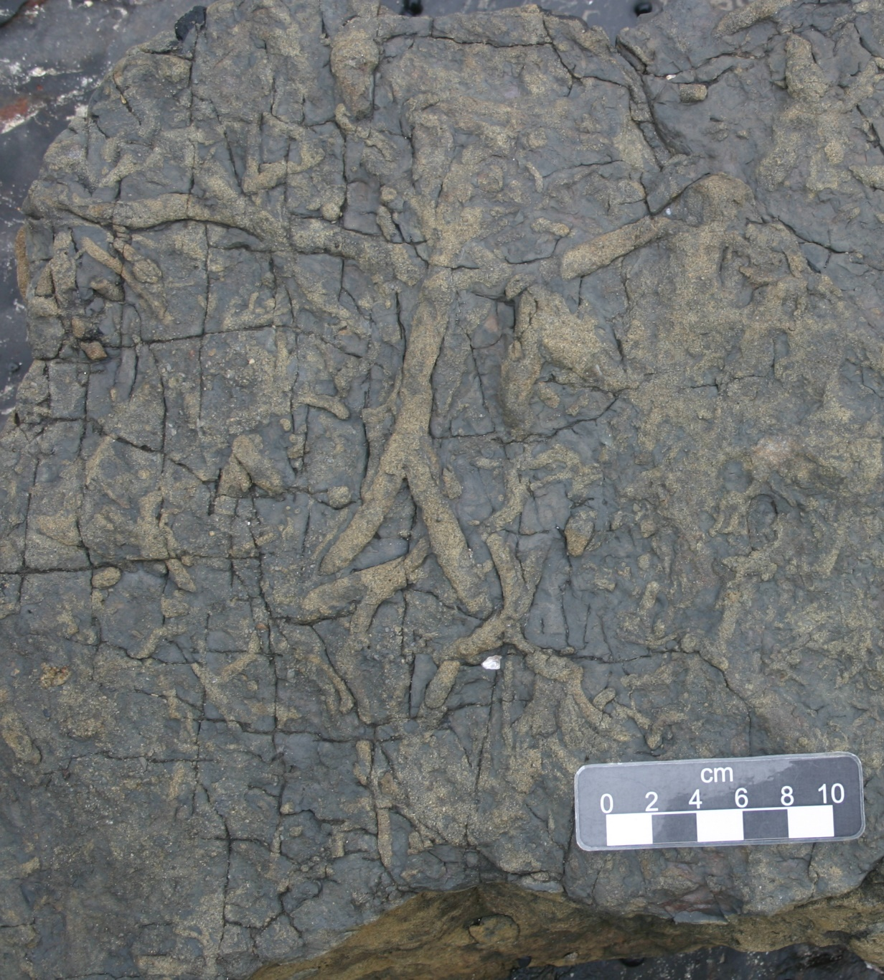
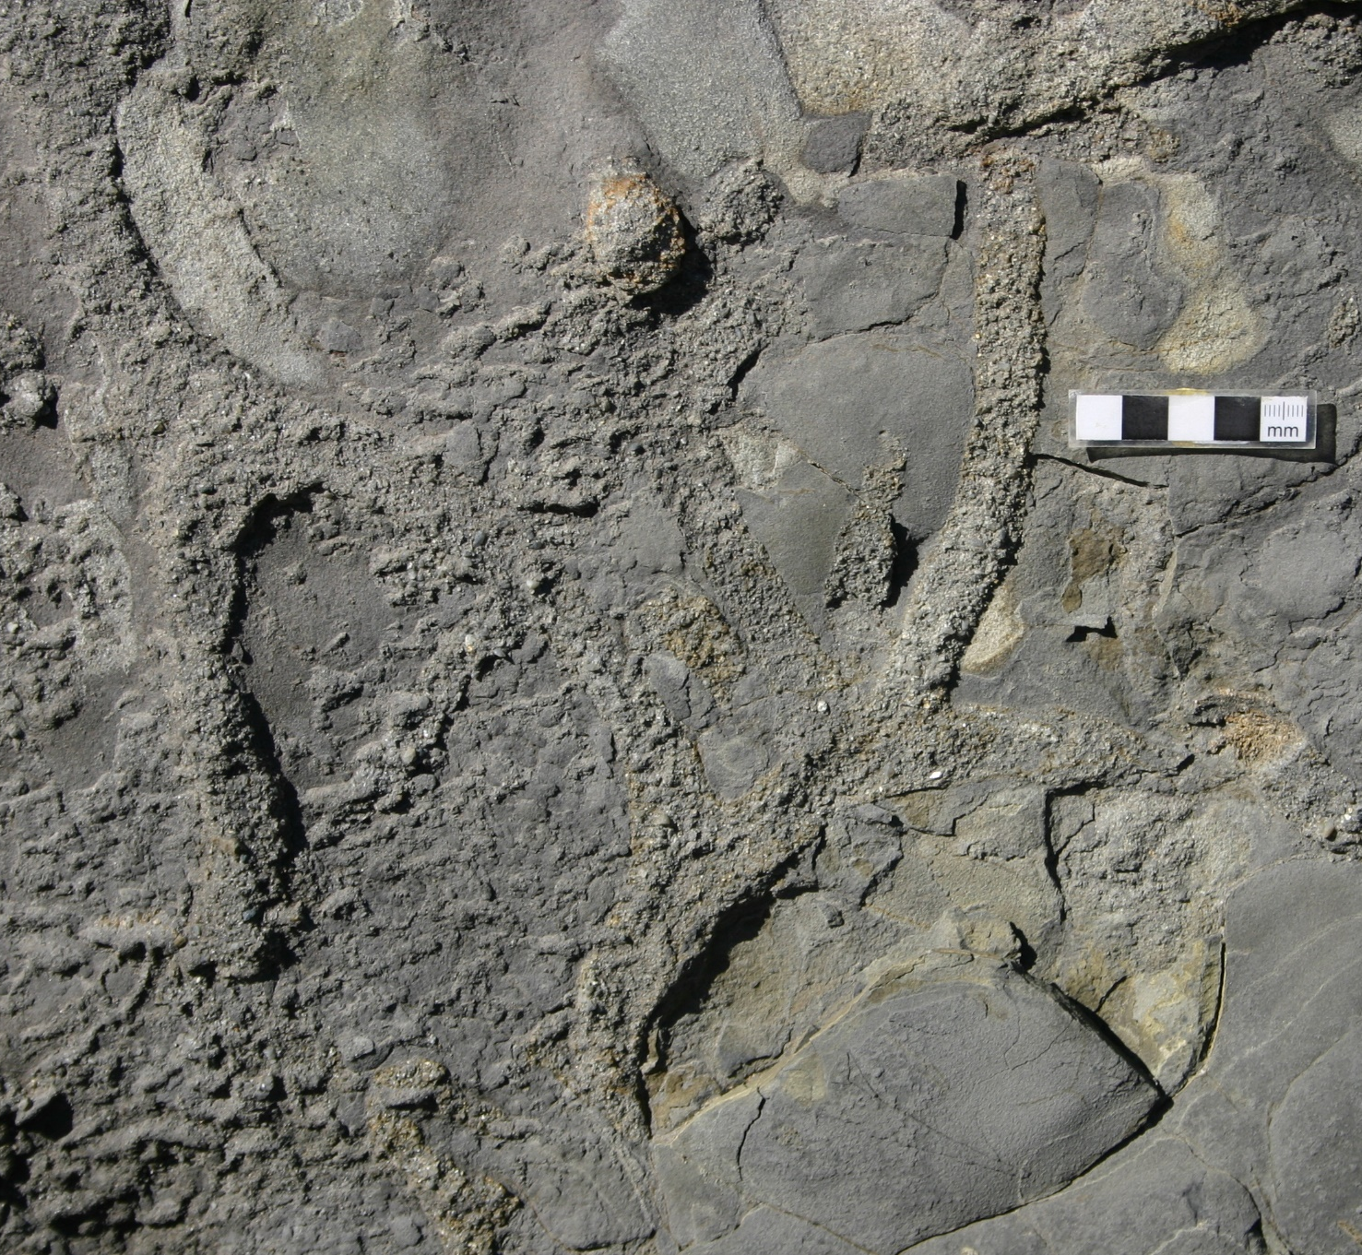
Thalassinoides: Large-diameter (cm-scale) vertical dwelling burrow with Y-shaped branch junctions; found in a variety of environments
Permian Wandrawandrian Fm, Australia
Paleogene Carmelo Fm, California

Slide 18
Some ichnofacies are substrate-controlled – their occurrence is governed only by the consistency of the substrate

Slide 19
Trypanites ichnofacies indicates lithified substrates (“hardgrounds”) and contains borings (filled with contrasting sediment and cut grain boundaries)
Trypanites borings (Ordovician Beekmantown Gp, NY)

Slide 20
The intensity of bioturbation can also be a useful environmental indicator
Increasing stress
(oxygen, salinity, etc.)
Increasing
sedimentation rate
Ichnofabric index
Estuary mudstone (possible low salinity) may have less bioturbation than offshore mudstone
Prodelta mudstone (high sed. rate) may have low bioturbation

Slide 21
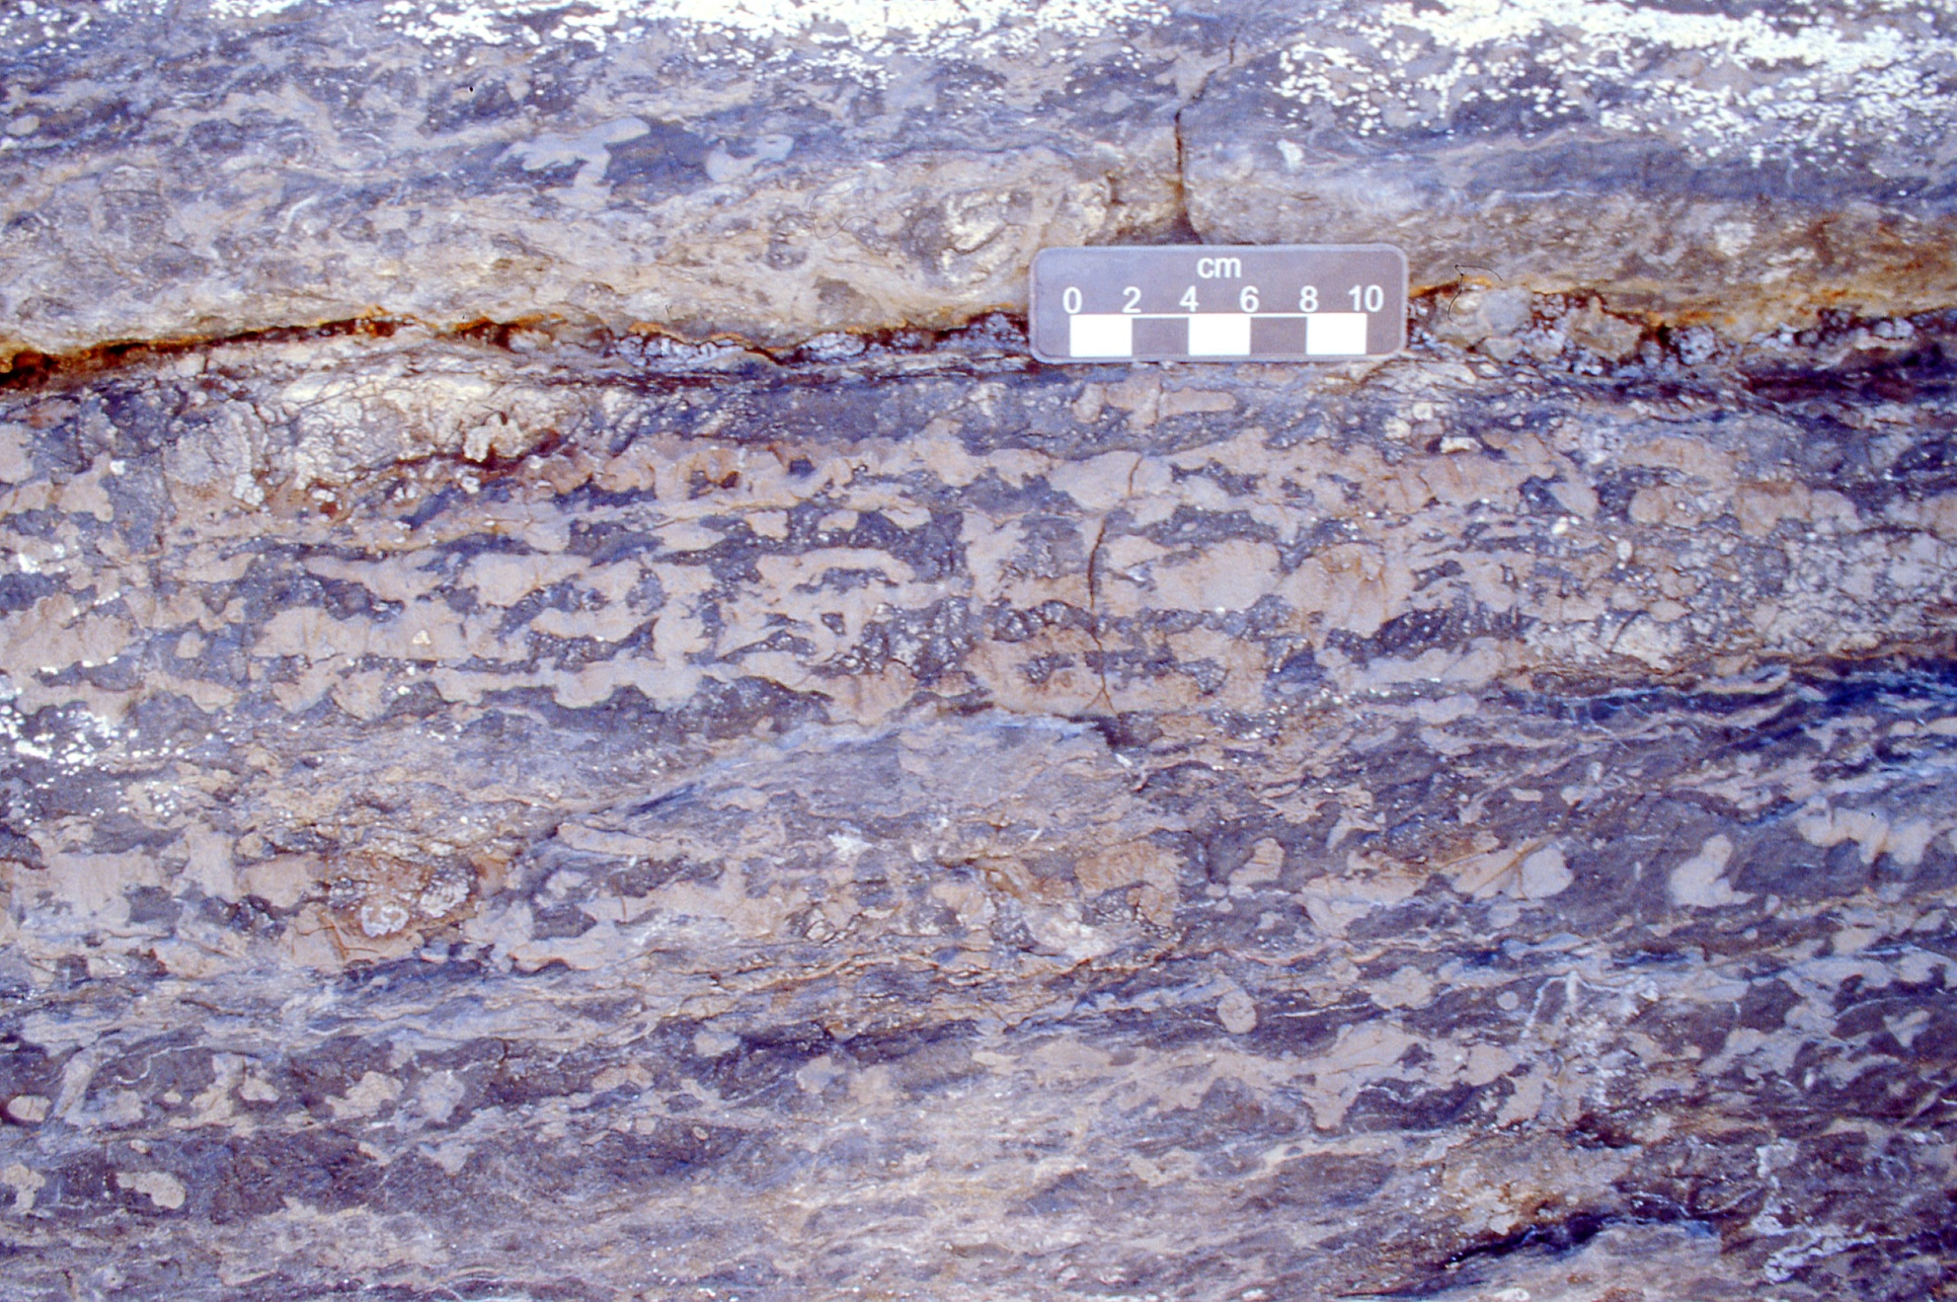
Burrow density is described by a semi-quantitative ichnofabric index score
Ichnofabric index 3 or 4 (Cambrian Poleta Fm, California)
Ichnofabric index

Slide 22
Burrow density is described by a semi-quantitative ichnofabric index score
Permian Pebbley Beach Fm, Australia
i.i.5
Ichnofabric index
i.i.2

