Slide 1
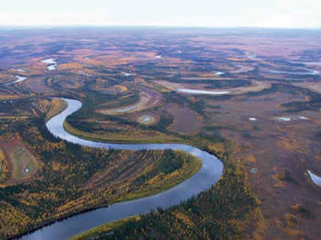
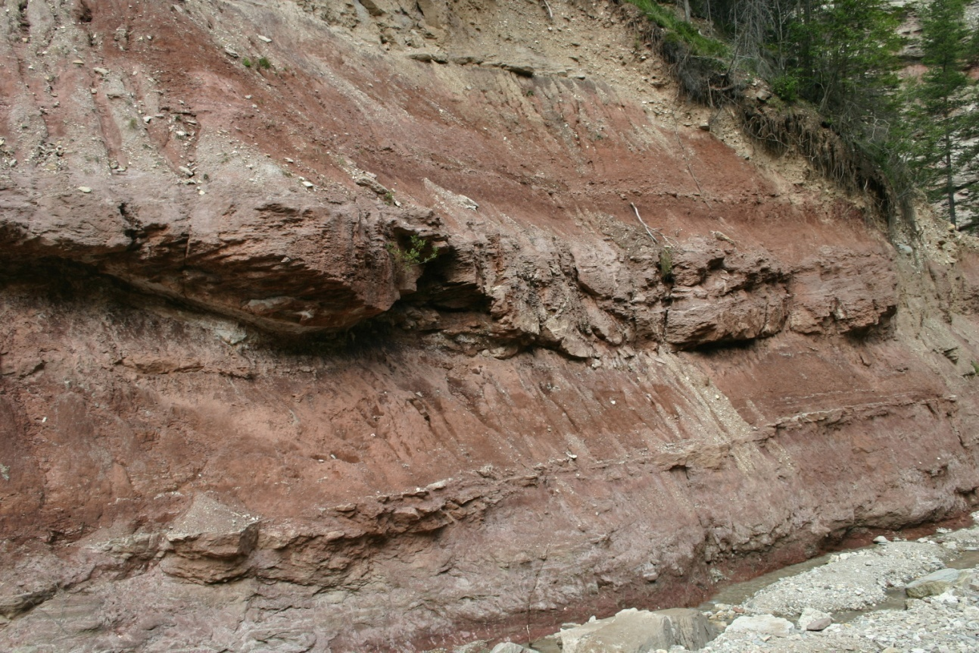
Fluvial Environments
Yukon River, Alaska
Val Gardena Sandstone (Upper Permian, Italy)

Slide 2
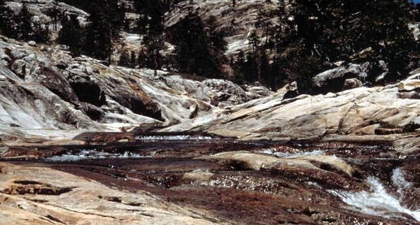
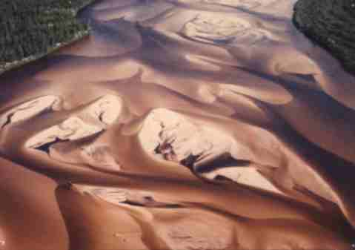
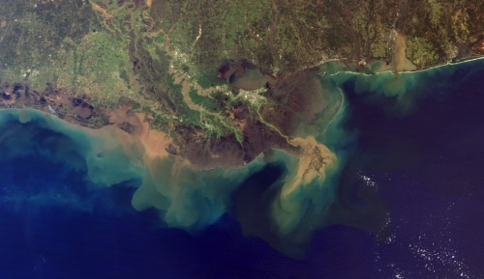
Weathering and erosion in mountain source area
Transport downstream via river systems
(Will come back to question of deposition vs. bypass vs. erosion)
Ultimate deposition of sediment in coastal marine environment

Slide 3
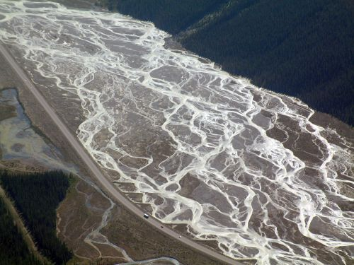
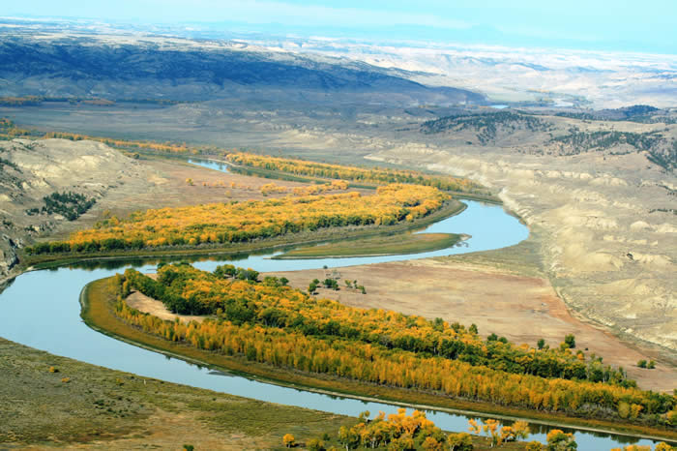
Rivers flow in flat areas called floodplains, which can be divided into channel and overbank regions
Where the channel is stable, it contains water more-or-less permanently; overbank area is dry except during flood events
Floodplain

Slide 4
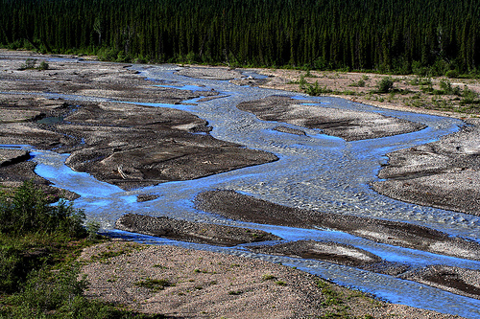
Braided rivers
Multiple, low-sinuosity channels that shift frequently
Numerous mid-channel bars
Little differentiation between channel and overbank areas
Sunwapta River, Alberta

Slide 5
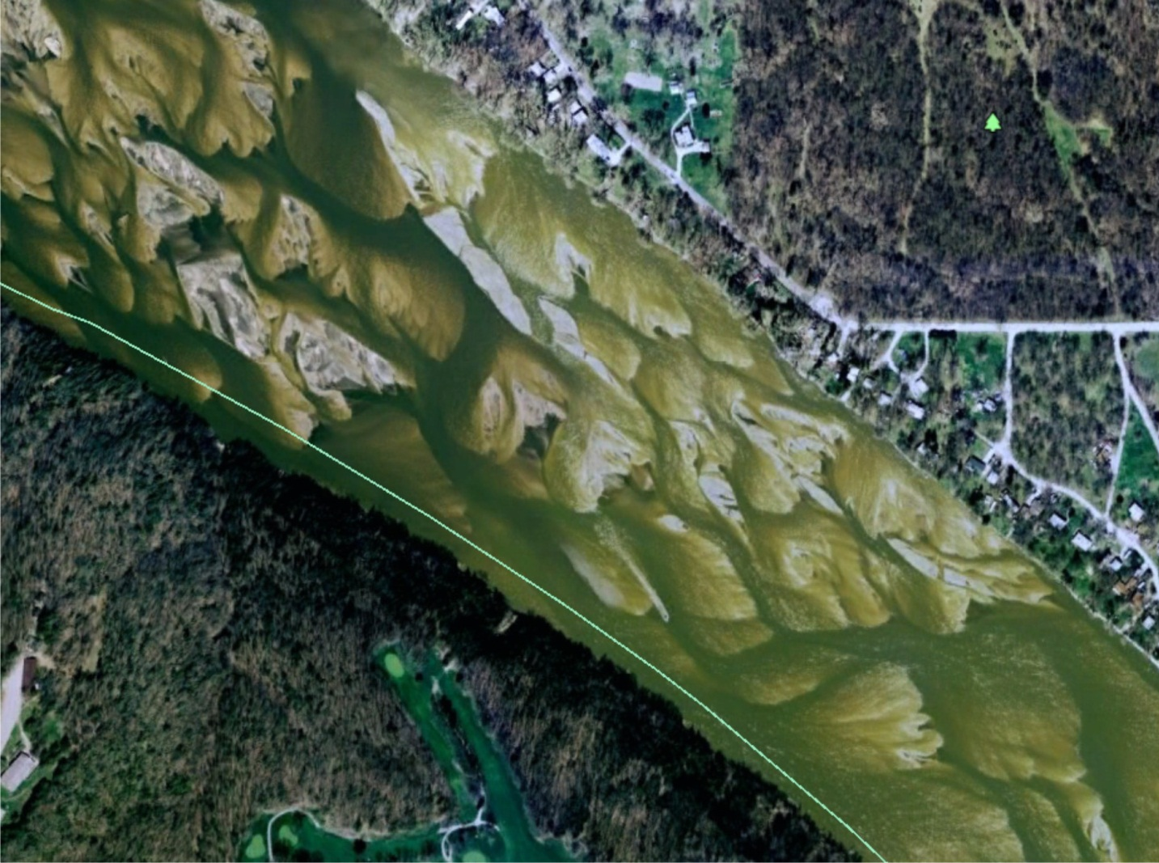
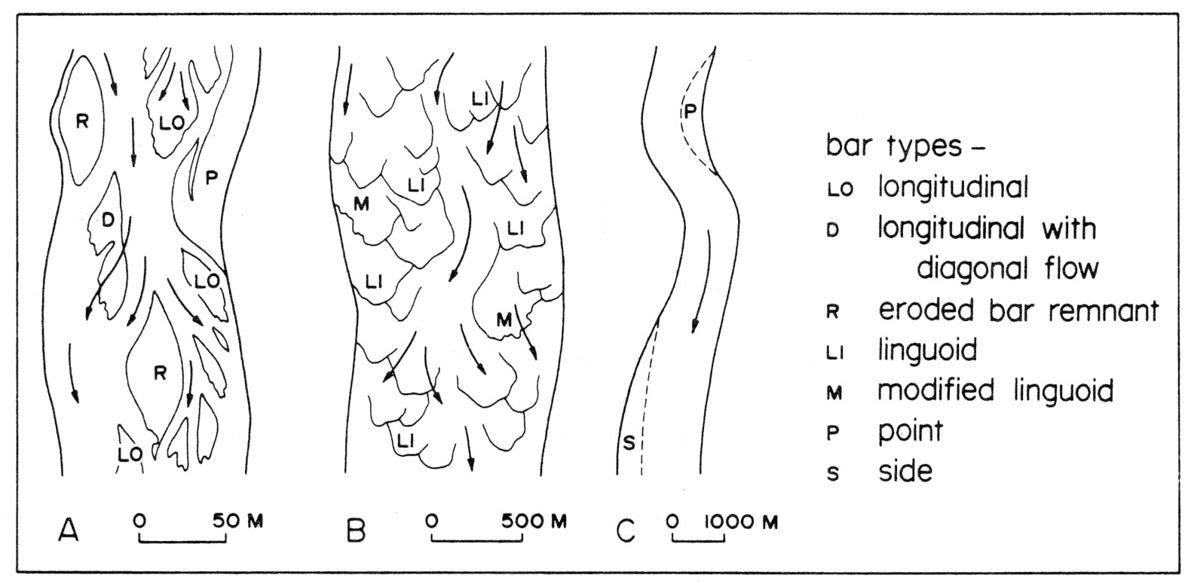
Mid-channel bars in braided systems are typically characterized by downstream accretion, where the bar migrates by adding new material to the downstream end (the upstream end erodes)

Slide 6
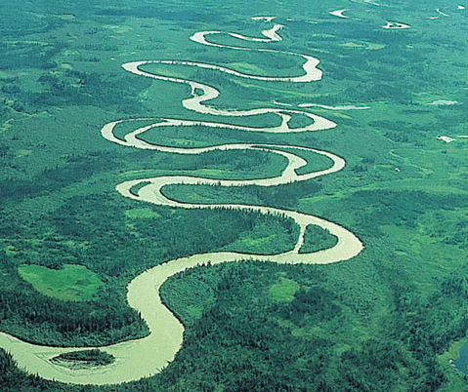
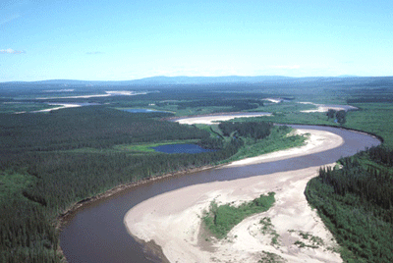
Meandering rivers
Single, often high-sinuosity channel that is fairly stable (migrates slowly)
Point bars attached to inside of bends
Channel and overbank areas clearly differentiated, separated by levee
Point bar
Williams River, Alaska

Slide 7
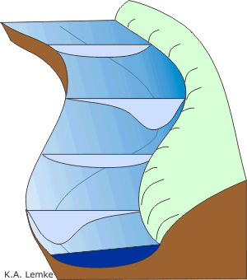
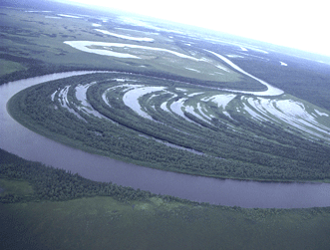
Velocity higher on outside of meander bends, causing erosion
Velocity lower on inner part of meander, causing deposition of point bars
Point bars grow by lateral accretion (perpendicular to flow direction)
Erosion
Channel migration
Deposition

Slide 8
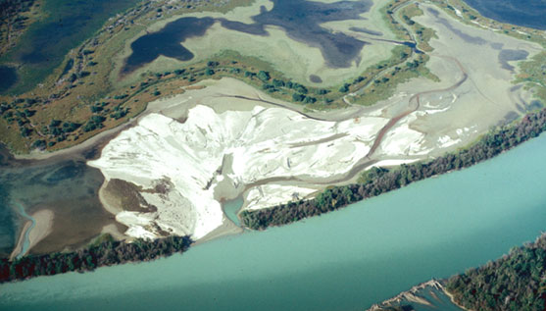
Channel and overbank regions may be separated by raised levee
If the water breaks through the levee, it will rapidly flow into overbank area, creating a deposit known as a crevasse splay deposit
Columbia River, British Columbia
Overbank
Levee
Channel

Slide 9
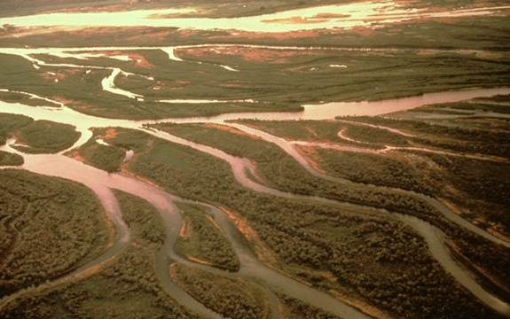
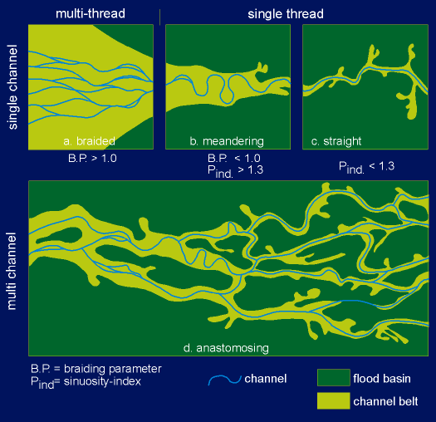
Anastomosing rivers (AKA Anabranched)
Multiple, stable channels
Permanent mid-channel islands
May have high sinuosity
In reality, all four of these channel types (including straight) are points on a continuum
Still, the channel type can have environmental significance (gradient, sediment supply, climate, vegetation, …)

Slide 10
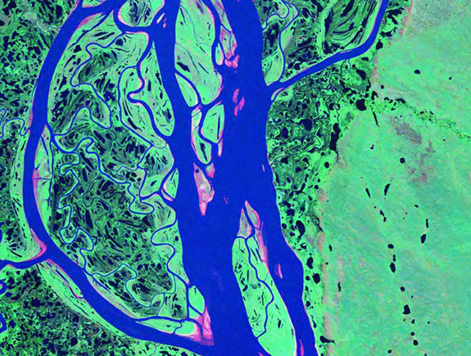
One word of caution: scale of observation possible at a typical outcrop may be tiny compared to true size of river system
If you’re lucky, you’ll probably see this…
10 miles
False-color satellite image, Mackenzie River, NWT

