Slide 1
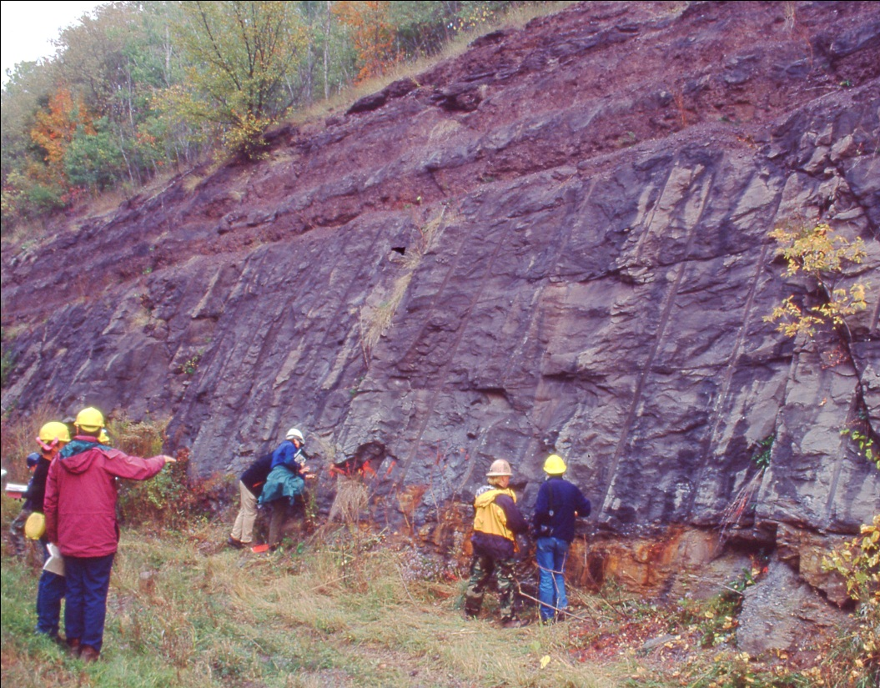
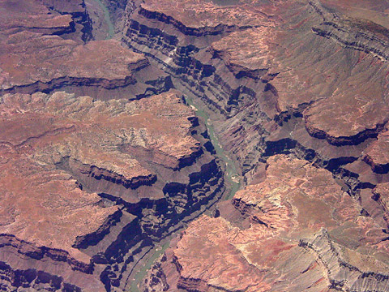
Fluvial Sequence Stratigraphy (Base Level and Accommodation)
Aggradation
Sediment is deposited
Incision
Sediment is eroded

Slide 2
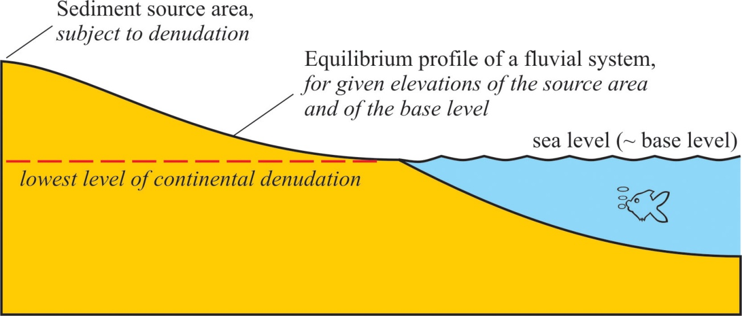
At equilibrium, river follows graded profile controlled by elevation of source area and base level (approximately sea level)
Climate (river discharge)
transport capacity vs. sediment load
Tectonism
Eustasy
Effect of eustasy decreases in upstream direction

Slide 3
Depositional Sequence: complete cycle of base level
Initial equilibrium profile
New equilibrium profile
New equilibrium profile
Base level fall
Initial equilibrium profile
Base level rise
Negative accommodation – river incises
Accommodation space – river aggrades

Slide 4
How do fluvial type, geometry, and facies differ at different parts of the base level cycle (sequence)?
Fluvial type – braided or meandering?
Channel geometry – isolated or amalgamated?
Grain size – fine or coarse?

Slide 5
Base level fall leads to negative accommodation and therefore incision

Slide 6
Early parts of base level rise?
Initial equilibrium profile
New equilibrium profile
Base level fall
At the end of base level fall, equilibrium profile is at its steepest
Coarse sediment available from erosion during incision

Slide 7
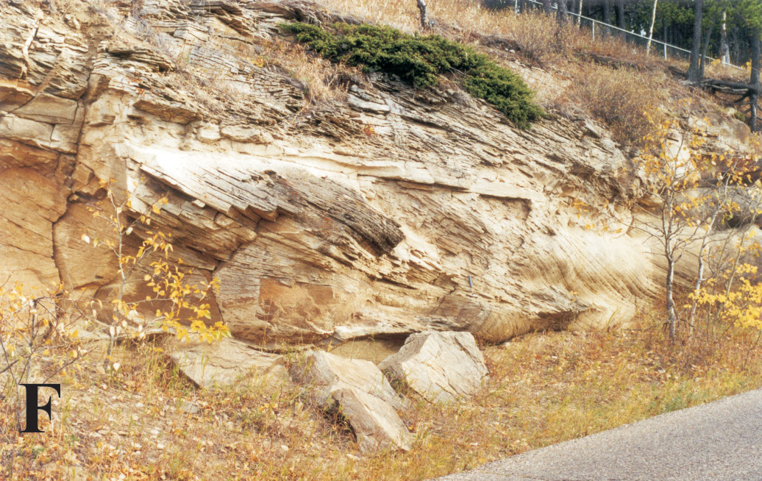
Low-Accommodation Fluvial Deposits
Dominated by higher-energy (coarser-grained) fluvial systems (often braided)

Slide 8
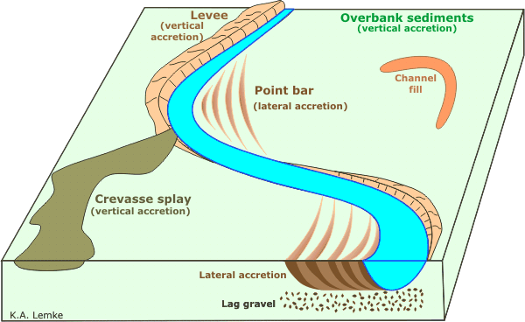
Rate of base level rise is slow
Geometry of fluvial deposits is a balance between lateral migration of channel erosion and upward aggradation of channel position

Slide 9
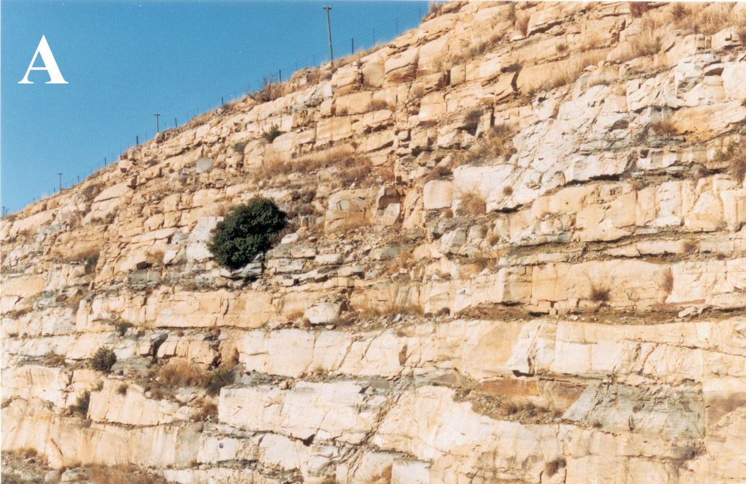
Low-Accommodation Fluvial Deposits
Dominated by amalgamated “multi-storey” channel-fill with few floodplain units

Slide 10
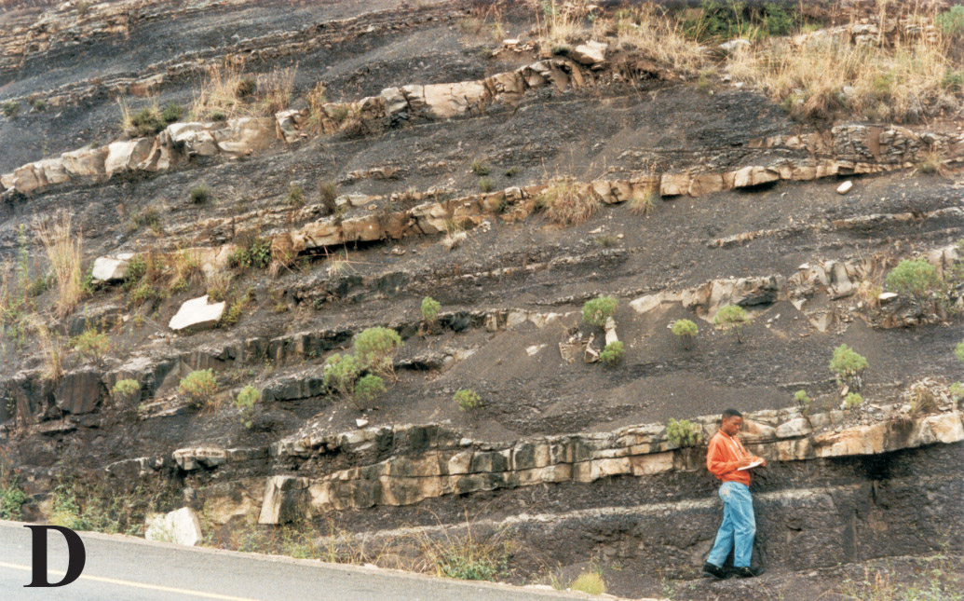
Rate of base level rise is fast
High-Accommodation Fluvial Deposits
Dominated by aggrading floodplain deposits with thin, isolated (“single storey”) channel sandstones

Slide 11
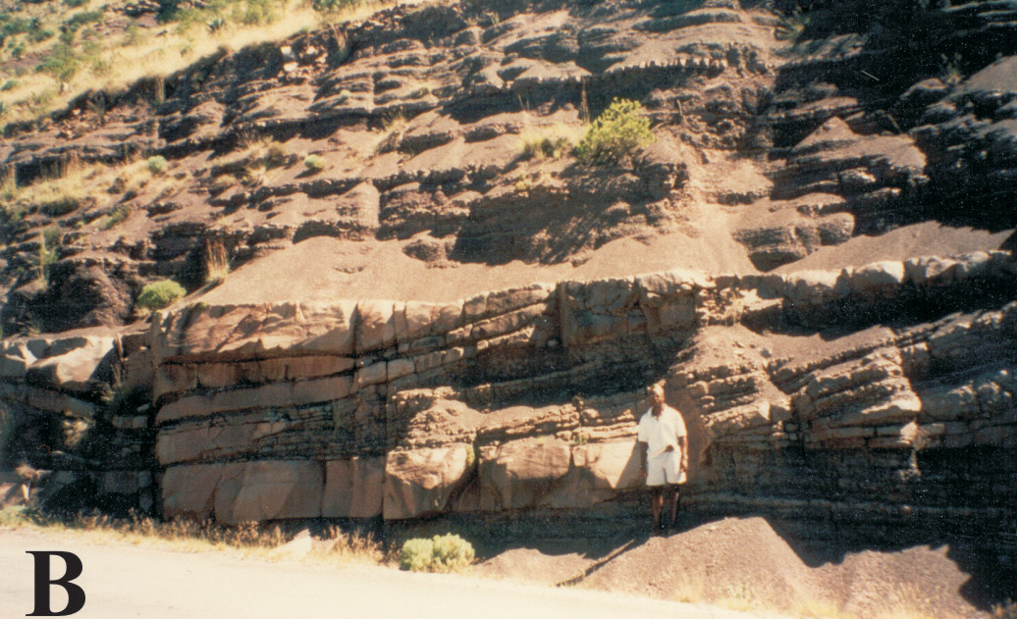
High-Accommodation Fluvial Deposits
Dominated by lower-energy fluvial systems (often meandering)
High-accommodation successions comprise most of fluvial depositional sequence

Slide 12
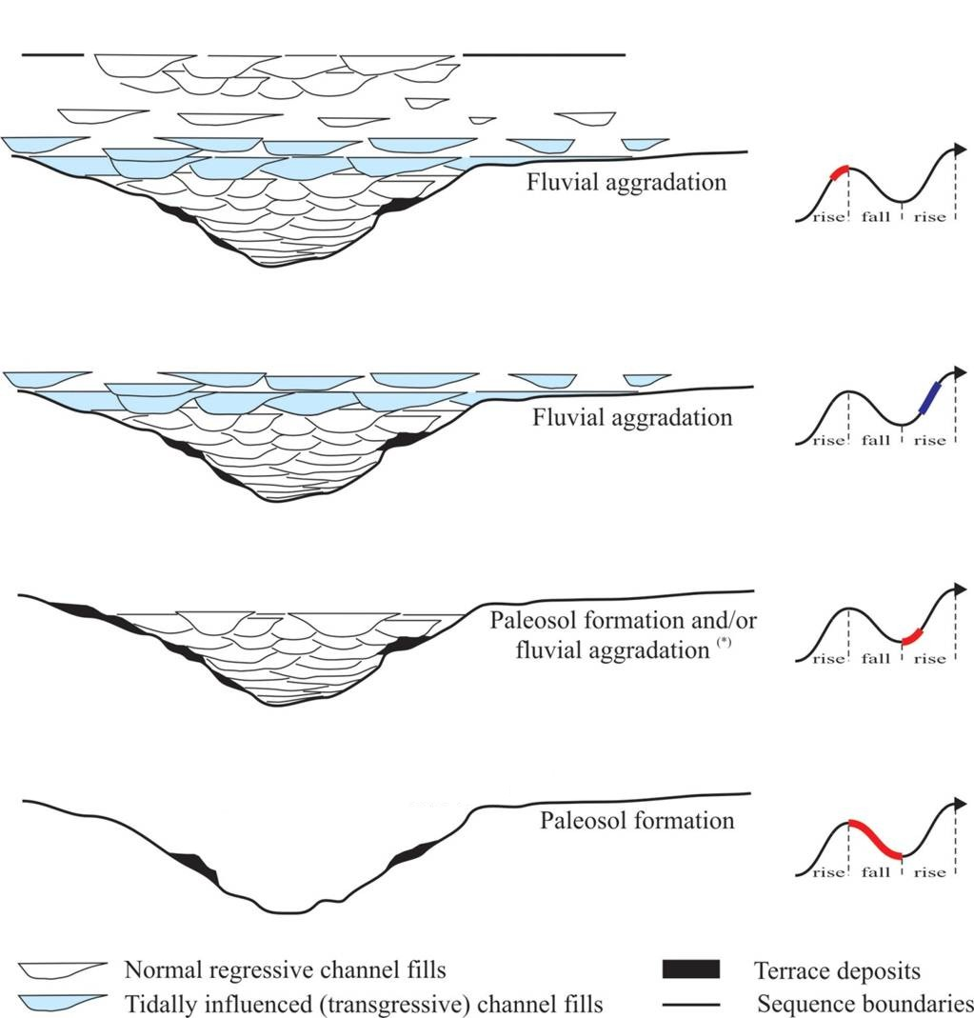
Equilibrium profile gradient
Rate of accommodation
small
large
0
low
high

