Slide 1
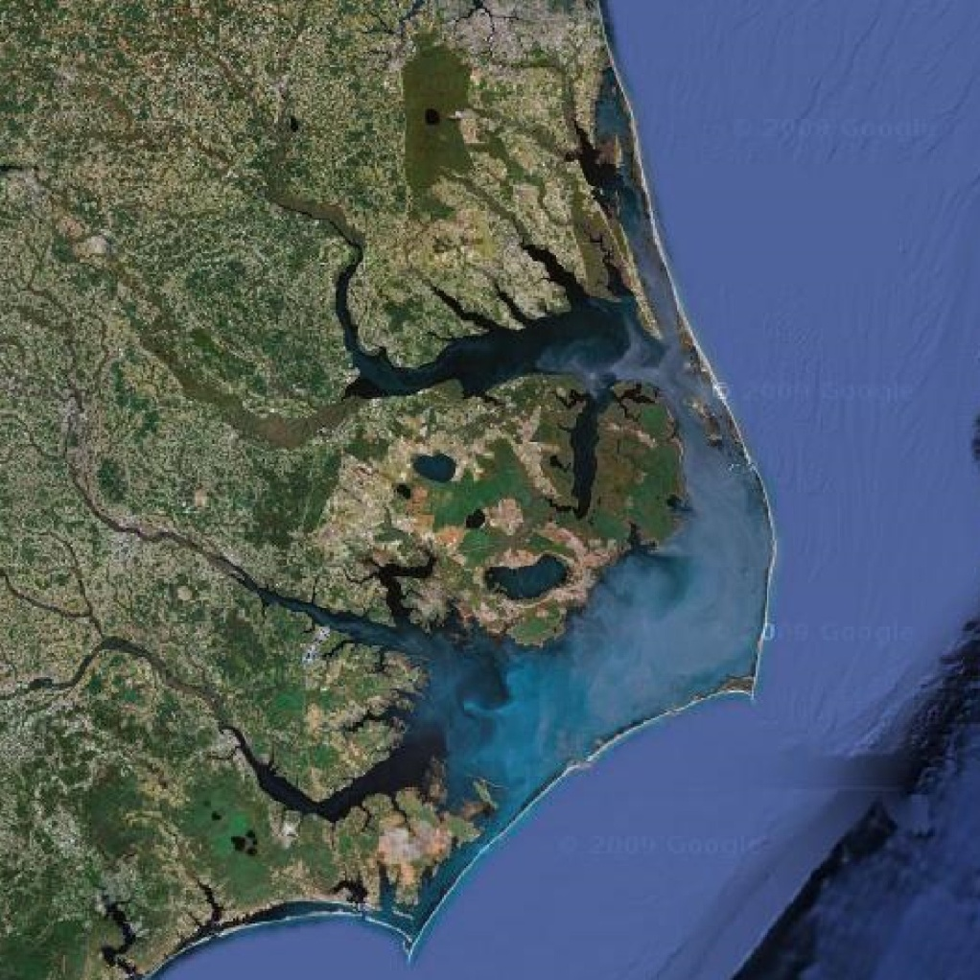
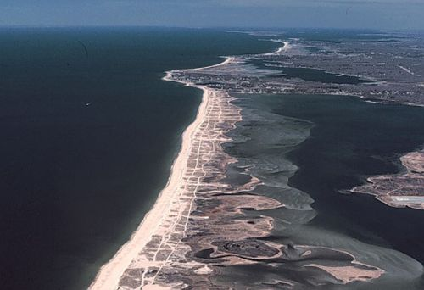
Barrier Islands
Notes:
…

Slide 2
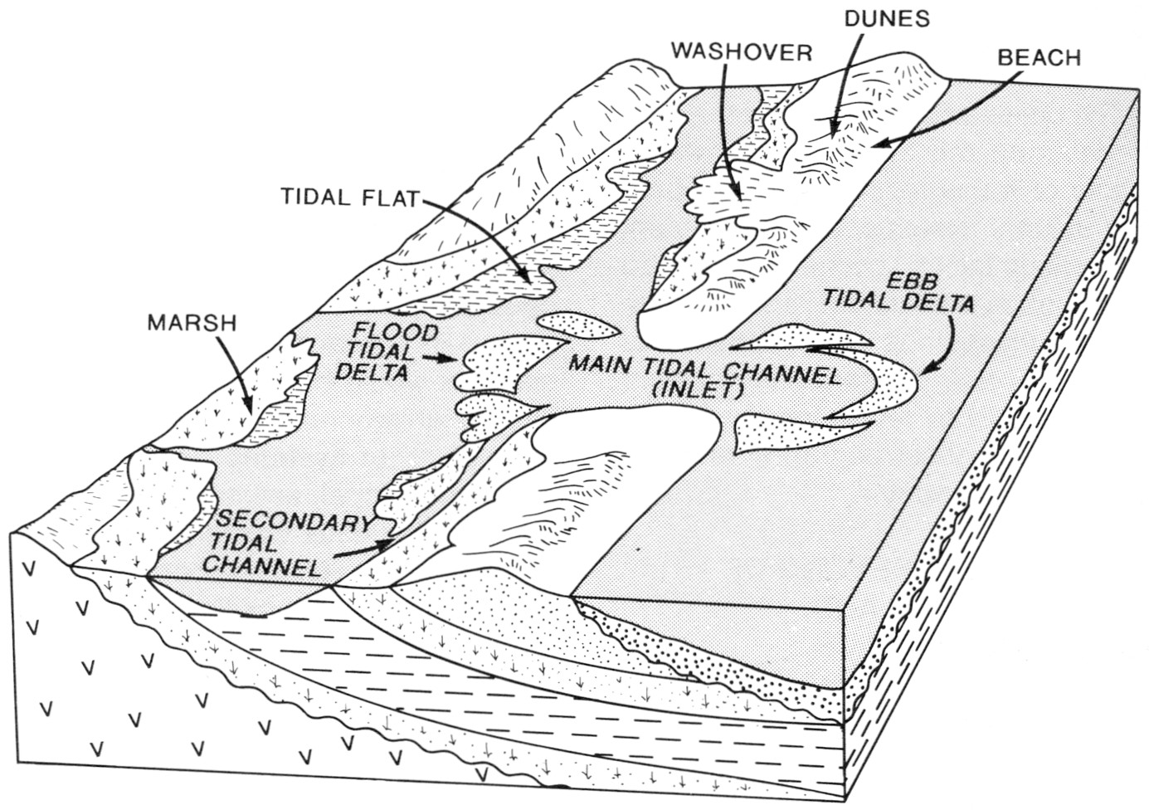
Complex sedimentary systems with a variety of subenvironments
Beach and shoreface
Lagoon and/or tidal flat
Tidal inlet and tidal deltas
Notes:
…

Slide 3
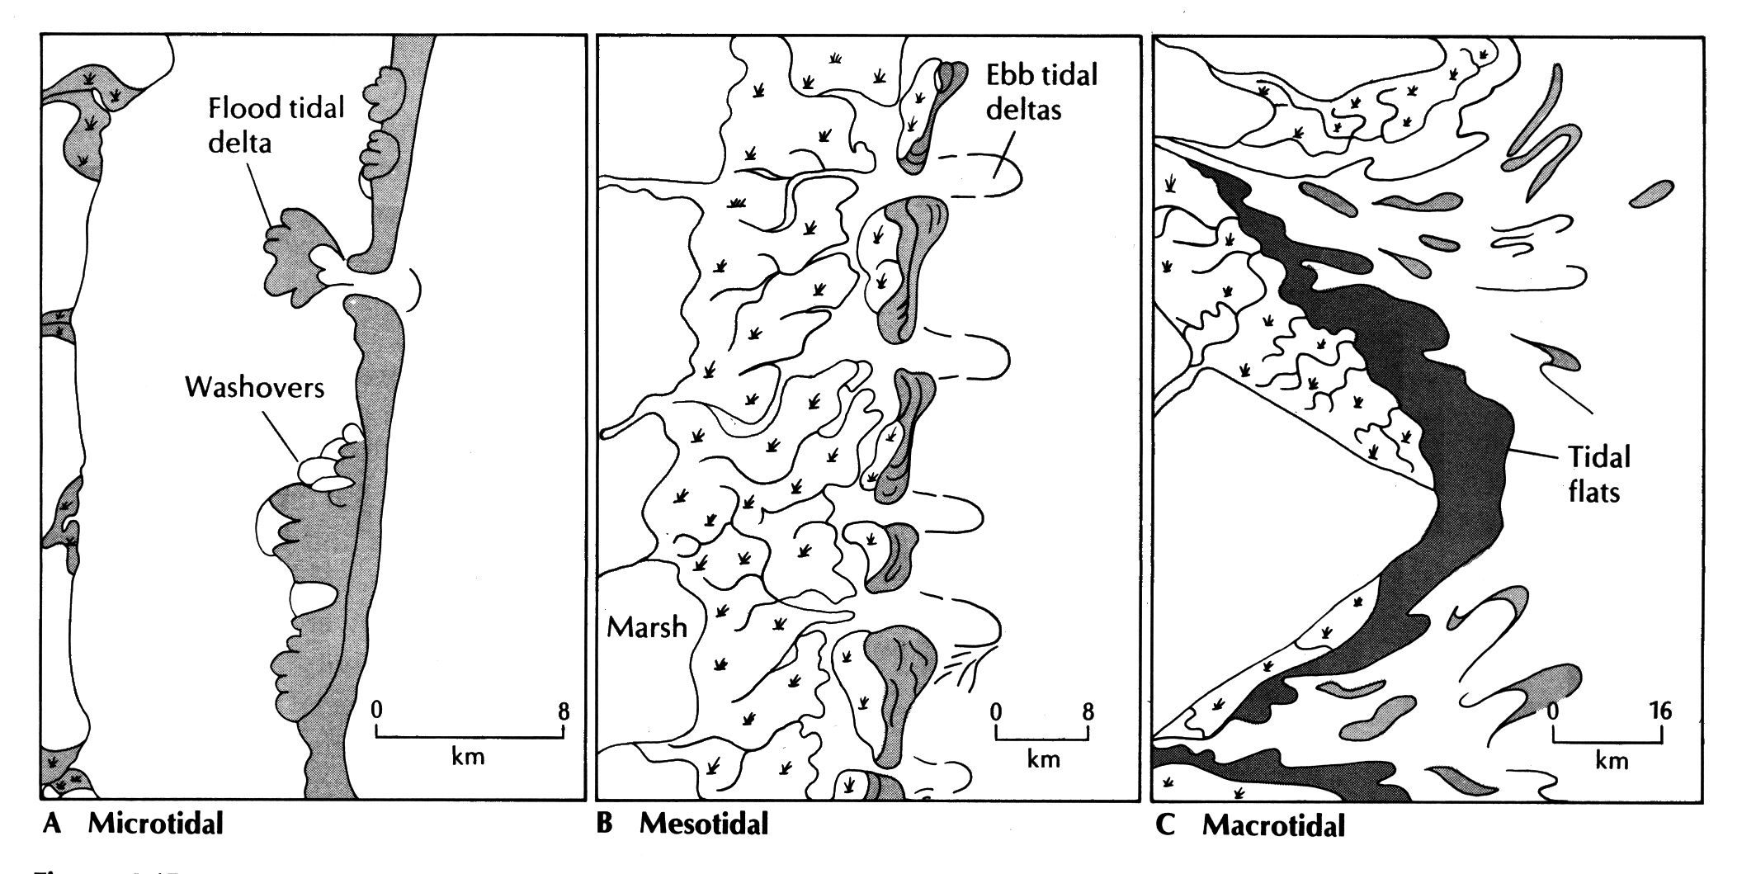
Development and morphology of barrier islands depends on coastal gradient (usually form on shallow slopes) and tidal range/wave energy
Tidal Range
<2 m
2-4 m
>4 m
Notes:
…

Slide 4
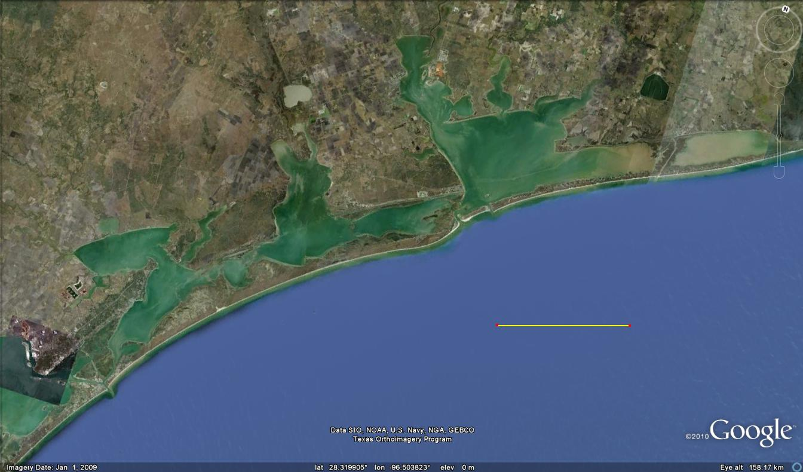
Microtidal, wave-dominated barrier islands, Texas
Back-Barrier Lagoon
Barrier Island
Tidal Inlet
30 km
Tidal Inlet
Notes:
…

Slide 5
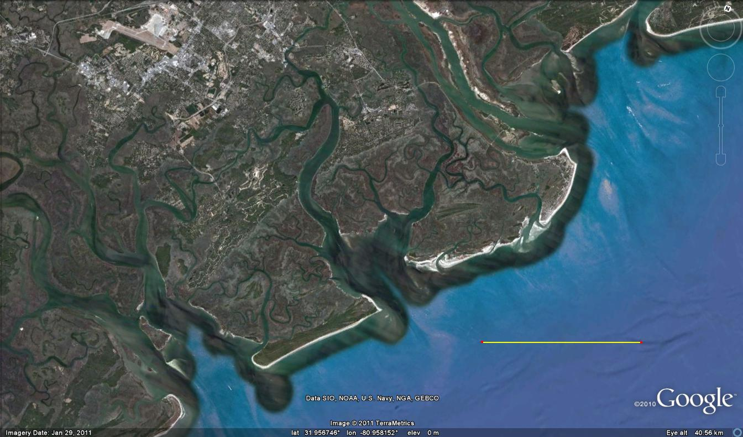
Mesotidal, tide-dominated barrier islands (Savannah, GA)
Back-Barrier Tidal Flat
Barrier Island
Barrier Island
10 km
Notes:
…

Slide 6
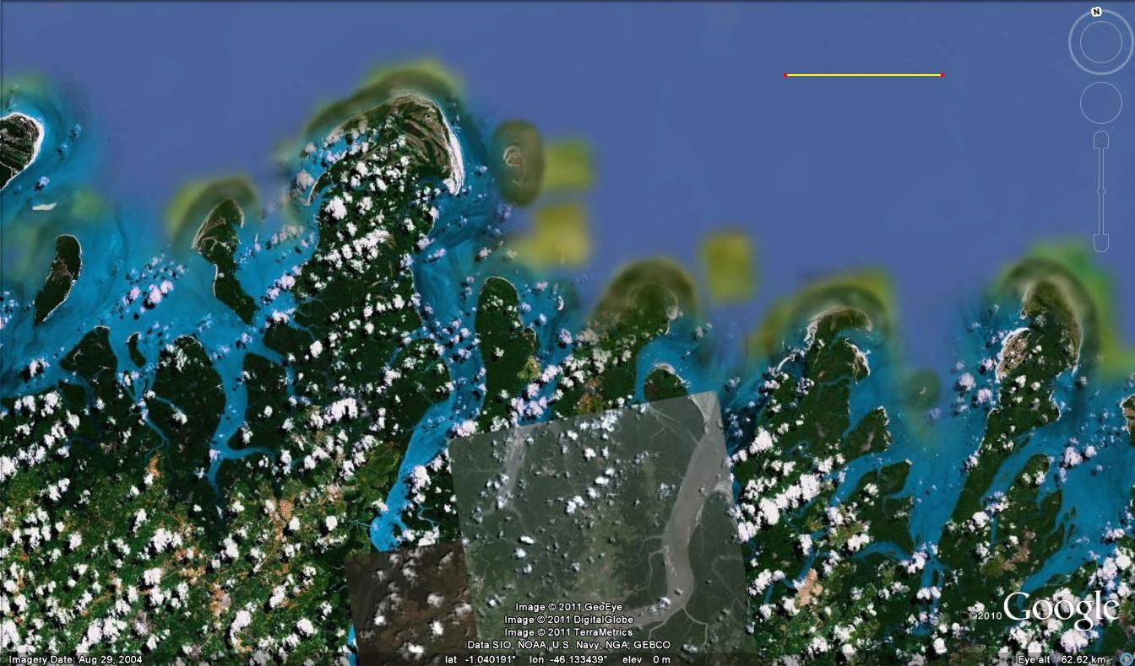
Meso- to macrotidal barrier islands (Brazil)
Barrier Island
10 km
Back-Barrier Mangrove Swamp
Notes:
…

Slide 7
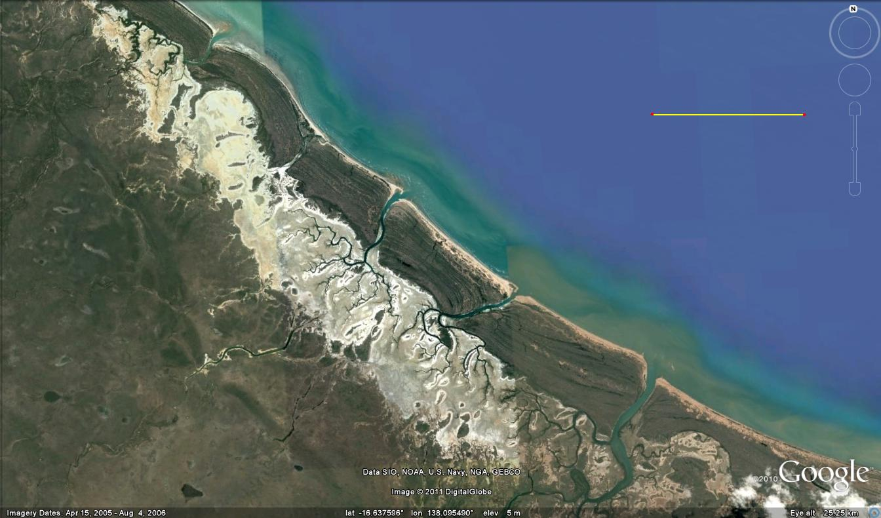
Prograding barrier islands, Gulf of Carpentaria (Australia)
5 km
Prograding Barrier Island
Arid Back-Barrier Tidal Flat
Notes:
…

Slide 8
Microtidal barriers are rarely overtopped by high tides, so tidal channels rare; dominance by wave processes (washover lobes and flood tidal deltas) instead
Tidal Range
<2 m
2-4 m
>4 m
Notes:
…

Slide 9
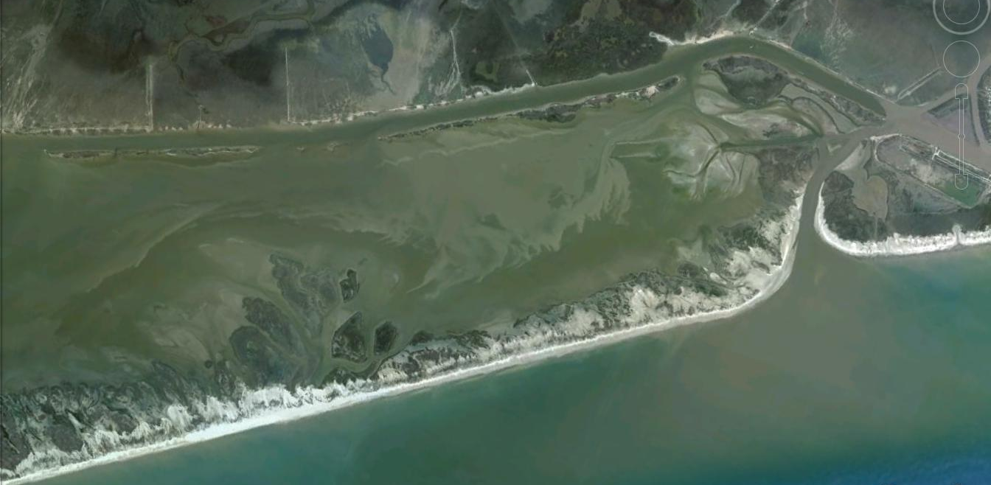
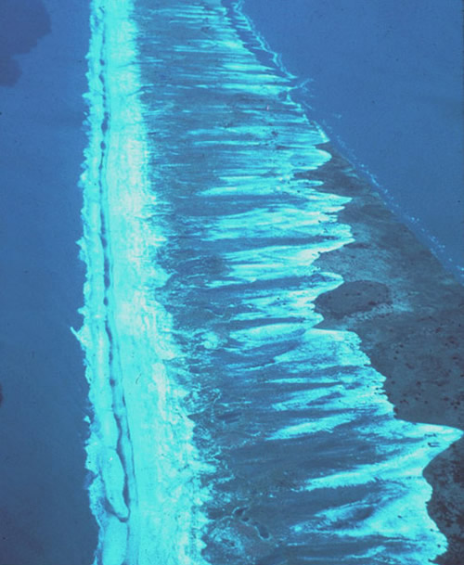
Washover fans are common constituents of microtidal, storm-influenced barriers
Form by storm surge deposition of sand in the back-barrier or lagoon
Notes:
…

Slide 10
Mesotidal barriers are more frequently overtopped by high tides; have more numerous tidal inlets and dominance by tidal currents
Tidal Range
<2 m
2-4 m
>4 m
Notes:
…

Slide 11
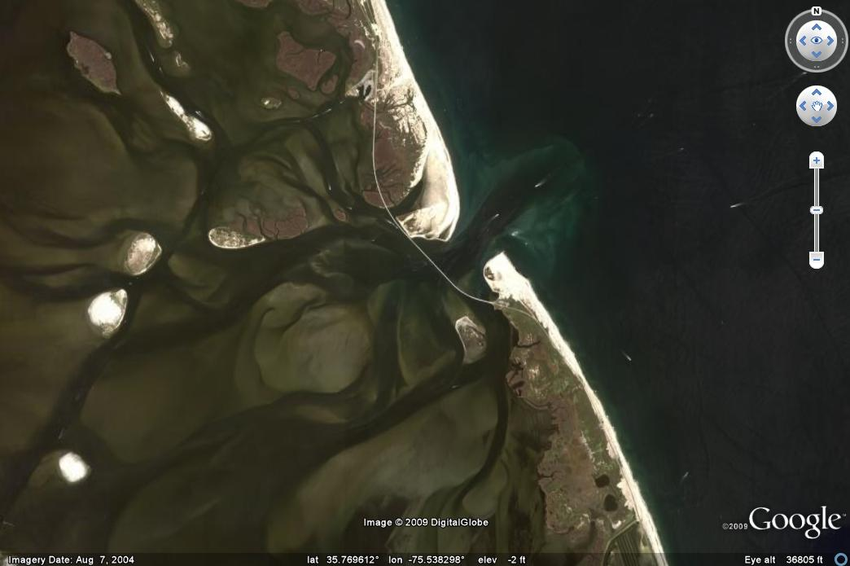
Tidal deltas and inlet are present in all barrier islands but more numerous (and more important in rock record) as tidal range increases
Ebb tidal delta
Flood tidal delta
Migrating tidal inlet

Slide 12
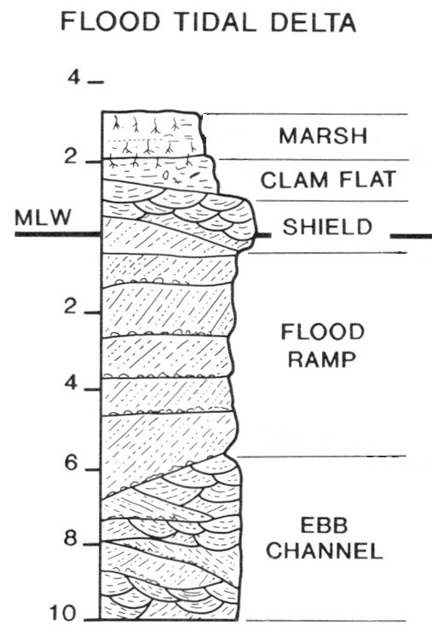
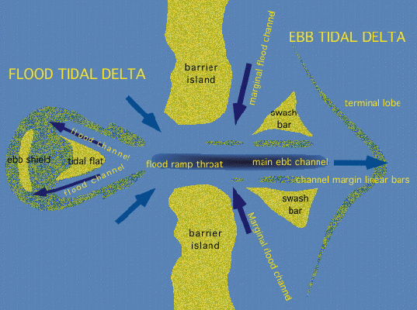
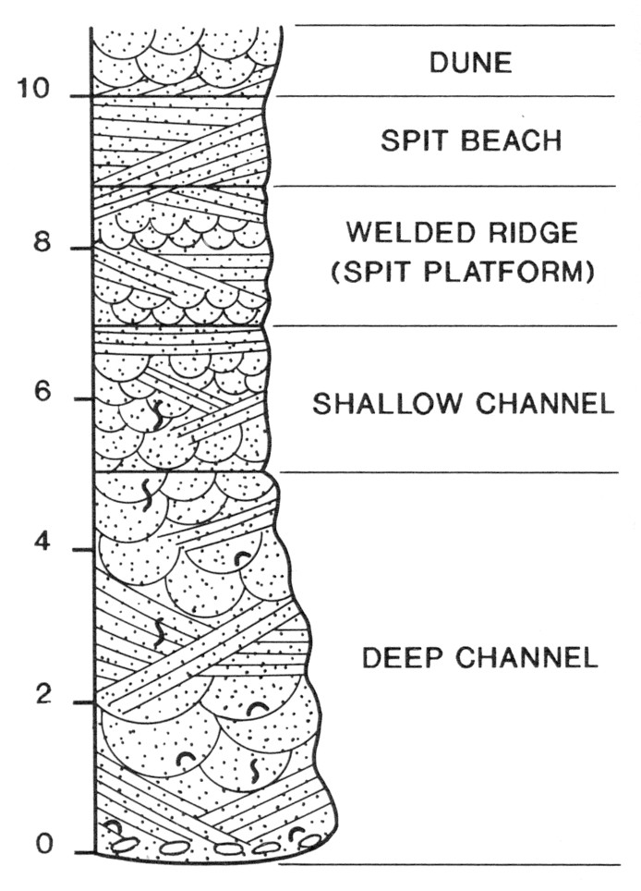
Tidal inlet
Tidal inlet
Incoming (flood) current fastest on margins
Outgoing (ebb) current fastest in channel base

Slide 13
Rapid lateral migration due to erosion and longshore sediment drift
Deep channels, slow lateral migration

Slide 14
Tidal inlet ravinement may erode flood tidal delta and lagoon sediments
In retrograding barrier islands, shoreface wave ravinement surface typically removes beach and dune facies
Notes:
…

Slide 15
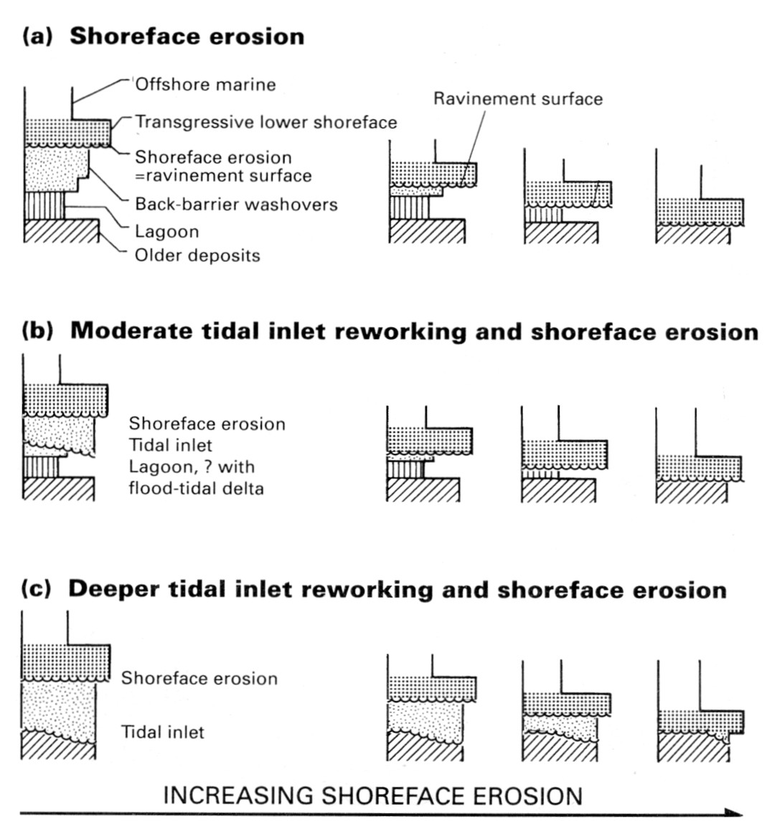
A ravinement surface can be a sequence stratigraphic surface (Transgressive Ravinement Surface) if it separates systems tracts
Ravinement surfaces can occur within systems tracts (TST below, TST above) and are called “within-trend” wave or tidal ravinement surfaces

