Slide 1
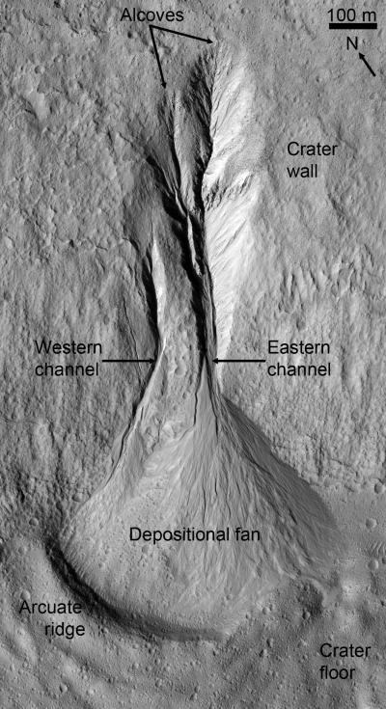
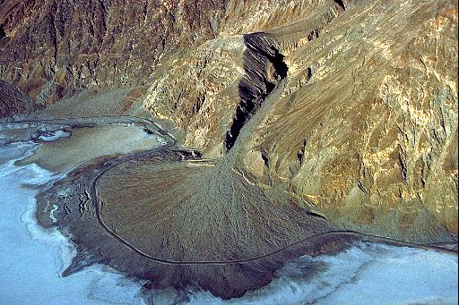
Alluvial Fan Environments
Mars
Badwater Fan, Death Valley

Slide 2
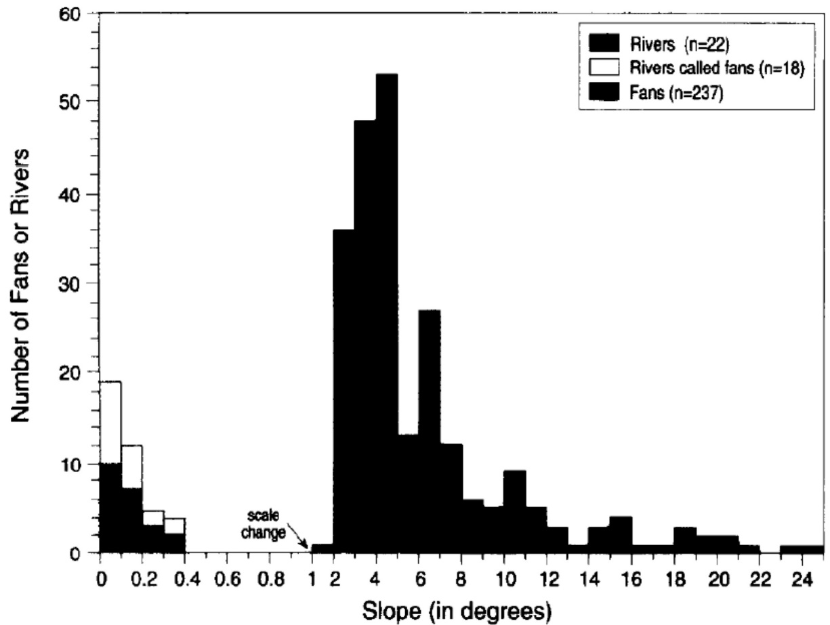
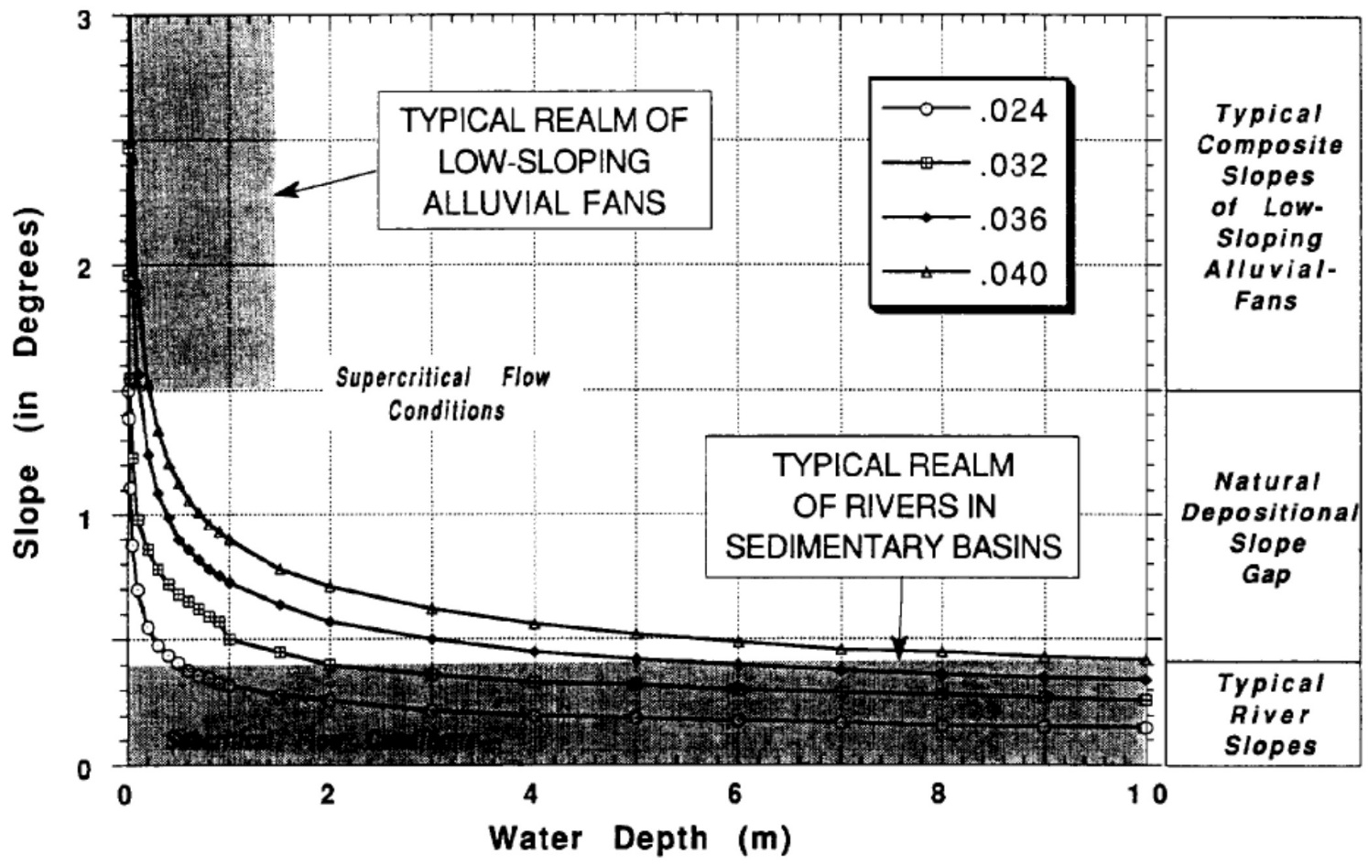
Alluvial fans vs. rivers
Distinct break in gradient separates fans (steeper) from rivers (shallower)
Alluvial fans characterized by different hydrodynamic processes and resulting facies than rivers
Water flow nearly always supercritical on fans
Supercritical flow
Subcritical

Slide 3
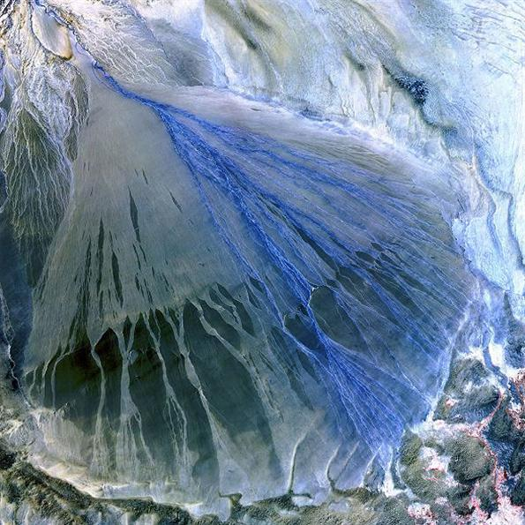
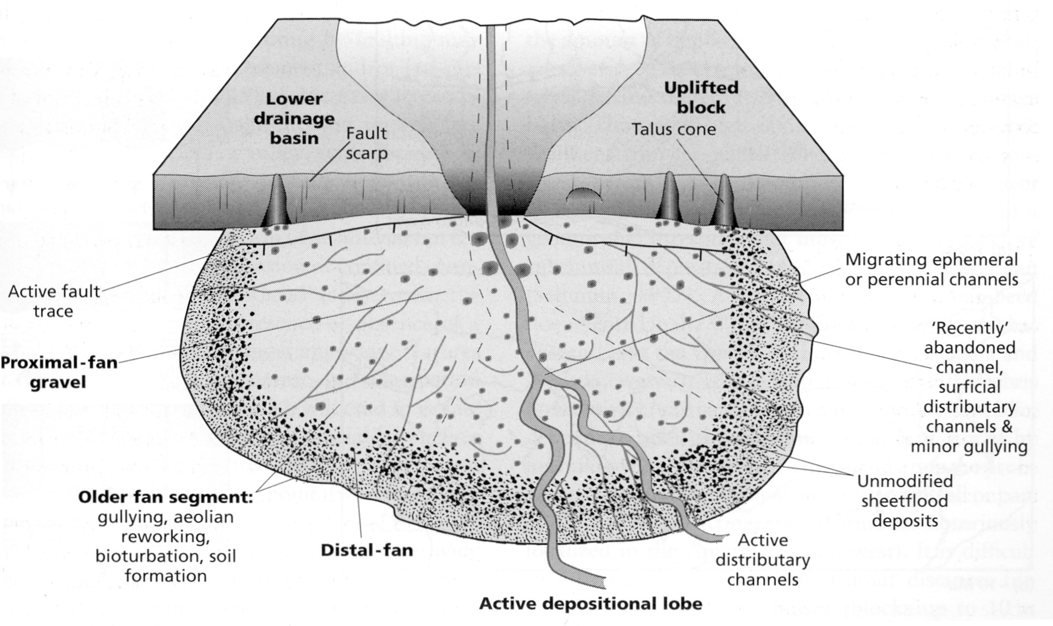
Alluvial fan sediments
Some alluvial fans, especially larger low-gradient fans, are dominated by deposits from hyperconcentrated flows and from sheetflow

Slide 4
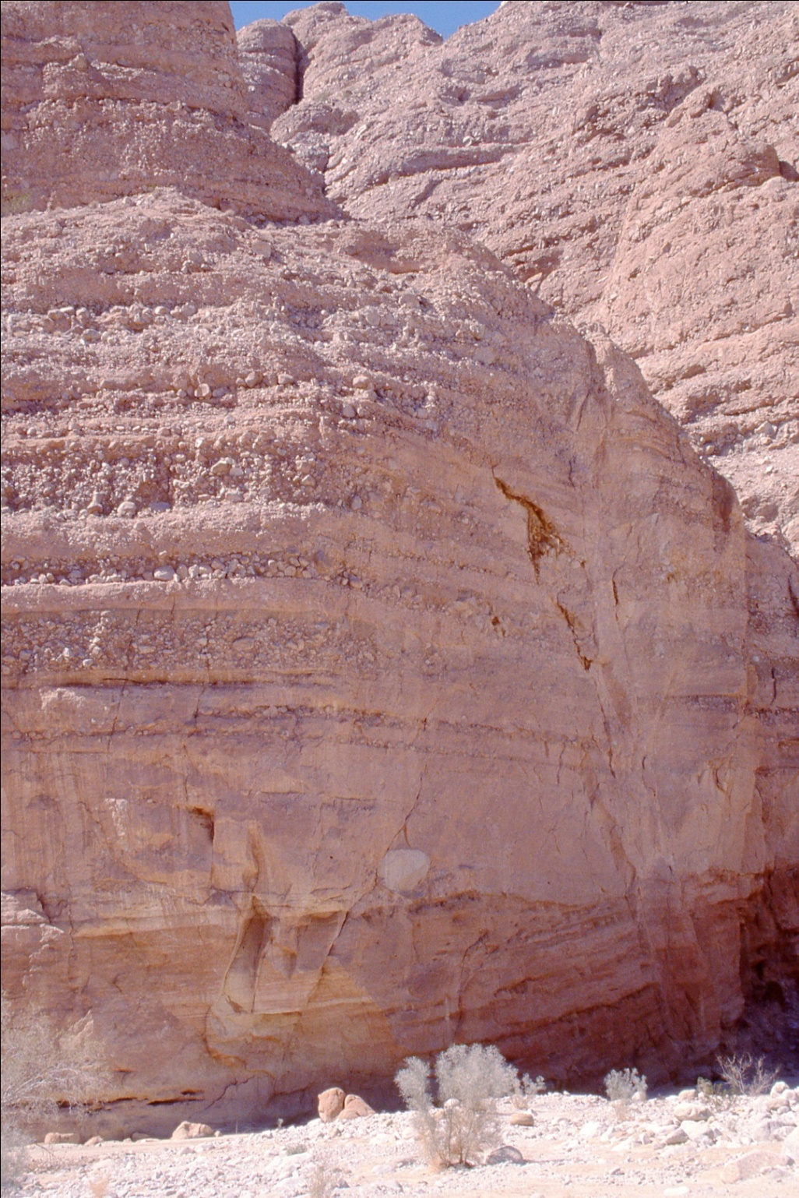
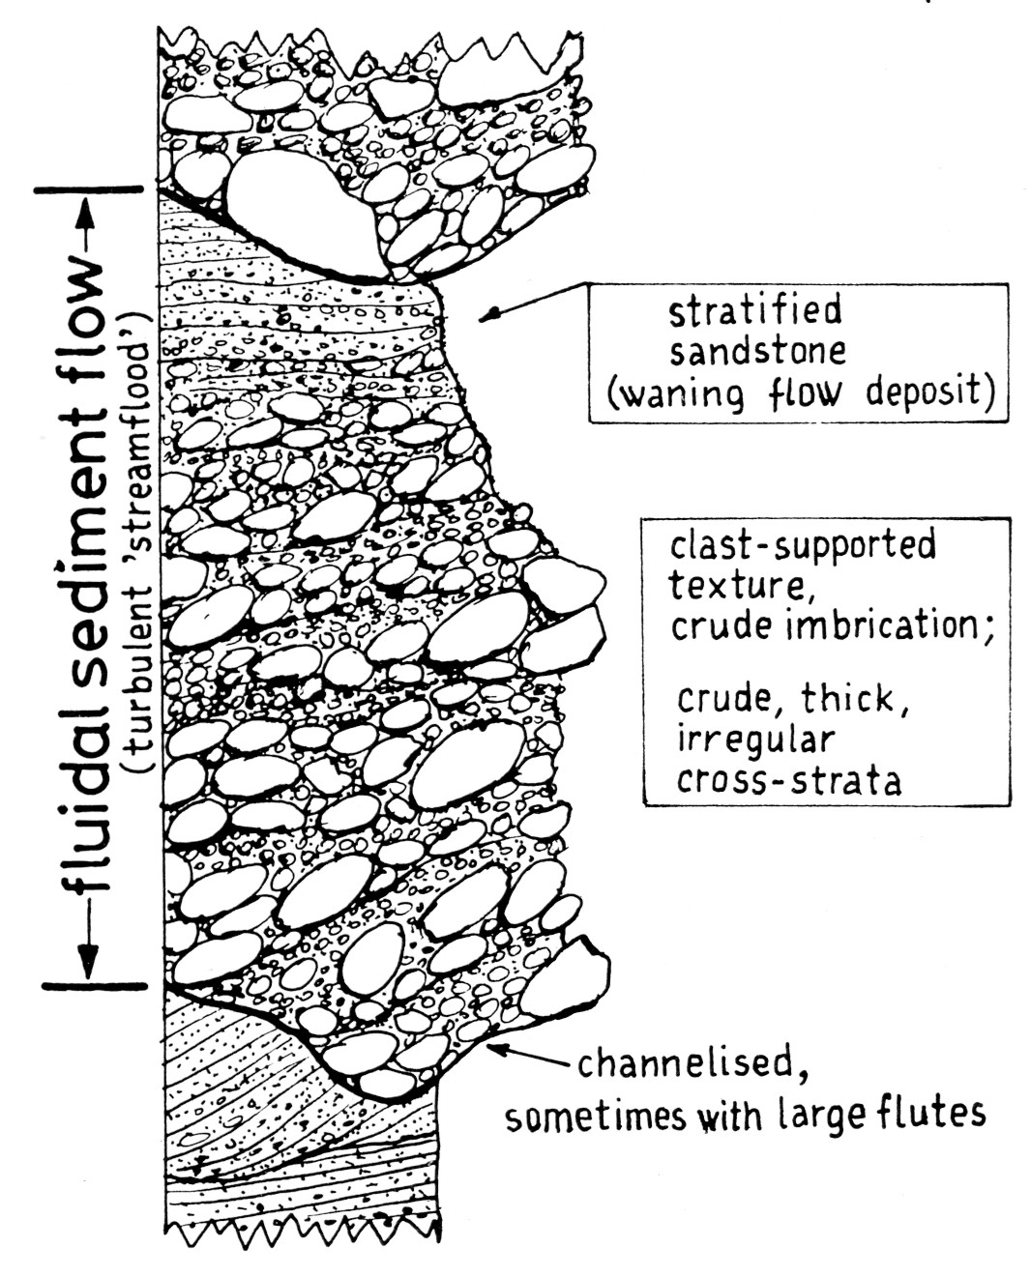
Hyperconcentrated flow
Miocene sheetflood deposits, Fish Canyon, California
Differs from braided fluvial system by lack of downstream accretion elements and bar forms
Usually clast-supported, imbricated
Crude normal grading from unhindered settling of grains in turbulent flow
Turbulence creates erosive base

Slide 5
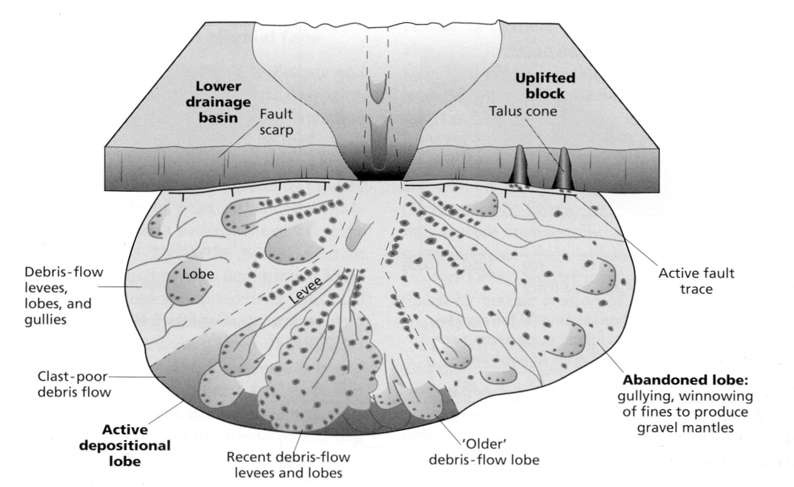
Alluvial fan sediments
Smaller alluvial fans with higher relief tend to be dominated by deposition from debris flows
Active depositional lobe occasionally shifts laterally to produce fan-shaped cone of sediment
Notes:
Debris flow is concentrated mixture of water, fine sediment (and usually coarse sediment)

Slide 6
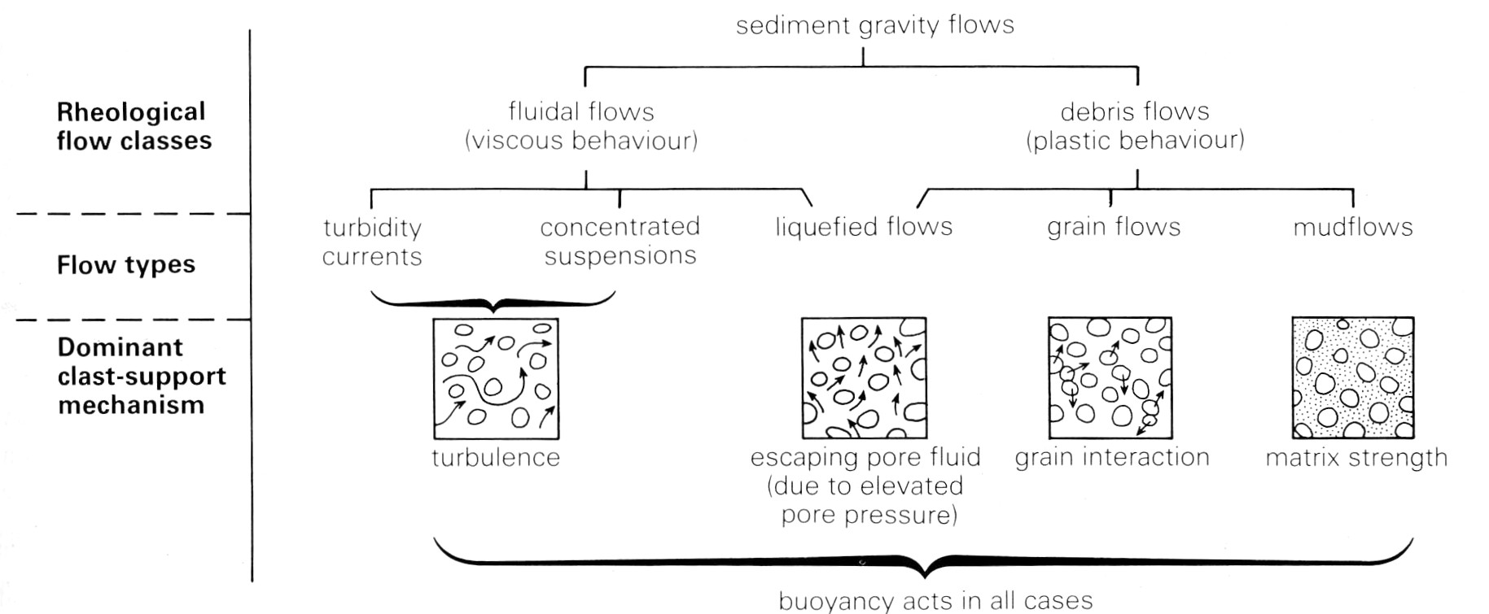
Debris flows are a type of sediment gravity flow (a mixture of water and sediment particles transported by gravity without help from moving ambient water)
Sediment gravity flows classified on basis of (1) rheology and (2) sediment-support mechanism

Slide 7
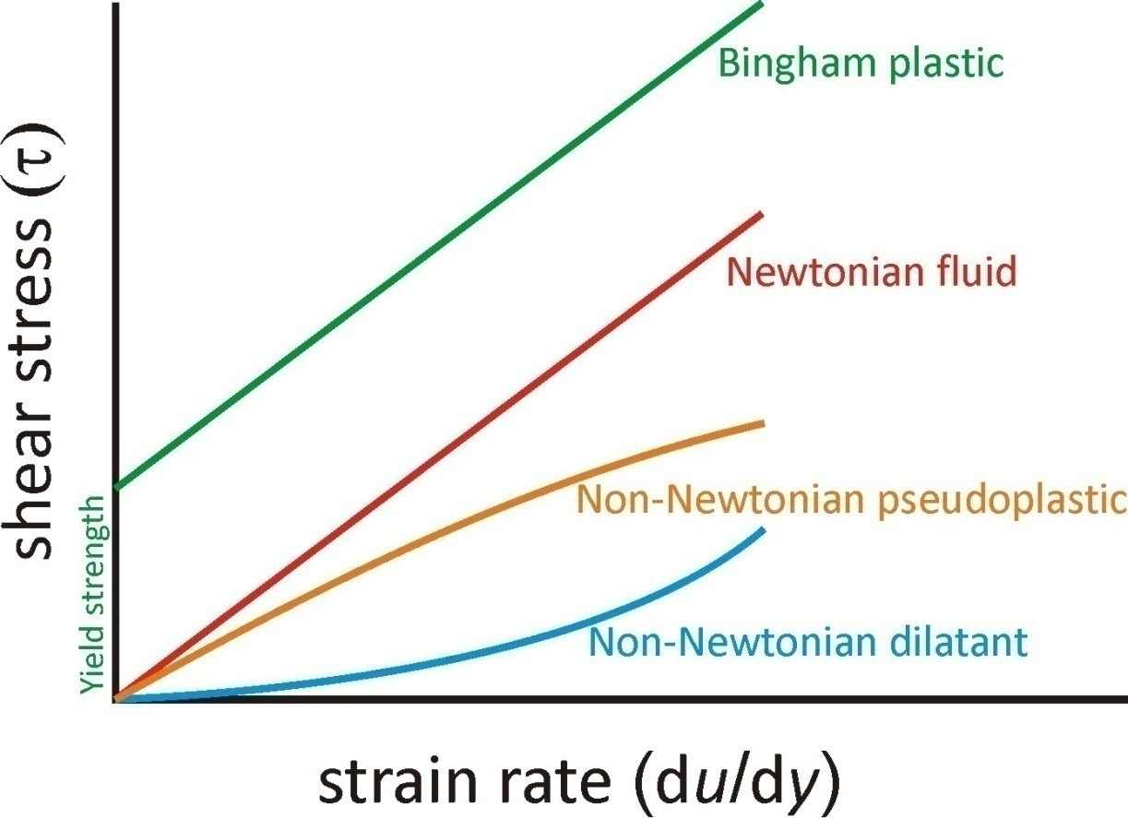
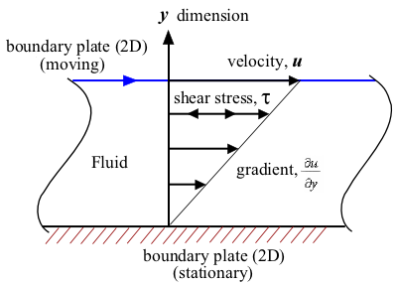
Flow rheology
Rheology describes the deformation of a fluid under a given shear stress
For a Newtonian fluid like water,
τ = μ δu/δy
Where μ is the fluid viscosity
Notes:
Yield strength a function of cohesion (usually from fine-grained clays in matrix) and normal weight stress

Slide 8
Flow rheology
Debris flows have a plastic rheology, with a yield strength
Yield strength means that the flow will not move or deform until a certain stress has been applied
Viscosity μ also constant for debris flow of given composition
τ = k + μ δu/δy
Notes:
Yield strength a function of cohesion (usually from fine-grained clays in matrix) and normal weight stress

Slide 9
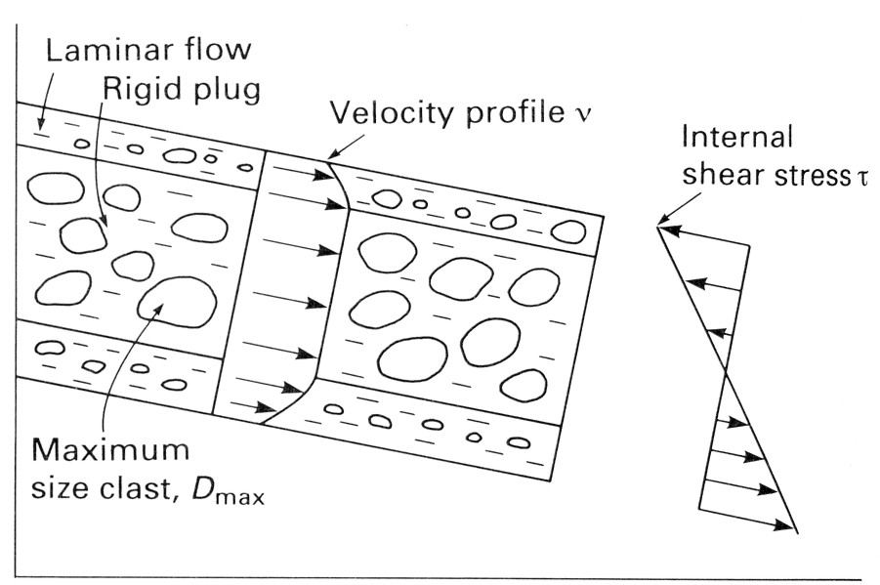
Shear stress < yield strength causes central part of flow to move as solid plug
Friction from interaction of moving flow with the ground (and air) creates shear stress at base and top of flow
Laminar flow (due to high viscosity) where shear stress > yield strength
When driving force from gravity is too low (i.e. slope too gentle), shear stress drops below yield strength and flow “freezes” in place
Notes:
High sediment concentration raises viscosity to point where viscous forces dominate over inertial even at high flow velocity
Rarely get laminar flow at top because viscosity contrast between air and flow too great and flow speed too small

Slide 10
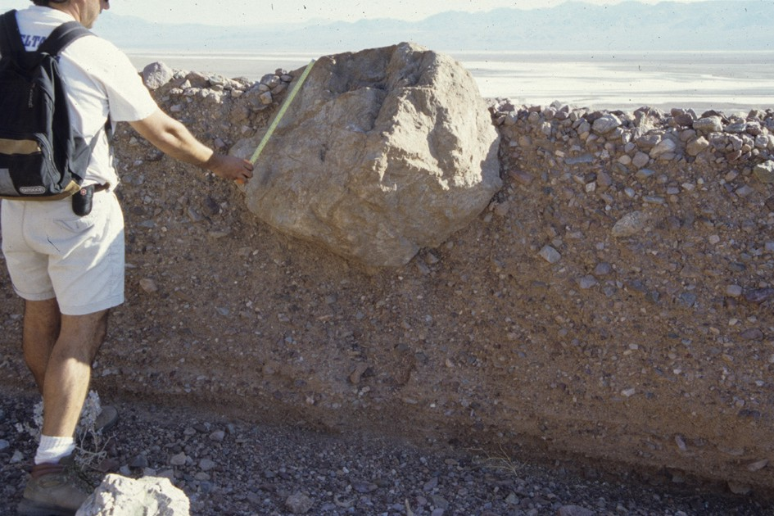
Sediment-support mechanism
How can debris flows carry such large boulders?
What forces act on boulder in debris flow?
k
D, ρ_{s}
ρ_{m}
Gravity: 4/3 π D³ ρ_{s} g
Buoyancy: 4/3 π D³ ρ_{m} g
Matrix Strength: Z k π D²
Notes:
Can we use Stokes’ law?
Strength term derived from plasticity theory. It is analogous to fluid resistance in the case of a Newtonian fluid like water – the force that must be applied to cause shear deformation of fluid

Slide 11
Gravity: 4/3 π D³ ρ_{s} g
Matrix density (ρ_{m}) can be high (as much as 2 g/cm³, compared to 2.7-3.0 g/cm³ for rocks) due to the high sediment concentration
k
D, ρ_{s}
Buoyancy: 4/3 π D³ ρ_{m} g
ρ_{m}
Matrix Strength: Z k π D²
Additional buoyancy contribution in sediment-rich mixtures:
Upward force on particles
Weight of overlying sediment+water
Pressure gradient
Notes:
Buoyancy is effectively the result of a pressure gradient

Slide 12
Gravity: 4/3 π D³ ρ_{s} g
k
D, ρ_{s}
Buoyancy: 4/3 π D³ ρ_{m} g
ρ_{m}
Matrix Strength: Z k π D²
Debris flows can have high yield strength k – even large boulders do not exert sufficient shear stress on fluid to overcome k
What gives a debris flow matrix strength?
Clay minerals form network by electrostatic or atomic forces
Matrix strength a function of clay content (possible at only 2-4% clay)
Notes:
Network formed from flocculation. Strength also a function of clay-mineral type, type of cations, temperature, perhaps others.

Slide 13
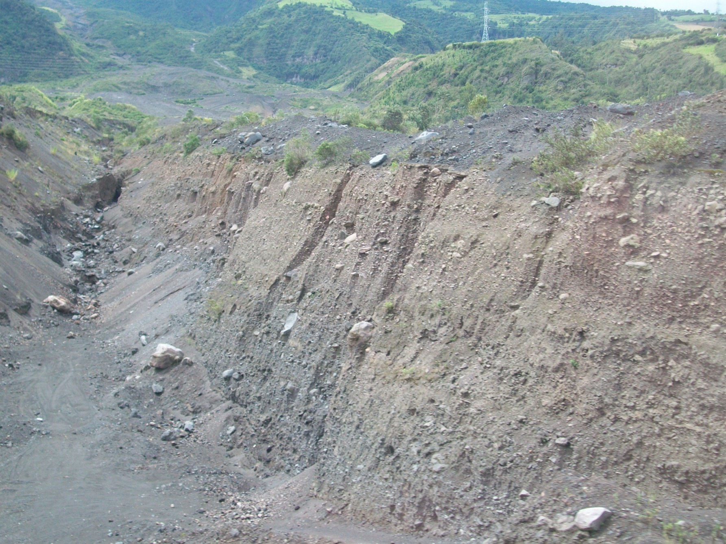
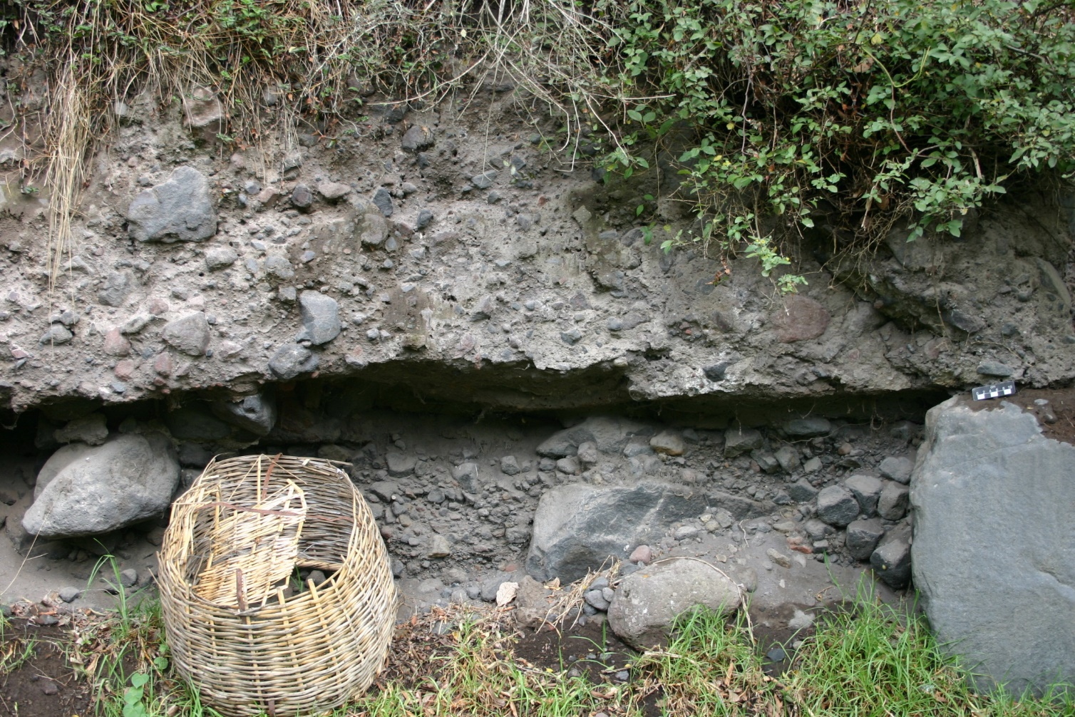
Holocene debris flow deposits Baños, Ecuador
Notes:
This rock type could be called a diamictite because it contains two contrasting size populations (coarse fraction in muddy matrix)

