Slide 1
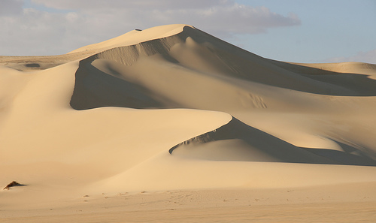
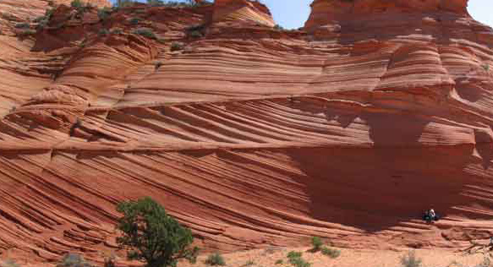
Aeolian Environments
Sahara Desert
Navajo Sandstone (Jurassic, Utah)

Slide 2
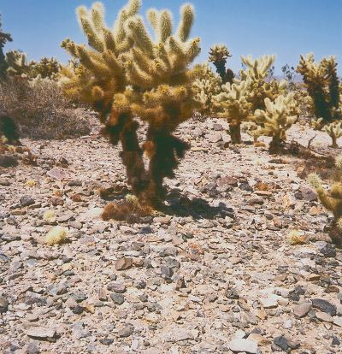
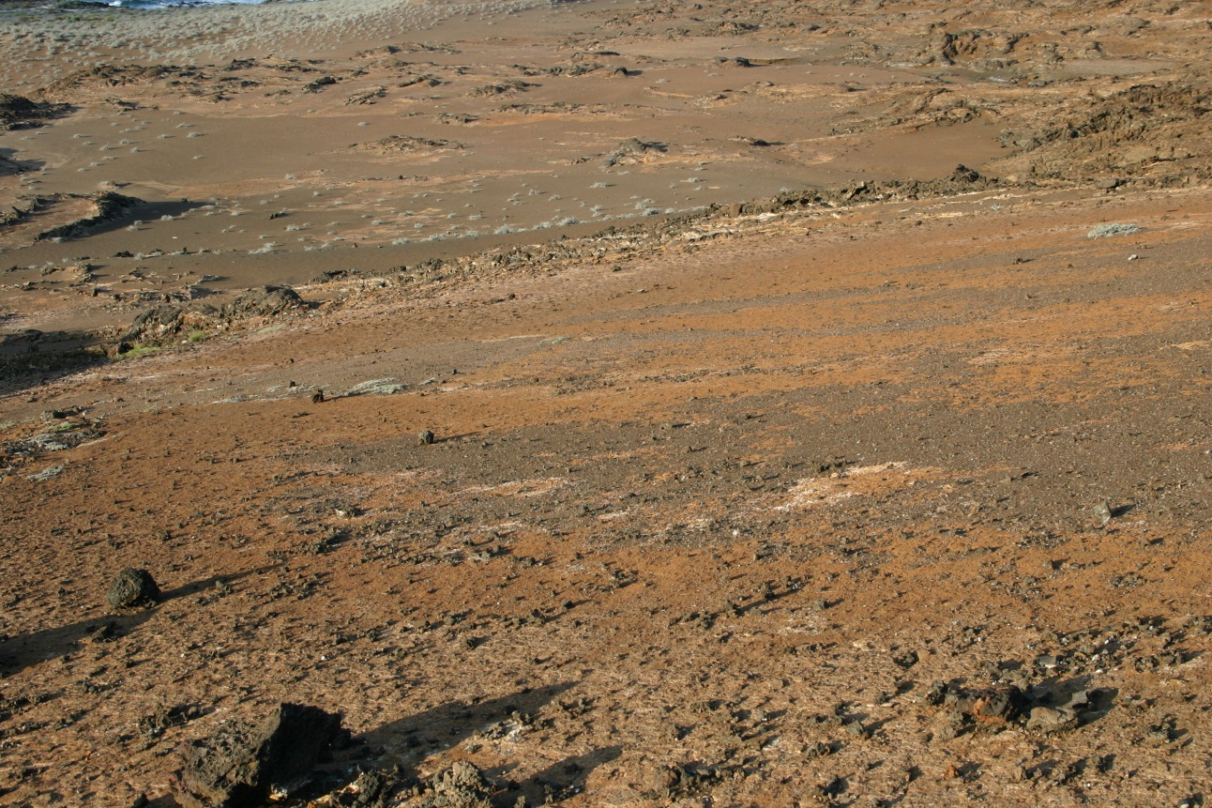
Most desert areas have rocky ground cover (desert pavement) formed by deflation (wind erosion) of finer sediment
Yet sand dunes are the dominant form of preserved sediment in aeolian settings
Deflation surface, Galapagos
Notes:
Desert pavement also called reg

Slide 3
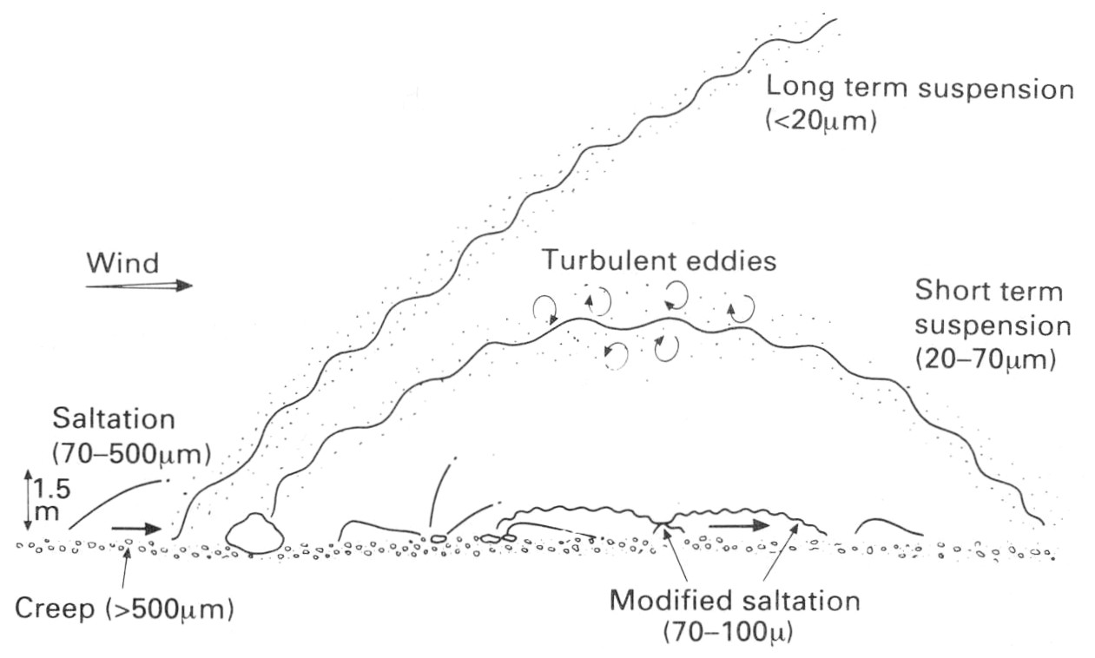
Aeolian sediment transport processes and bedforms are analogous in many ways to fluvial processes and bedforms
Sediment transported by creep (traction), saltation, suspension

Slide 4
Air is a fluid, but it is about 750 times less dense than water (and 50 times less viscous)
In water flow:
In air flow:
$${\text{u}}^{∗}=\text{0.}1\sqrt{\text{(}\frac{\text{r}\text{grain}\text{ – }\text{r}\text{fluid}}{\text{r}\text{fluid}}\text{)} \text{g} \text{D}}$$
$${\text{u}}^{∗}=\text{0.06}\sqrt{\text{(}\text{r}\text{grain}\text{ – }\text{r}\text{fluid}\text{)} \text{g} \text{D}}$$
(Shields’ criterion)
(Bagnold threshold)
Transport of a particle with diameter D in air requires fluid velocity ~30 times greater than in water

Slide 5
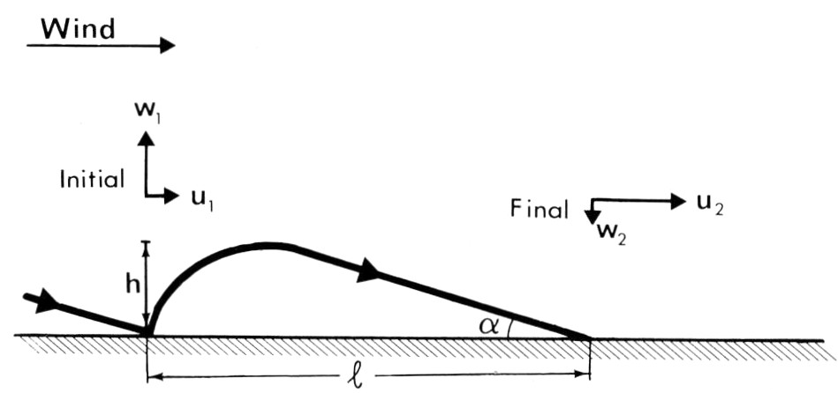
Saltating particles follow ballistic trajectory after ejection from bed
Impact force of colliding grain is much greater in air, compared to water
Grain collisions, not fluid drag, is principal mechanism for particle movement in aeolian transport

Slide 6
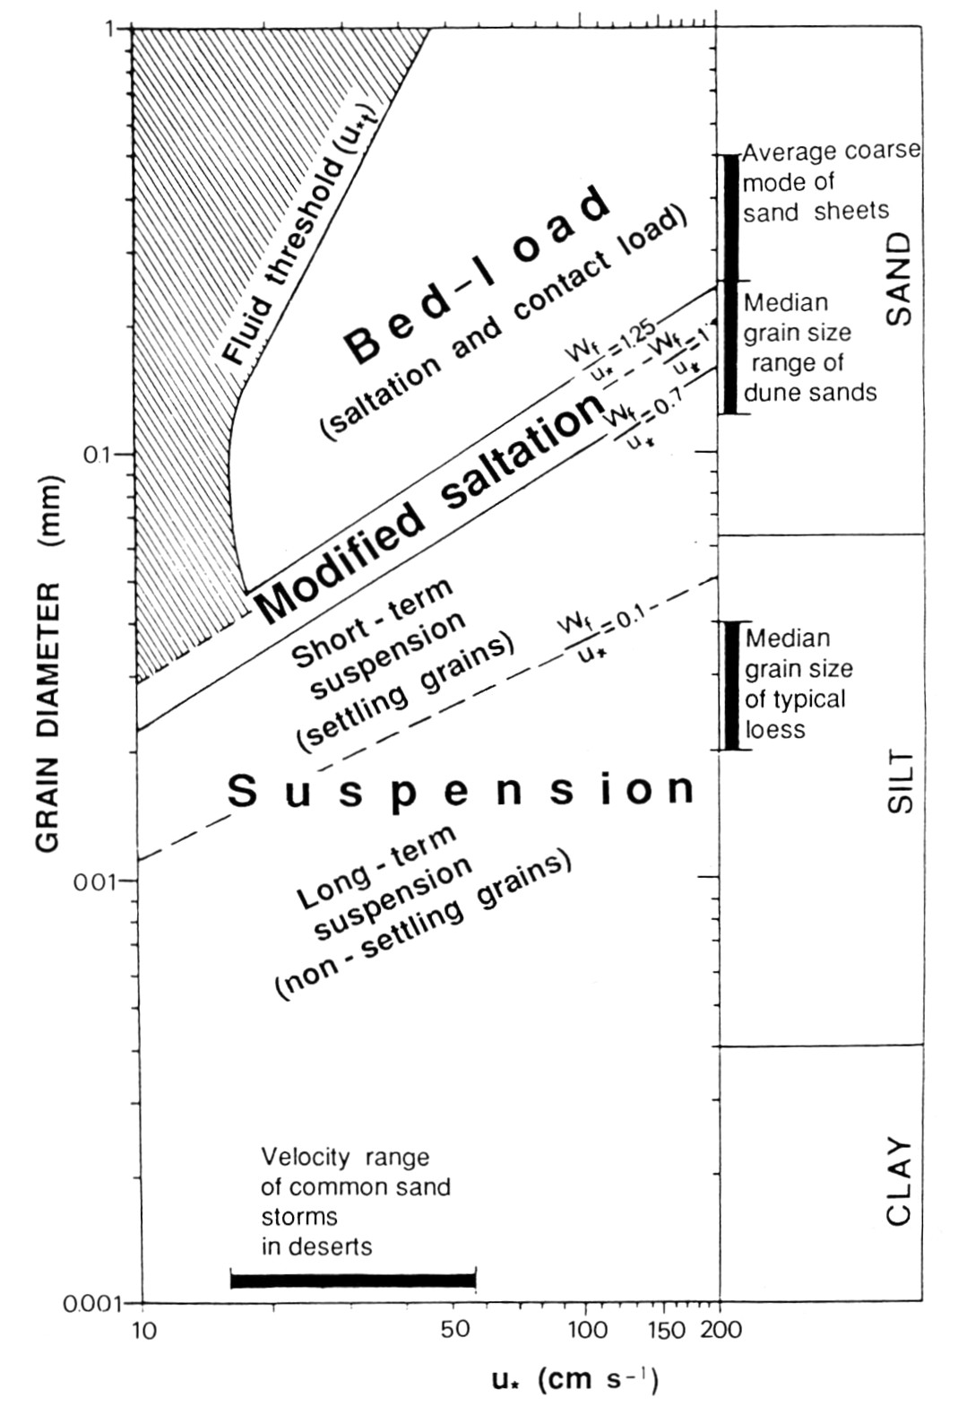
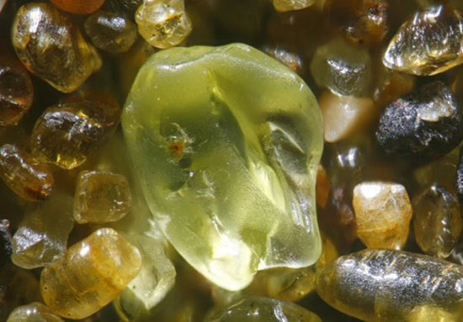
Because typical wind speeds are unable to move grains coarser than medium sand, aeolian deposits are well-sorted fine sand
Collisions lead to supermature quartz arenites, often with “frosted” surface textures

Slide 7
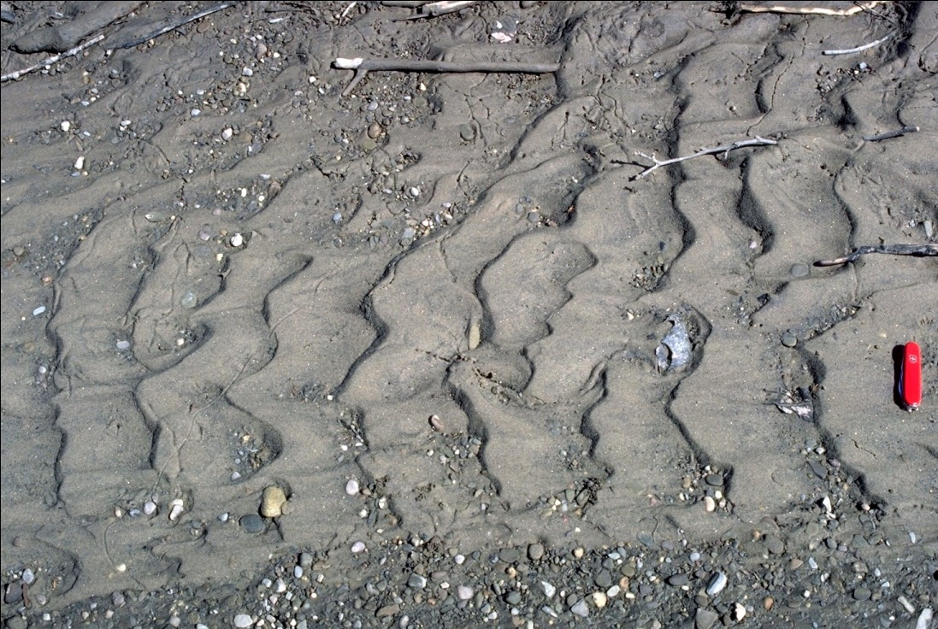
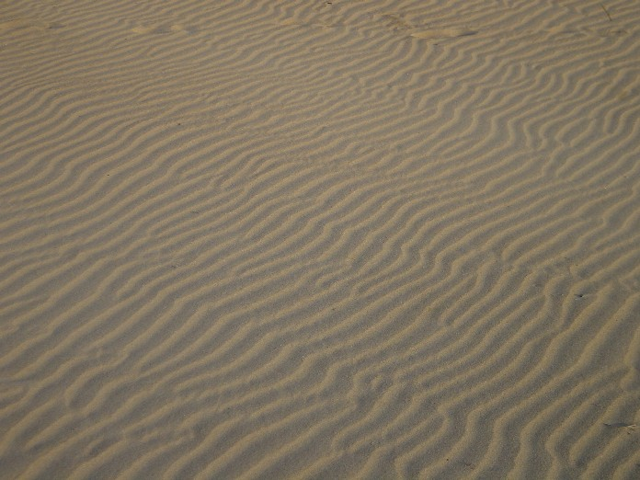
Wind ripples
Wind ripples superficially resemble subaqueous current ripples
Asymmetrical shape, small size (wavelength 0.02-2 m, height 1 mm-10cm)
Current ripples
Wind ripples
Notes:
Doesn’t scale with characteristic or mean jump length – function of probability distribution of trajectory population in which low-energy reptating grains outnumber high-energy saltating grains by a large margin. Thus wavelength is more than mean jump length (perhaps 6 times).
Why coarser grain size/poor sorting? When fine sand strikes a larger particle its rebound energy is higher and jump length longer.
No phase diagram exists, but continuing greater wind speed can smooth ripples analogous to upper flow regime plane bed

Slide 8
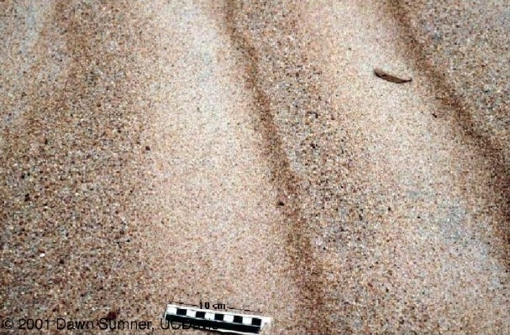
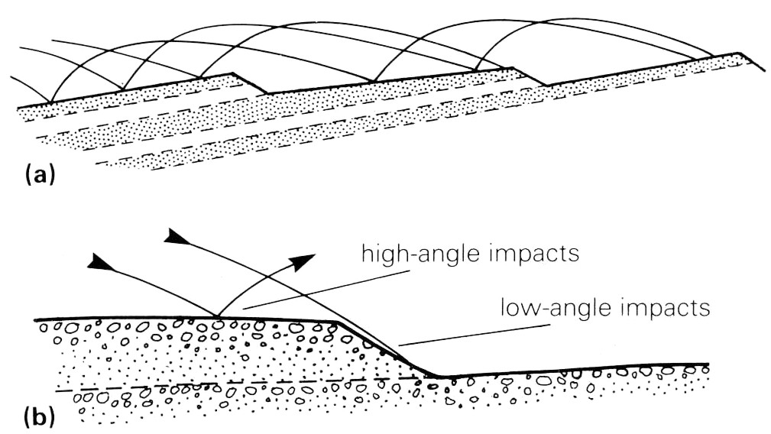
But unlike subaqueous ripples (which migrate by lee-side avalanches of traction deposits), wind ripples migrate by saltation bombardment
Finer sand ejected from crest but preserved in troughs where impact energy is lower, leading to inverse grading (fine at base, coarse at top)
Notes:
What direction is airflow? From right to left.

Slide 9
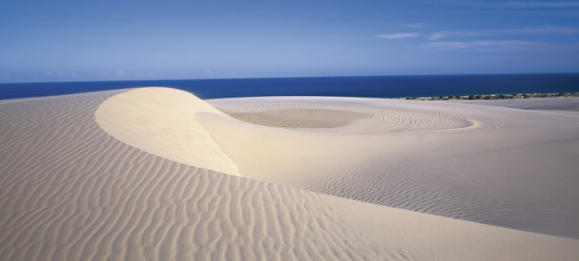
Wind ripples superimposed on larger dunes, with various morphologies depending on the angle of wind direction
Deposition by grainfall (saltation) and grainflow (slope failure when angle>critical)

Slide 10
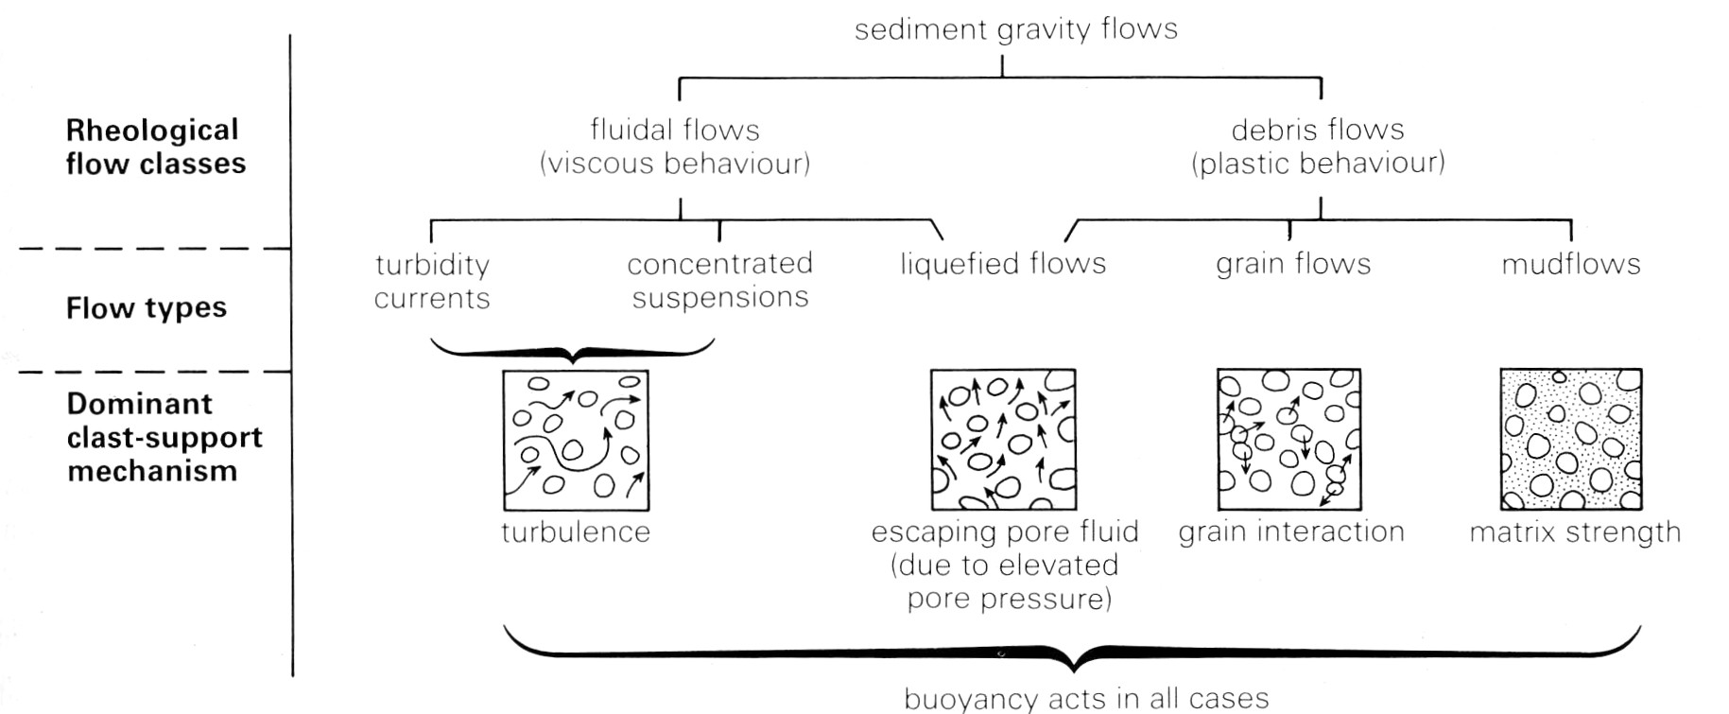
Flowing sand after a lee slope failure is transported as a grain flow, a type of sediment gravity flow with plastic rheology and sediment support by grain interaction (“dispersive pressure”)

Slide 11
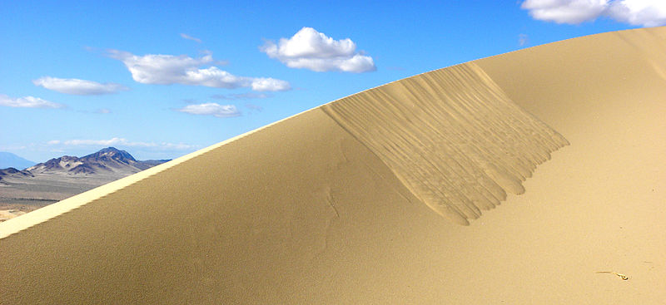
Sediments are cohesionless but have frictional yield strength that must be overcome, so grain flows only occur on steep slopes (>30°)
Rapidly deposited when slope decreases and shear stress unable to maintain dispersive pressure, so form lobe-shaped deposits

Slide 12
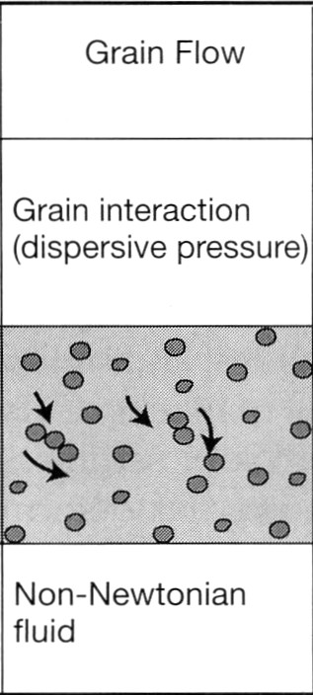
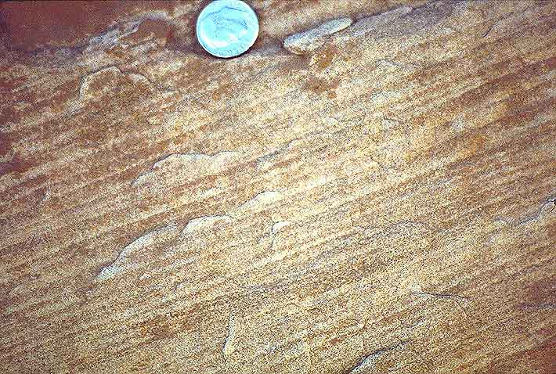
Sediment support mechanism: collisions between particles (dispersive pressure), which provide volumetric dilation by forcing grains apart
Grain flow deposits have inverse grading, due either to vertical gradients in dispersive pressure or (more likely) to kinetic sieving of smaller particles through spaces between grains
Laminar motion
Inversely graded mm-scale grain flow stratification
Notes:
But no dilatant rheology at low shear stresses at least

Slide 13
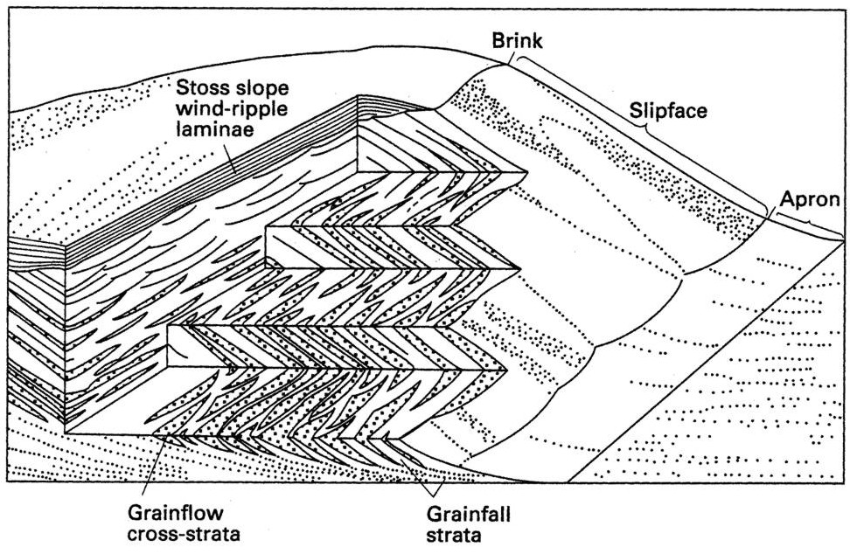
Grainfall strata: indistinctly laminated, well-sorted sand, thin toward base of dune
Grainflow strata: thin (<1 cm) inversely graded sand, thicken downslope

