Slide 1
CGHub library
Where are the patrons?
Jim warner
UC Santa Cruz

Slide 2
CGHub on the UC San Diego campus uses CENIC to distribute traffic
There is a strong commercial component to genomic analysis compared with, say, the Large Hadron Collider. Distribution might be qualitatively different.

Slide 3
CENIC has …
Member connections
Direct peering relationships
Internet2
NLR
Pacific Wave
Commercial Internet services

Slide 4
What we did . . .
A month’s data saw 2.2 Petabytes of requests from ~500 different IPv4 addresses
Looked those up to find the ASN.
Ran traceroute on each of those to find the CENIC exit.
Summed the bytes for each exit
I hate pie charts, but . . .
Notes:
Downloads are client driven, pulling file chunks from an array of parallel servers. Logs of data transferred, if they existed, would be spread across multiple servers. Instead we attribute traffic equal to the size of the requested object to the destination address at the time the transfer is set up. If most transfers succeed on the first attempt, this will be the same as measuring completed transfers.

Slide 5
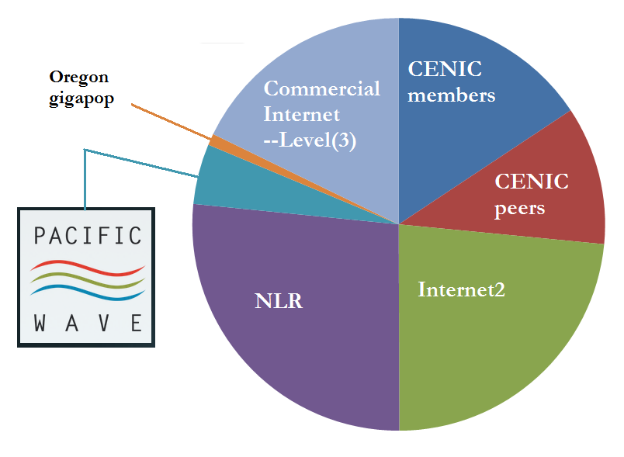
Notes:
PNW Gigapop is less than 1 percent, so not shown. From CENIC’s perspective, Internet2 has separate connections for the I2 network and the Commercial Peering Service. I could have made those separate slices.

Slide 6
CENIC members
SDSC
UCSD
UCSF
UCSC
USC
Stanford
Berkeley

Slide 7
CENIC Peers. . .
Google
Amazon
Customers of Hurricane Electric
Customers of Abovenet
Customers of XO

Slide 8
Commercial Internet
No permission to disclose this information. If they were retail establishments:
Bloomingdale’s
Nordstrom
Neiman Marcus
Kohl’s
Macy’s
Saks Fifth Avenue
Sears
Notes:
The actual biotech companies list is firms with large enough networks to have their own ASN. They advertise in the commercial breaks on the CBS Evening News and 60 minutes.

Slide 9
Internet2 and NLR
Lots of EDUs and some US Govt agencies | . . . But not Canada
Norway | Israel
Japan | Sweden
Germany | UK
Finland | Denmark
France | Korea
Spain | Greece
Australia | Croatia
India | Netherlands

