Slide 1
Posters
How to make them. How to present them.

Slide 2


Slide 3
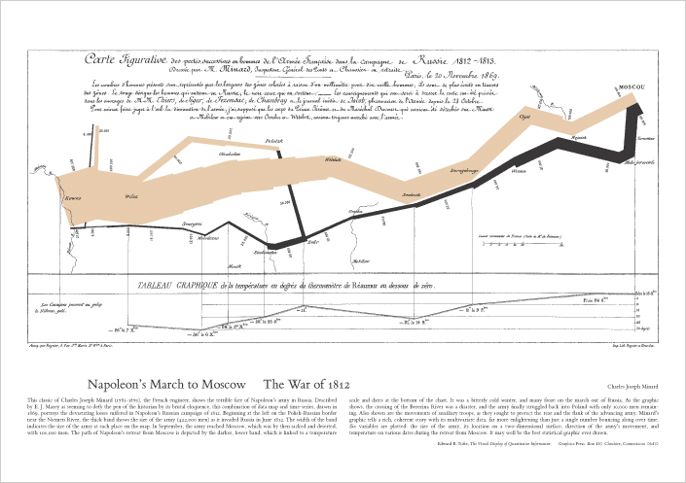

Slide 4
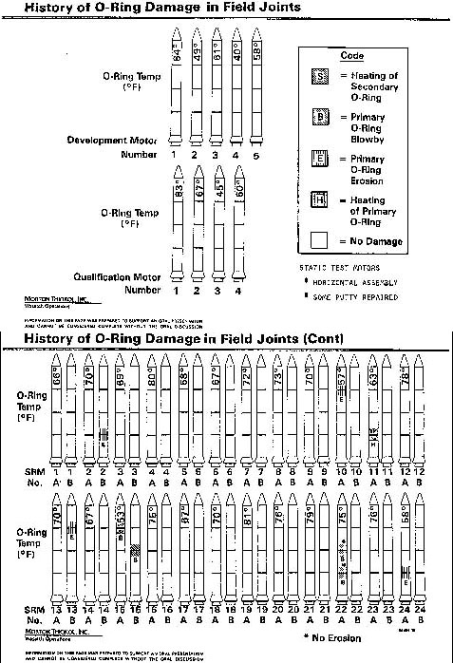

Slide 5
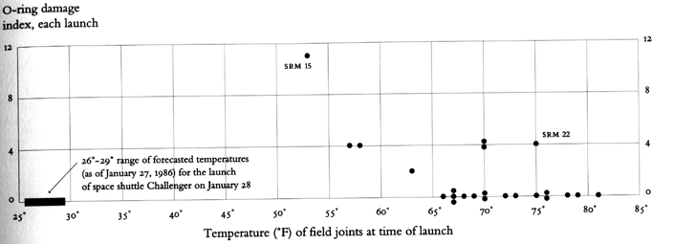

Slide 6
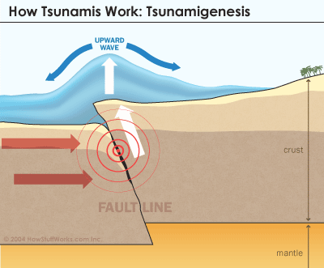

Slide 7
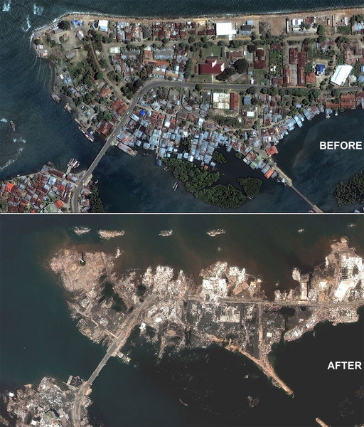

Slide 8
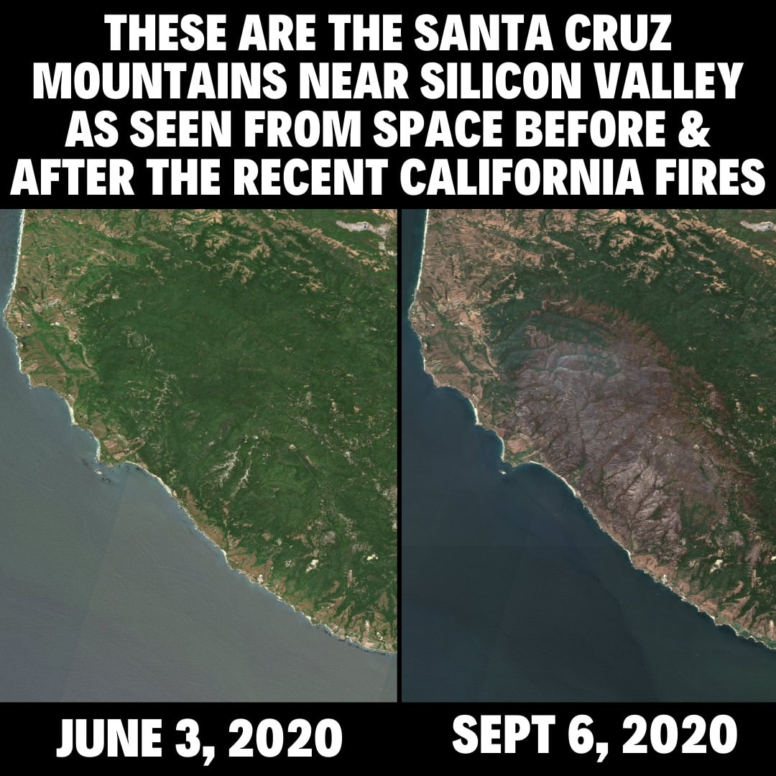

Slide 9
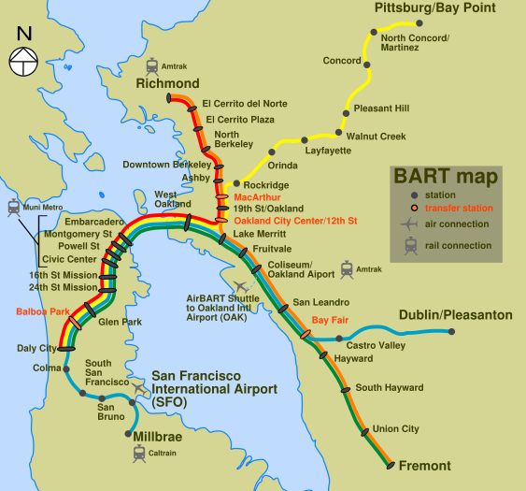
To Present Data

Slide 10
When Words are Inefficient: Surgeon’s End Loop Knot - Text
Form a loop at the end of the line.
With the loop, tie an overhand knot.
Pass the loop through a second time.
Adjust the loop size.
Lubricate and pull the knot tight.
Trim the end.

Slide 11

When Words are Inefficient: Surgeon’s End Loop Knot - Illustrated

Slide 12
The Problem With Big Blocks of Text
Frequently, the readers of long blocks of text, rather than analyze the entire text box carefully, have a tendency to simply read the first little bit. Sometimes, this syndrome can be alleviated by turning longer blocks of text into shorter lists of individual points. Even simple things like white space between list items can help draw attention to each underlying idea.

Slide 13
The Advantage of Lists
Often, viewers of long blocks of text just read the first bit.
Putting the key points in a list can help.
The empty spaces between the bullet points make the list look even simpler.

Slide 14
First questions to ask yourself:
What's your content?
Create a topic statement – one sentence to describe your point.
What are you trying to achieve?
Who will be attending?

Slide 15
Goal:
Attract visitors.
Use the poster as a visual aid to illustrate your points.
Use the poster to generate conversation between you and your visitors.

Slide 16
Props
Does your subject matter allow for a practical demonstration?
Physical hardware – or a mockup/prototype
Your software on a laptop
Video of your project
These are less portable, sometimes conflict with space restraints
Plan your presentation without the props

Slide 17
Planning your Poster
Make your poster Readable.
Do the ideas flow from one item to the next?
Does the text have grammar/spelling problems?
Avoid:
Complex sentence structures
Passive voice
Unnecessary adjectives
Long paragraphs

Slide 18
Make your poster legible.
Use larger fonts
Major points should be readable from 6-10 feet away
Even minor points should be obvious at a glance

Slide 19
Make your poster organized.
Information should flow logically
Make the starting point clear
Make the visual path obvious

Slide 20
Keep your message succinct.
Keep your language short and to the point.
Use the space but don’t cramp
20% text, 40% graphics, 40% white space
Be concise and selective. Key points are important, not details
Edit ruthlessly

Slide 21
Image Resolution
Make sure your graphics will be clear when printed out.
When choosing images, consider:
The source of the image.
The purpose of the image.
The output of the printing/display device.
Beware of Low-resolution graphics
Low quality images become pixelated at poster sizes.
Try a Google image search, setting Tools > Size > Large

Slide 22
Citations and Acknowledgements
Citation sections are important, but should not take up a large amount of space
Text should be readable from close-up, but not larger
Images can be cited in a caption or in a separate citation section, but both is too much
Acknowledgements are for
Other people involved in a project
Advisors
Sources of funding
Anyone who assisted with your work but isn’t a co-author
(Not all posters need an Acknowledgements section.)

Slide 23
Starting your poster:
Determine your main message.
Lay out your elements crudely.
Eliminate extraneous material.
Consider looking online for templates.
http://colinpurrington.com/tips/poster-design

Slide 24
Presenting your poster
Style, format, color, readability, attractiveness, and showmanship all count
Message should be clear: 3-5 minutes
You are on display with your poster

Slide 25
Things to Do:
Wear a name tag.
Greet viewers and offer to answer questions.
Stand to the side of your poster, give viewers space.
Speak to the viewers, not the poster.
Walk viewers through the figures.
Leave a note if you must leave during your session.
Thank viewers for visiting.

Slide 26
Recommended reading
Useful resources for poster design:
https://guides.nyu.edu/posters/poster-basics
http://guides.library.cornell.edu/poster
http://www.swarthmore.edu/NatSci/cpurrin1/posteradvice.htm
Poster templates:
https://www.posterpresentations.com/free-poster-templates.html
https://www.posternerd.com/SciPosters_Templates.aspx
Note: if you use a template, mention the source of that template either in your citations or acknowledgements.

Slide 27
How to Print it:
Poster Guidelines for On-Campus printing: http://bels.soe.ucsc.edu/PosterGuidelines
Most critical: 48”x36” dimensions, do not use a dark background
See next slide for costs
Submit PowerPoint or PDF file to web form at: http://bels.soe.ucsc.edu/posters
Name your poster with last name, subject, and revision number if you have had this poster printed before. Example: Vitale-100TbNetworking-R3.ppt
5-day minimum lead-time for lowest-cost printing.
Alternate options include FedEx, OfficeMax, and Staples, but you should call ahead to find out turnaround times and costs. They may be able to print black and white posters for lower prices.

Slide 28




Baskin Engineering Logo requirement:
All posters must include the Baskin Engineering Logo:
https://communications.soe.ucsc.edu/baskin-engineering-brand

Slide 29
Fall 23 Costs – Printing at BELS
11/28 Presentations
Submitted by 11/17 – Free
11/18-11/21 - $13 rush fee
11/22-11/26 - $27 rush fee
11/27 or later: $69 rush fee (if they even have time to print it!)
11/30 Presentations
Submitted by 11/21 – Free
11/22-11/27 - $13 rush fee
11/28 - $27 rush fee
11/29 or later - $69 rush fee (if they even have time to print it!)
NOTE: Form will list $41 base charge, but this is waived if you select “CSE 185” under “Purpose”

