Slide 1
Grant Proposal Project

Slide 2
Assignment Option 1: Student Project Fund Grant (Option 2 starts on Slide 16)
Your college (Cowell, Porter, Rachel Carson, etc.) may offer students funds for student projects.
This is real. If your college does offer money, there may still be time to apply for it.
Are you starting your senior design project later? Congratulations, you might be able to fund it through money available from your college.
Have you already finished your senior design project? Congratulations, you probably have a good idea of what your needs will be.
For the purposes of this assignment, assume you are working on a senior design project to complete your Engineering major.
You’d rather someone else pay for parts and equipment, if possible.
Make a case for your project. Why is it worth funding?

Slide 3
Assignment Requirements
Look up available “Student Project Funds” offers for your College.
Examples:
Cowell: http://cowell.ucsc.edu/academics/cowell-project.html
(If the guidelines page is still broken, check out: https://people.ucsc.edu/~gmoulds/CMPE185/spf-guidelines-17-18.pdf)
Stevenson: http://stevenson.ucsc.edu/academics/scholarships/
Crown: https://crown.ucsc.edu/academics/fellowships-grants/index.html
Because of the requirements for this assignment, your grant proposal may be longer than the requested page length from your college.
Formatting
Your grant proposal should appear professional
Example Grant Proposal (you don’t have to adhere to this exact format, but you can use it as a guideline): https://web.archive.org/web/20181119182117/https://www.lac.org/wp-content/uploads/2014/07/Grant_Proposal_Template.pdf
Adhere to the section requirements for this assignment, not to the sections listed in this particular template

Slide 4
More student project funding
Oakes https://oakes.ucsc.edu/academics/studentscholarship/guidelines-for-individual-student-projects-fund.pdf
Merrill https://merrill.ucsc.edu/academics/student_opportunities/project-funds/index.html
Porter https://porter.ucsc.edu/academics/pdfs/pcuf%20application.html
College 9 https://collegenine.ucsc.edu/academics/student-project-funds/index.html
College 10 https://collegeten.ucsc.edu/academics/student-project-funds/index.html
Rachel Carson https://rachelcarson.ucsc.edu/images%202018/student-project-fund-application.pdf
Kresge: https://kresge.ucsc.edu/academics/individual-project_fund.doc

Slide 5
Do you not have a Senior Design Project?
If you’re planning to complete a Senior Design Project, but don’t yet know what it will be about,
Or you are planning on another capstone project, like a senior thesis,
You can also invent a plausible design project.
If none of these are viable, consider “Assignment Option 2: Travel Grant Funding”

Slide 6
Required Content
Average length tends to be 6-8 pages, including the following:
Cover page
Title
Project Summary
Methods
Expected Results
Timeline
Itemized Budget and Justification
Relevant Experience
References

Slide 7
Cover page
Grant proposals almost always include a front page that provides basic information about the project.
Project title
Name of applicant(s)
Funding amounts
For example, see page 3 of
https://cowell.ucsc.edu/academics/spf-guidelines-22-23-eform.pdf
If your college does not explicitly require a cover page, follow the Cowell guideline above.

Slide 8
Methods
Be thorough in describing your methods.
Insufficiently described Methods sections are a good indicator of a poorly thought-out project.
This is the part where you explain the actual work you plan to do, and if you’re unclear on this point your request for funding won’t be taken seriously.
Things to include in a methods section:
Use of specific budget items.
Diagrams/models/schematics of your project.
Explicit steps you plan to carry out.

Slide 9
Expected results
What results do you expect to achieve that will prove (or not) the success of your project?
Example: If you were designing an autonomous robotic hand
Would it be enough to create independently moving fingers?
Or would it need to be able to perform a specific type of task, like picking up differently shaped objects?

Slide 10
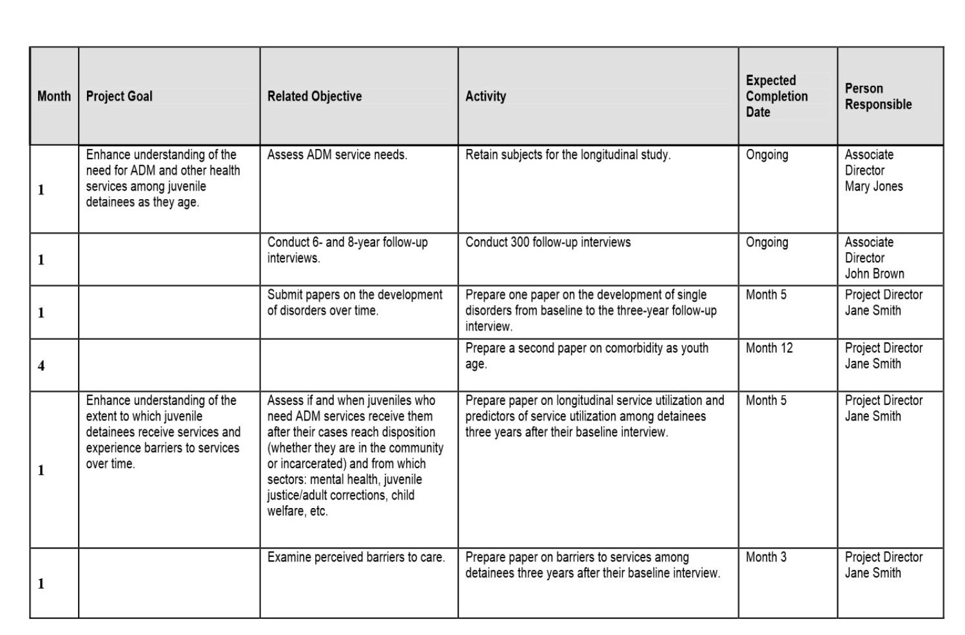
Timeline example

Slide 11
Special consideration: Your budget
Your involvement is unpaid.
Any equipment purchased with the grant money but not part of the deliverables theoretically become property of UCSC.
Material costs are appropriate, but your requests should be reasonable.
Specify these costs in your itemized budget.
In table format, list the cost and source of each item in your budget. Include the exact item, quantity, vendor, price per unit, and any sales tax.

Slide 12
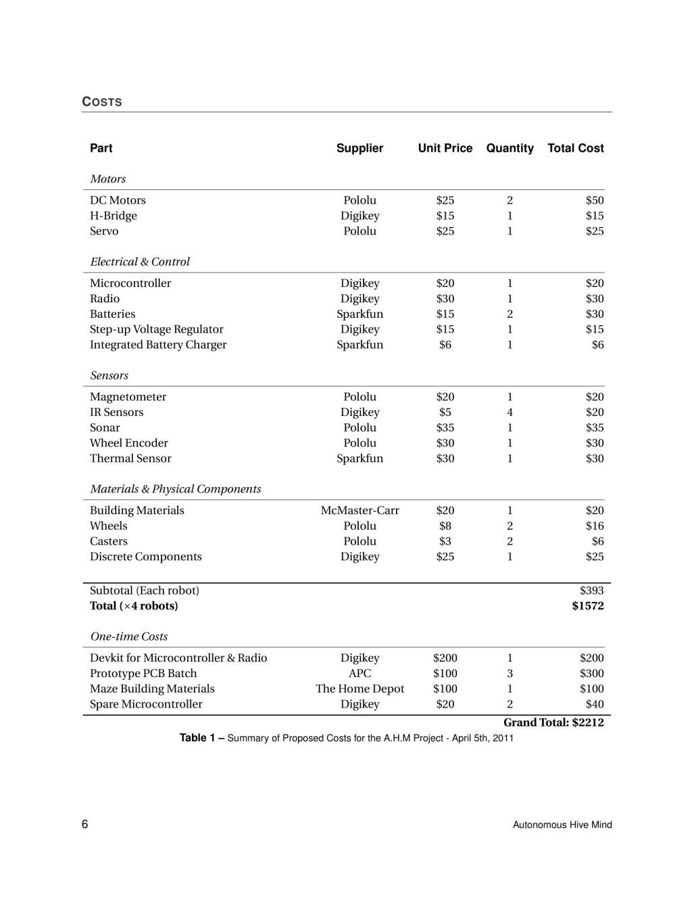
Budget example
Notes:
INCLUDE: Suppliers and quantities. Clearly present Grand Total

Slide 13
Budget Justification
Justify each major budget item.
What counts as a major budget item?
If your project requires buying a dozen 29-cent LEDs, you likely don’t need to explain the choice.
If your project requires that you buy a 4000 watt generator, you should explain why you need a generator of this size.
Simply put, any part of your budget that might appear overpriced or unnecessary requires explanation.

Slide 14
Relevant Experience
Briefly explain your qualifications to carry out this project.
Programming experience, lab experience, etc.
Relevant job experience.
Your major, relevant course projects and general coursework.

Slide 15
References
Is your project based on someone else’s work or research?
Cite their contribution.

Slide 16
Assignment Option 2: Conference Travel Grant
The UCSC Undergraduate Conference Travel Grant Program
To encourage undergraduate Computer Science and Engineering majors to travel to important conferences, the UCTGP is offering travel grants that can potentially pay for airfare, lodging, registration fees, and even meals.
Expenses within the continental United States and Canada may be covered up to $1500.
For conferences overseas, expenses can go up to $3000.
(Note: This is not a real fund. There is a grant program for BSOE undergraduate travel, but it only covers $250.)
You may find an existing, planned conference or ask for a grant for a conference that has already happened. (Do refer to it in the future tense, however.)
You will also have to write a letter of Recommendation for yourself that a “Faculty Advisor” would be willing to add their name to. (More later)

Slide 17
Possible sources for Conferences:
Association for Computing Machinery (ACM):
https://www.acm.org/upcoming-conferences
Institution of Electrical and Electronics Engineers (IEEE):
https://www.ieee-ras.org/conferences-workshops/upcoming-conferences
Long list of Computer Science Conferences
https://en.wikipedia.org/wiki/List_of_computer_science_conferences

Slide 18
Travel Grant Fund:
Complete the grant application form and submit a printout of the forms
Travel Grant Application.docx
or
https://docs.google.com/document/d/1lHf_XgbDtFwzYB-X5GmpHmcVQ1c9QBwbUfSQGaMAxkc/edit?usp=sharing
Complete each section
Adhere to the application format
You must fit your text into the required format
Do not remove prompts or change section headings
Individual sections may be longer or shorter than the blank blocks in the document.

Slide 19
Requirement: Letter of Recommendation
This travel grant requires a letter of recommendation from a Faculty Advisor. (Important: This is fictional. Do not bother any actual Faculty)
For the purposes of this assignment, you have a Faculty Advisor willing to write you a letter of recommendation.
But, this Faculty Advisor is tremendously busy this quarter and would like you to write the letter. (Get used to this.)
The Faculty Advisor will read the letter before signing it, and might refuse if the contents are implausible.

Slide 20
On writing a letter of recommendation for yourself:
First, this is not the place for modesty.
We often think that bragging about ourselves is unseemly.
But when we recommend others, most people err on the over-positive side. So if you’re writing from another person’s perspective, be enthusiastic about it.
However, if your praise is unsubstantiated or unprovable, the recommender may not sign off on the letter.
So, search for positive, concrete details about yourself that your recommender could potentially fact-check.
Key details:
Coursework/projects with this recommender, or projects public enough that others in the department would know of them.
Relevant professional experiences.
Membership/leadership in a relevant organization or club.
Some less-tangible personal praise is a good idea: “Chris was delightful to work with, and we had many fascinating conversations during office hours” is fine, but don’t overdo it and don’t invent anything that didn’t actually happen.

