Slide 1
185 Final Project
(Also covers Project Proposal and Document Specification)

Slide 2
Project Proposal
A one-page document describing:
What is your paper going to be about?
What is its purpose?
Who is its intended audience?
(Note: you may change your paper topic after submitting a Project Proposal, but you must submit a new Project Proposal.)

Slide 3
Document Specification
1. Introduction
State the topic of your Final Project
State the purpose and intended audience of your final project.
Does not need to be the full introduction of your Final Project.
But this can help focus your research.

Slide 4
Document Specification
2. Technical Discussion Outline
Should address major points
Organize your points of interest
3. Proposed Research
List research sources
Exact sources, when possible
Otherwise, general sources you plan to investigate
4. Indicate your chosen style guide.
(Document Specification length: typically 2-3 pages, much of this in outline form)

Slide 5
Document Specification
Purpose:
Economy of effort
Input from instructors and peers can focus your efforts before you do unnecessary work
Work planning
Helps in establishing a clear writing schedule
You’ll know what you need to research before it’s too late to research it
Improved Organization

Slide 6
Final Project: What sort of article is this?
Thesis chapter?
If so, present it with enough information to be an independent paper.
Journal article for publication?
Consider which journal
Tailor style to journal
Project report?
Who are you reporting to?
Are you recording information or drawing specific conclusions?
Other sort of writing project?
Tell us what you’d like to do in your proposal
If you’re not sure what’s acceptable, speak with your TA

Slide 7
Past Final Projects:
Single Cycle CPU Simulator.
The Complete Guide to the Polymerase Chain Reaction.
Graphic User Interface Design for Beginners.
Collision Detection for Gaming Applications.
Networked Application Frameworks.
Reconfigurable Reverse Telemetry System for Retinal Prosthesis.

Slide 8
Final Project – requirements
Length: 15-20 pages, double spaced
This assumes a reasonable number of figures in a standard MLA style (12pt fonts, 1-inch margins, etc.)
If you’re using many figures, or particularly large figures, increase your length appropriately.
If you’re using a vastly different style guide, like the single-spaced, dual-column IEEE style used in the LaTeX Tutorial, you can cut your length accordingly.
But please don’t play games with margins and spacing to hide a lack of content. We will still notice.

Slide 9
Key elements:
(Note: the need for “situational” sections depend on the nature of your project.)
Abstract (situational)
Introduction
Materials and Methods (situational)
Results (situational)
Discussion
Conclusion

Slide 10
Other elements
Visual aids (recommended)
Appendices (situational)
Supportive, but nonessential information.
Citations (required)

Slide 11
In short…
Front Matter
Introduction (always)
Abstract (if a Journal-style Article)
Materials and Methods (if a research project)
Middle Part
Discussion (always)
Results (if necessary)
Visual Aids (if necessary)
The End
Conclusion (always)
Works Cited (always)

Slide 12
Foregrounding – major findings
Can be present in your:
Title
(Hint: “CSE 185 Final Project” is not a useful title.)
Abstract (if you have one)
Purpose statement (in introduction, typically)
Key visual aids with meaningful captions
Informative section headings

Slide 13
Abstract
Used as screening device
Is this the article the reader is looking for?
Used as stand-alone text
Provides simple, high level information
Reader may or may not return later
Provides preview of article
Facilitates indexing
Advises librarians, record-keepers
Should have keywords for automated retrieval

Slide 14
Introduction
Identifies audience
Provides background
Explains problem/thesis
Sets style or tone

Slide 15
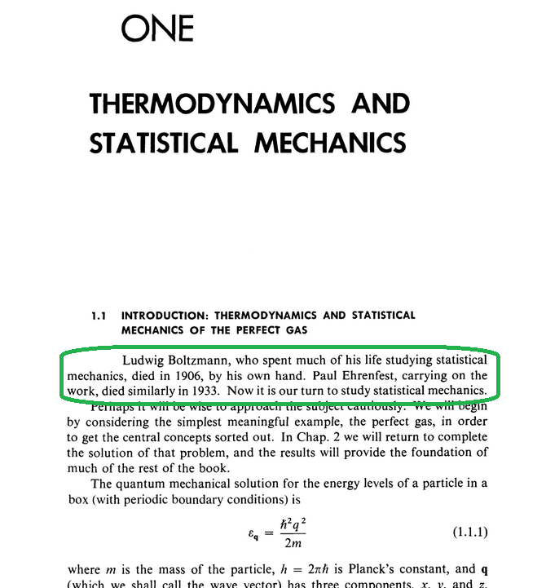
A dubious but memorable example:
States of Matter (1975), by David L. Goodstein

Slide 16
Discussion
Typically, the bulk of the writing.
What are the implications of your subject?
Do they confirm or refute others’ observations?
What are the contributions to your field?
New hypotheses?
Proposed future research?
Practical applications?

Slide 17
Conclusion
Can mirror introduction, but key differences:
Can assume a higher level of understanding.
Not the place for background information.
Can build on the data/results already presented.
Can ask parting questions or suggest further research.

Slide 18
Any questions?

